Slide 1
Evolutionary Computing
Dr. T presents…
COMP 5660/6660

Slide 2
Mutation
Bit-String Representation:
  Bit-Flip
  E[#flips] = L * p_{m}
Integer Representation:
  Random Reset (cardinal attributes)
  Creep Mutation (ordinal attributes)

Slide 3
Mutation cont.
Floating-Point
  Uniform
  Nonuniform from fixed distribution
    Gaussian, Cauche, Levy, etc.

Slide 4
Permutation Mutation
Swap Mutation
Insert Mutation
Scramble Mutation
Inversion Mutation (good for adjacency based problems)

Slide 5
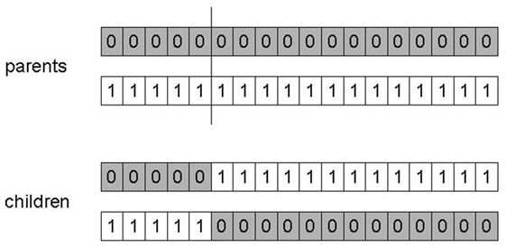
Binary Representation:
1-point crossover
Choose a random point on the two parents
Split parents at this crossover point
Create children by exchanging tails
P_{c} typically in range (0.6, 0.9)
Notes:
More likely to keep together genes that are near each other
Can never keep together genes from opposite ends of string
This is known as Positional Bias
Can be exploited if we know about the structure of our problem, but this is not usually the case

Slide 6
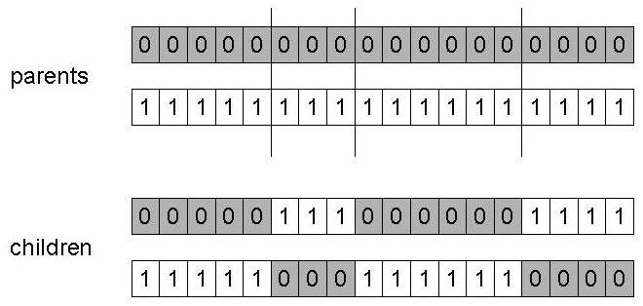
Binary Representation: n-point crossover
Choose n random crossover points
Split along those points
Glue parts, alternating between parents
positional bias
Notes:
Generalisation of 1-point, but still some positional bias

Slide 7
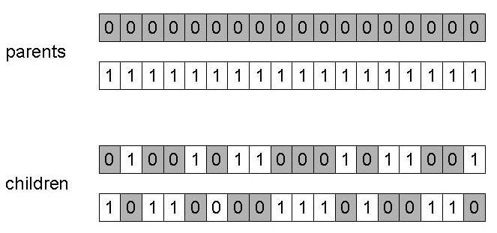
Binary Representation:
Uniform crossover
Assign 'heads' to a parent, 'tails' to other
Flip a coin for each gene of the first child
Make inverse copy for the second child
Inheritance is independent of position
distributional bias
Notes:
Distribution bias: high chance of inheriting near 50% of genes from each parent, small chance of inheriting most genes from one parent
Can used weight coin to favor one parent over the other (e.g., fitness based, diversity based, etc.)

Slide 8
Real-Valued Representation:
Crossover operators
Discrete:
  each allele value in offspring z comes from one of its parents (x,y) with equal probability: z_{i} = x_{i} or y_{i}
  Could use n-point or uniform
Intermediate
  exploits idea of creating children “between” parents (hence a.k.a. arithmetic recombination)
  z_{i} = α x_{i} + (1 - α) y_{i} where α : 0 ≤ α ≤ 1.
  The parameter α can be:
    constant: uniform arithmetical crossover
    variable (e.g., dependent on fitness)
    picked at random every time

Slide 9
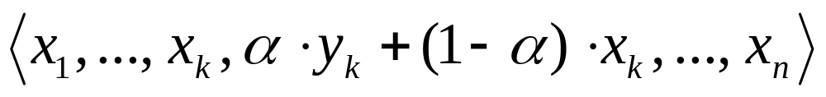
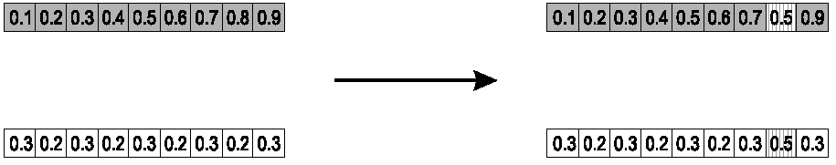
Real-Valued Representation:
Single arithmetic crossover
Parents: ⟨x₁,…,x_{n} ⟩ and ⟨y₁,…,y_{n}⟩
Pick a single gene (k) at random
child₁ is:
Reverse for other child

Slide 10
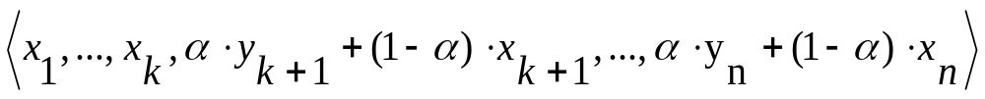
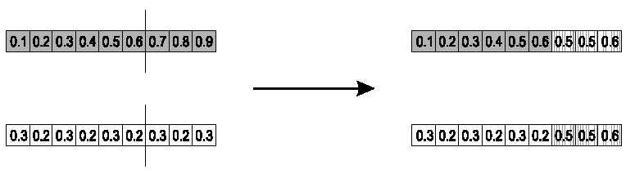
Real-Valued Representation:
Simple arithmetic crossover
Parents: ⟨x₁,…,x_{n} ⟩ and ⟨y₁,…,y_{n}⟩
Pick a random gene (k) after this point mix values
child₁ is:
reverse for other child

Slide 11
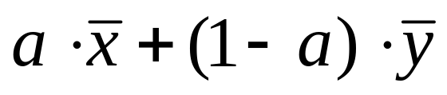
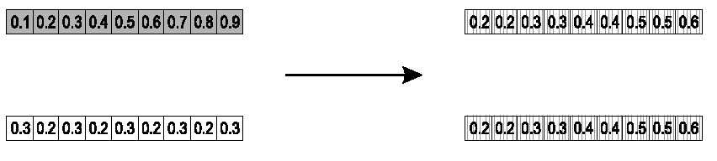
Real-Valued Representation:
Whole arithmetic crossover
Most commonly used
Parents: ⟨x₁,…,x_{n} ⟩ and ⟨y₁,…,y_{n}⟩
Child₁ is:
reverse for other child

Slide 12
Real-Valued Representation:
Blend Crossover
Parents: ⟨x₁,…,x_{n} ⟩ and ⟨y₁,…,y_{n}⟩
Assume x_{i} < y_{i}
d_{i} = y_{i} – x_{i}
Random sample z_{i}= [x_{i} – αd_{i}, y_{i} + α d_{i}]
Original authors had best results with α = 0.5

Slide 13
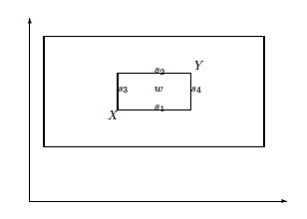
Real-Valued Representation:
Overview different possible offspring
Parents: X, Y
Single arithmetic: {s₁, s_{2,} s₃, s₄} w/ α = 0.5
Whole arithmetic: {w} w/ α = 0.5, inner box for varying α
Blend crossover:
outer box for
α = 1

Slide 14
Permutation Recombination
Order based problems
Order Crossover
Cycle Crossover
Adjacency based problems
Partially Mapped Crossover (PMX)
Edge Crossover

Slide 15
Order Crossover
Choose 2 random crossover points & copy mid-segment from p1 to offspring
Starting from 2nd crossover point in p2, copy unused numbers into offspring in the order they appear in p2, wrapping around at end of list

Slide 16
Cycle Crossover
Start with first unused position and allele of p1
Look at allele in the same position in p2
Go to position with same allele in p1
Add this allele to cycle
Repeat above steps until you arrive at first allele of p1
Construct offspring by alternating cycles

Slide 17
PMX
Choose 2 random crossover points & copy mid-segment from p1 to offspring
Look for elements in mid-segment of p2 that were not copied
For each of these (i), look in offspring to see what copied in its place (j)
Place i into position occupied by j in p2
If place occupied by j in p2 already filled in offspring by k, put i in position occupied by k in p2
Rest of offspring filled by copying p2

Slide 18
Edge Crossover
Step 1: Construct edge table
Step 2: Construct offspring

Slide 19
Initialization
Uniform random
Heuristic based
Knowledge based
Genotypes from previous runs
Seeding

Slide 20
Population Models
Two historical models
  Generational Model
  Steady State Model
    Generational Gap
General model
  Population size
  Mating pool size
  Offspring pool size
  Plus vs comma strategy

Slide 21
Parent selection
Random
Fitness Based
  Proportional Selection (FPS)
  Rank-Based Selection
Genotypic/phenotypic Based

Slide 22
FPS Issues & Solutions
  High risk of premature convergence
  Uneven selective pressure
  Fitness function not transposition invariant
  Windowing
    f’(x)=f(x)-β^{t} with β^{t}=min_{y in P}^{t}f(y)
    Dampen by averaging β^{t} over last k gens
  Goldberg’s Sigma Scaling
    f’(x)=max(f(x)-(f_{avg}-c*δ_{f}),0.0) with c=2 and δ_{f} is the standard deviation in the population

Slide 23
Simple Genetic Algorithm (SGA)
Representation: Bit-strings
Recombination: 1-Point Crossover
Mutation: Bit Flip
Parent Selection: Fitness Proportional
Survival Selection: Generational

Slide 24
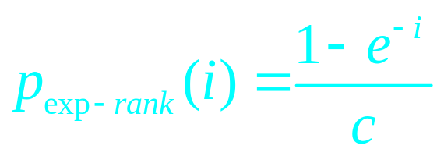
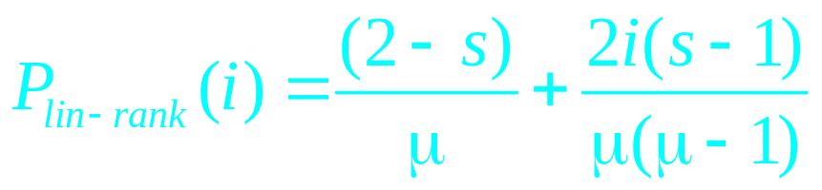
Rank-Based Selection
  Mapping function (ala SA cooling schedule)
  Exponential Ranking
  Linear ranking

Slide 25
Sampling methods
Roulette Wheel
Stochastic Universal Sampling (SUS)

Slide 26
Rank based sampling methods
Tournament Selection
  Tournament size
  With or without replacement

Slide 27
Survivor selection
Fitness-based
  Parent selection mechanisms
  Truncation
Elitism
Age-based

Slide 28
Termination
CPU time / wall time
Number of fitness evaluations
Lack of fitness improvement
Lack of genetic diversity
Solution quality / solution found
Combination of the above

Slide 29
Behavioral observables
Selective pressure
  Takeover time
Population diversity
  Fitness values
  Phenotypes
  Genotypes
  Alleles

Slide 30
EA dynamics (1)
EV:
Randomly generate initial population
Do Forever:
  Randomly select a parent
  Clone selected parent and mutate offspring
  Randomly select an adult and terminate the less fit of the selected adult and the offspring

Slide 31
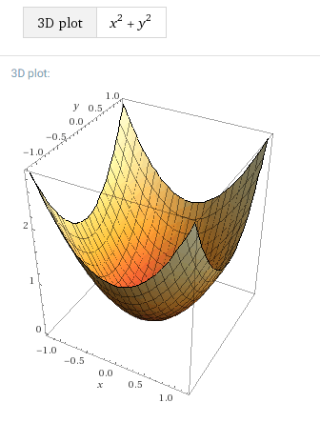
EA dynamics (2)
EV’s behavior on f(x,y)=x² + y²

Slide 32
EA dynamics (3)
Some potential options:
EV will randomly converge to a homogeneous fixed point on one of the peaks
EV’s population will split into four subpopulations, each converged on one of the peaks
EV will oscillate indefinitely among the peaks
Opposing pressures result in a dynamic equilibrium in the middle of the valley

Slide 33
Report writing tips
Use easily readable fonts, including in tables & graphs (11 pnt fonts are typically best, 10 pnt is the absolute smallest)
Number all figures and tables and refer to each and every one in the main text body (hint: use autonumbering)
Capitalize named articles (e.g., ``see Table 5'', not ``see table 5'')
Keep important figures and tables as close to the referring text as possible, while placing less important ones in an appendix
Always provide standard deviations (typically in between parentheses) when listing averages

Slide 34
Report writing tips
Use descriptive titles, captions on tables and figures so that they are self-explanatory
Always include axis labels in graphs
Write in a (semi-)formal style (never use first person singular, instead say, for instance, ``the author'‘)
Format tabular material in proper tables with grid lines
Avoid making explicit physical layout references like “in the below table” or “in the figure on the next page”; instead use logical layout references like “in Table” or “in the previous paragraph”
Provide all the required information, but avoid extraneous data (information is good, data is bad)

Slide 35
Constraint Handling
Ignore constraints
Kill invalid offspring
Assign arbitrarily low fitness
Feasible phenotype mapping decoder
Repair function
Feasible solution space closed under variation operators
Penalty function

Slide 36
Ignore constraints
Ignore the constraints under the motto: all is well that ends well

Slide 37
Kill invalid offspring

Slide 38
Feasible phenotype mapping decoder

Slide 39
Repair function

Slide 40
Feasible solution space closed under variation operators

Slide 41
Penalty function

Slide 42
Multi-Objective Optimization
Single vs multi-objective optimization
Scalarization
Fixed weighted sum drawbacks

Slide 43
Multi-Objective EAs (MOEAs)
First MOEA in 1984 by Schaffer: Vector-Evaluated Genetic Algorithm (VEGA)
In 1989 Goldberg proposed MOEAs based on domination
Objectives typically conflict
In a standard EA, an individual A is said to be better than an individual B if A has a higher fitness value than B
In a MOEA, an individual A is said to be better than an individual B if A dominates B

Slide 44
Domination in MOEAs
An individual A is said to dominate individual B iff:
  A is no worse than B in all objectives
  A is strictly better than B in at least one objective

Slide 45
Pareto Optimality (Vilfredo Pareto)
Given a set of alternative allocations of, say, goods or income for a set of individuals, a movement from one allocation to another that can make at least one individual better off without making any other individual worse off is called a Pareto Improvement. An allocation is Pareto Optimal when no further Pareto Improvements can be made. This is often called a Strong Pareto Optimum (SPO).

Slide 46
Pareto Optimality in MOEAs
Among a set of solutions P, the non-dominated subset of solutions P’ are those that are not dominated by any member of the set P
The non-dominated subset of the entire feasible search space S is the globally Pareto-optimal set

Slide 47
Goals of MOEAs
Identify the Global Pareto-Optimal set of solutions (aka the Pareto Optimal Front)
Find a sufficient coverage of that set
Find an even distribution of solutions

Slide 48
MOEA metrics
Convergence: How close is a generated solution set to the true Pareto-optimal front
Diversity: Are the generated solutions evenly distributed, or are they in clusters

Slide 49
MOEA Example
Given a table with ID and two objectives to maximize:
(1) Plot the table using dotted lines to indicate the area of domination for each element.
(2) List for each element which elements it dominates.

Slide 50
MOEA Example (cont.)
(3) Show population distributed over non-dominated levels, after each addition of an element, starting with element 1 and ending with element 10; indicate elements with their IDs. So you need to show 10 different population distributions, the first one consisting of 1 element, and the last one consisting of 10 elements.

Slide 51
MOEA In-Class Exercises
Exercise 1:
  Pick real-world multi-objective scenario with at least five objectives
  Select initially two objectives and:
    Generate ten random trial solutions
    Draw the domination graph
    Write out the domination table
    Adding the trial solutions one by one, write out the levels of non-domination

Slide 52
MOEA In-Class Exercises
Exercise 1 (cont.):
  Iteratively increase the number of objectives by one, update the trial solutions accordingly, and write-out the levels of non-domination for all ten trial solutions
  What do you hypothesize based on the results of increasing the number of objectives?
Exercise 2:
  Explore whether it’s possible to create an MOEA scenario with a small population where adding individuals initially causes another individual to be discarded, but then later for it to be re-generated

Slide 53
Deterioration in MOEAs
Competition can result in the loss of a non-dominated solution which dominated a previously generated solution
This loss in its turn can result in the previously generated solution being regenerated and surviving

Slide 54
Nonelitist MOEAs
[1993] Multiobjective Genetic Algorithm (MOGA): fitness=#dominated individuals+1 employs FPS w/ fitness sharing among equal rank individuals for diversity
[1994] Nondominated Sorting Genetic Algorithms (NSGA): population sorted into nondominated fronts, fitness=#individuals in inferior fronts, employs FPS w/ fitness sharing on a per front basis for diversity

Slide 55
Nonelitist MOEAs (cont.)
[1994] Niched Pareto Genetic Algorithm (NPGA): replaces the combination of FPS and fitness sharing with a modified tournament selection which first compares based on dominance, and then on genetic uniqueness

Slide 56
Elitist MOEAs
EC research in 1990s showed power of elitism, inspiring elitist MOEAs
Three prominent elitist MOEAs were:
  [2000] Fast Elitist Nondominated Sorting Genetic Algoritm II (NSGA-II)
  [2000] Pareto Archived Evolutionary Strategy (PAES)
  [2001] Strength Pareto EA (SPEA-2)

Slide 57
NSGA-II
Initialization – before primary loop
  Create initial population P₀
  Sort P₀ on the basis of non-domination
  Best level is level 1
  Fitness is set to level number; lower number, higher fitness
  Binary Tournament Selection
  Mutation and Recombination create Q₀

Slide 58
NSGA-II (cont.)
Primary Loop
  R_{t} = P_{t} + Q_{t}
  Sort R_{t} on the basis of non-domination
  Create P_{t + 1} by adding the best individuals from R_{t}
  Create Q_{t + 1} by performing Binary Tournament Selection, Recombination, and Mutation on P_{t + 1}

Slide 59
NSGA-II (cont.)
Crowding distance metric: average side length of cuboid defined by nearest neighbors in same front
Parent tournament selection employs crowding distance as a tie breaker

Slide 60
Epsilon-MOEA
Steady State
Elitist
No deterioration

Slide 61
Epsilon-MOEA (cont.)
Create an initial population P(0)
Epsilon non-dominated solutions from P(0) are put into an archive population E(0)
Choose one individual from E, and one from P
These individuals mate and produce an offspring, c
A special array B is created for c, which consists of abbreviated versions of the objective values from c

Slide 62
Epsilon-MOEA (cont.)
An attempt to insert c into the archive population E
The domination check is conducted using the B array instead of the actual objective values
If c dominates a member of the archive, that member will be replaced with c
The individual c can also be inserted into P in a similar manner using a standard domination check

Slide 63
SNDL-MOEA
Desired Features
  Deterioration Prevention
  Stored non-domination levels (NSGA-II)
  Number and size of levels user configurable
  Selection methods utilizing levels in different ways
  Problem specific representation
  Problem specific “compartments” (E-MOEA)
  Problem specific mutation and crossover

Slide 64
Evolutionary Programming (EP)
Traditional application domain: machine learning by FSMs
Contemporary application domain: (numerical) optimization
arbitrary representation and mutation operators, no recombination
contemporary EP = traditional EP + ES
  self-adaptation of parameters

Slide 65
EP technical summary tableau
Representation | Real-valued vectors
Recombination | None
Mutation | Gaussian perturbation
Parent selection | Deterministic
Survivor selection | Probabilistic (μ+μ)
Specialty | Self-adaptation of mutation step sizes (in meta-EP)

Slide 66
Historical EP perspective
EP aimed at achieving intelligence
Intelligence viewed as adaptive behaviour
Prediction of the environment was considered a prerequisite to adaptive behaviour
Thus: capability to predict is key to intelligence

Slide 67
Prediction by finite state machines
Finite state machine (FSM):
  States S
  Inputs I
  Outputs O
  Transition function δ : S x I → S x O
  Transforms input stream into output stream
Can be used for predictions, e.g., to predict next input symbol in a sequence

Slide 68
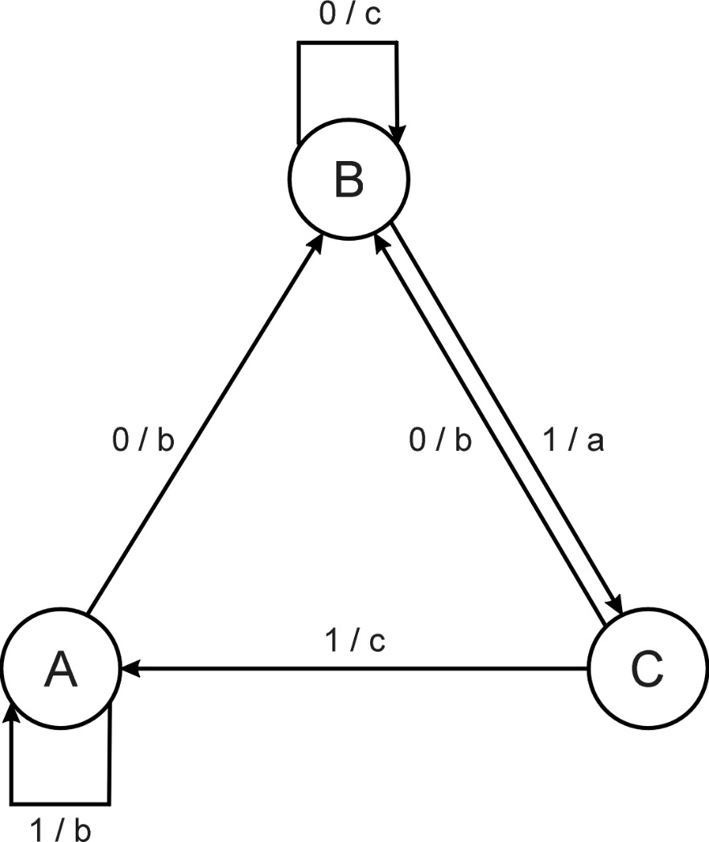
FSM example
Consider the FSM with:
  S = {A, B, C}
  I = {0, 1}
  O = {a, b, c}
  δ given by a diagram

Slide 69
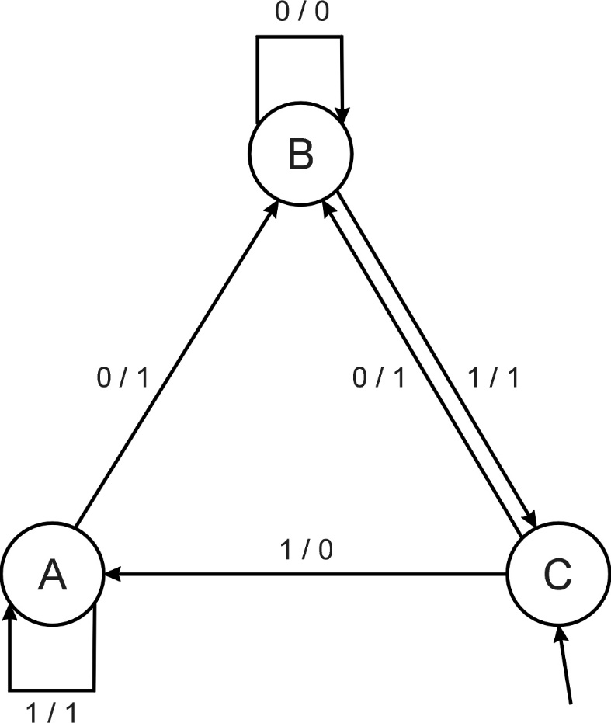
EP Worksheet Exercise #1
Consider the following FSM:
Task: predict next input
Quality: % of out_{i} = in_{(i+1)}
Given initial state C
Input sequence 011101
Leads to output 110111
Quality: 3 out of 5

Slide 70
EP Worksheet Exercise #2 evolving FSMs to predict primes
P(n) = 1 if n is prime, 0 otherwise
I = N = {1,2,3,…, n, …}
O = {0,1}
Correct prediction: out_{i}= P(in_{(i+1)})
Fitness function:
  1 point for correct prediction of next input
  0 point for incorrect prediction
  Penalty for “too many” states

Slide 71
Introductory example: evolving FSMs to predict primes
Parent selection: each FSM is mutated once
Mutation operators (one selected randomly):
  Change an output symbol
  Change a state transition (i.e., redirect edge)
  Add a state
  Delete a state
  Change the initial state
Survivor selection: (μ+μ)
Results: overfitting, after 202 inputs best FSM had one state and both outputs were 0, i.e., it always predicted “not prime”

Slide 72
Modern EP
No predefined representation in general
Thus: no predefined mutation (must match representation)
Often applies self-adaptation of mutation parameters
In the sequel we present one EP variant, not the canonical EP

Slide 73
Representation
For continuous parameter optimisation
Chromosomes consist of two parts:
  Object variables: x₁,…,x_{n}
  Mutation step sizes: σ₁,…,σ_{n}
Full size: ⟨ x₁,…,x_{n}, σ₁,…,σ_{n} ⟩

Slide 74
Mutation
Chromosomes: ⟨ x₁,…,x_{n}, σ₁,…,σ_{n} ⟩
σ_{i}’ = σ_{i} • (1 + α • N(0,1))
x’_{i} = x_{i} + σ_{i}’ • N_{i}(0,1)
α ≈ 0.2
boundary rule: σ’ < ε₀ ⇒ σ’ = ε₀
Other variants proposed & tried:
  Lognormal scheme as in ES
  Using variance instead of standard deviation
  Mutate σ-last
  Other distributions, e.g, Cauchy instead of Gaussian

Slide 75
Recombination
None
Rationale: one point in the search space stands for a species, not for an individual and there can be no crossover between species
Much historical debate “mutation vs. crossover”
Pragmatic approach seems to prevail today

Slide 76
Parent selection
Each individual creates one child by mutation
Thus:
  Deterministic
  Not biased by fitness

Slide 77
Survivor selection
P(t): μ parents, P’(t): μ offspring
Pairwise competitions, round-robin format:
  Each solution x from P(t) ∪ P’(t) is evaluated against q other randomly chosen solutions
  For each comparison, a "win" is assigned if x is better than its opponent
  The μ solutions with greatest number of wins are retained to be parents of next generation
Parameter q allows tuning selection pressure (typically q = 10)

Slide 78
Example application: the Ackley function (Bäck et al ’93)
The Ackley function (with n =30):
Representation:
  -30 < x_{i} < 30 (coincidence of 30’s!)
  30 variances as step sizes
Mutation with changing object variables first!
Population size μ = 200, selection q = 10
Termination after 200,000 fitness evals
Results: average best solution is 1.4 • 10 ^{–2}

Slide 79
Example application: evolving checkers players (Fogel’02)
Neural nets for evaluating future values of moves are evolved
NNs have fixed structure with 5046 weights, these are evolved + one weight for “kings”
Representation:
  vector of 5046 real numbers for object variables (weights)
  vector of 5046 real numbers for σ‘s
Mutation:
  Gaussian, lognormal scheme with σ-first
  Plus special mechanism for the kings’ weight
Population size 15

Slide 80
Example application: evolving checkers players (Fogel’02)
Tournament size q = 5
Programs (with NN inside) play against other programs, no human trainer or hard-wired intelligence
After 840 generation (6 months!) best strategy was tested against humans via Internet
Program earned “expert class” ranking outperforming 99.61% of all rated players

Slide 81
Deriving Gas-Phase Exposure History through Computationally Evolved Inverse Diffusion Analysis
Joshua M. Eads
Former undergraduate student in Computer Science
Daniel Tauritz
Associate Professor of Computer Science
Glenn Morrison
Associate Professor of Environmental Engineering
Ekaterina Smorodkina
Former Ph.D. Student in Computer Science

Slide 82

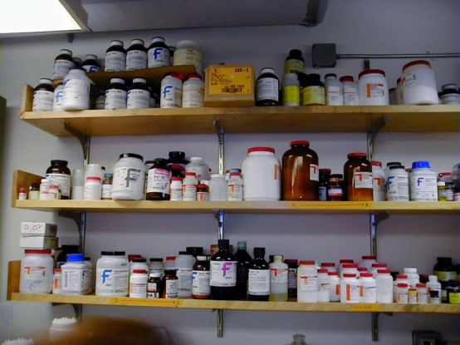

Introduction
Find Contaminants
and Fix Issues
Examine Indoor
Exposure History
Unexplained
Sickness

Slide 83
Background
Indoor air pollution top five environmental health risks
$160 billion could be saved every year by improving indoor air quality
Current exposure history is inadequate
A reliable method is needed to determine past contamination levels and times

Slide 84
Problem Statement
A forward diffusion differential equation predicts concentration in materials after exposure
An inverse diffusion equation finds the timing and intensity of previous gas contamination
Knowledge of early exposures would greatly strengthen epidemiological conclusions

Slide 85
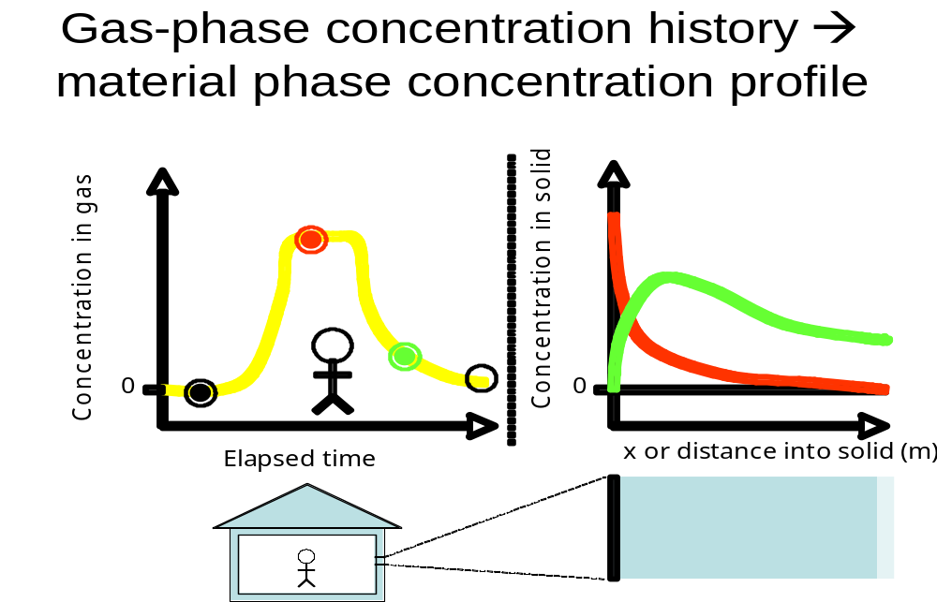
Gas-phase concentration history and material absorption

Slide 86
Proposed Solution
Use Genetic Programming (GP) as a directed search for inverse equation
Fitness based on forward equation
x^5 + x^4 - tan(y) / pi
x^2 + sin(x)
sin(cos(x+y)^2)
sin(x+y) + e^(x^2)
5x^2 + 12x - 4
x^2 - sin(x)
X
+
Sin
/
?

Slide 87
Related Research
It has been proven that the inverse equation exists
Symbolic regression with GP has successfully found both differential equations and inverse functions
Similar inverse problems in thermodynamics and geothermal research have been solved

Slide 88
Interdisciplinary Work
Collaboration between Environmental Engineering, Computer Science, and Math
Parent Selection
Candidate
Solutions
Forward Diffusion Equation
Competition
Reproduction
Population
Fitness
Genetic Programming Algorithm

Slide 89
Genetic Programming Background
+
Y = X^2 + Sin( X * Pi )
*
Sin
X
X
*
X
Pi

Slide 90


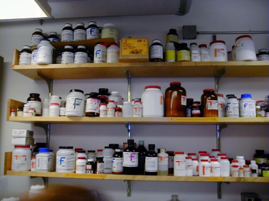
Summary
Ability to characterize exposure history will enhance ability to assess health risks of chemical exposure

Slide 91
Genetic Programming (GP)
Characteristic property: variable-size hierarchical representation vs. fixed-size linear in traditional EAs
Application domain: model optimization vs. input values in traditional EAs
Unifying Paradigm: Program (i.e., Executable Model) Induction

Slide 92
Program induction examples
Optimal control
Planning
Symbolic regression
Automatic programming
Discovering game playing strategies
Forecasting
Inverse problem solving
Decision Tree induction
Evolution of emergent behavior
Evolution of cellular automata

Slide 93
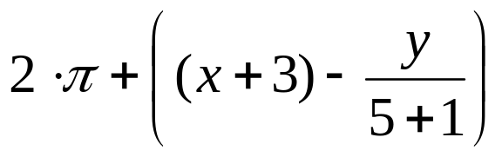
Tree Representation (1/6)
Trees are a universal form, e.g. consider
Arithmetic formula:
Logical formula:
Program:
(x ∧ true) → (( x ∨ y ) ∨ (z ↔ (x ∧ y)))
i =1;
while (i < 20)
{
i = i +1
}

Slide 94
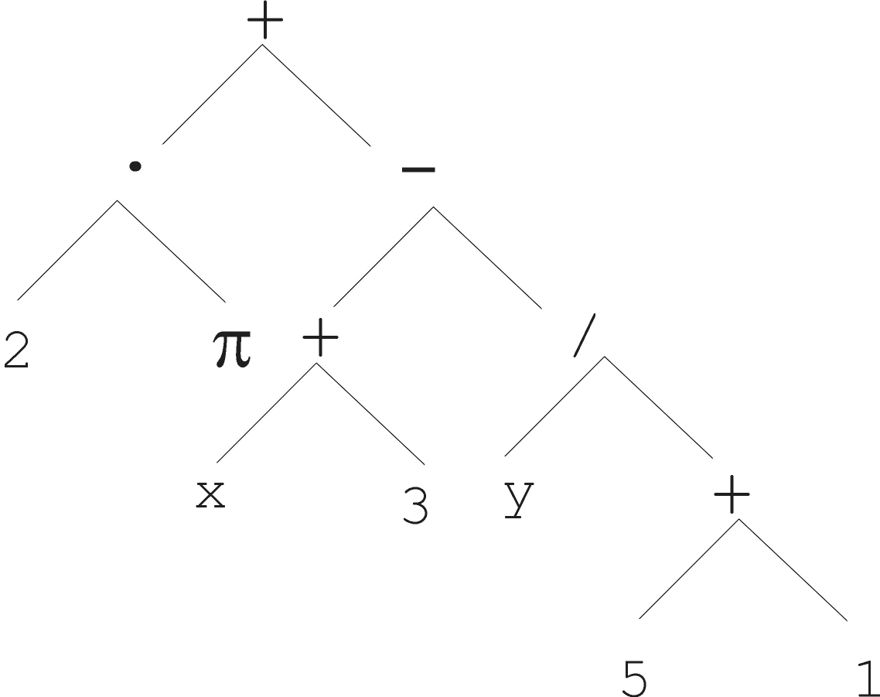
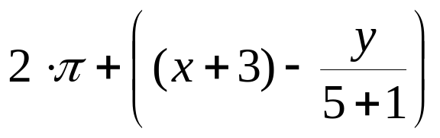
Tree Representation (2/6)

Slide 95
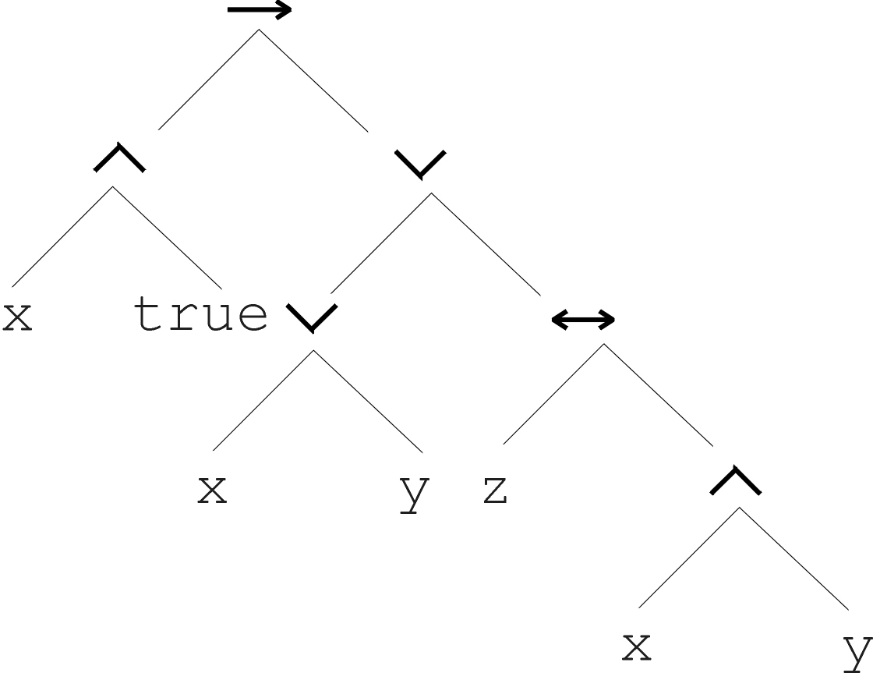
Tree Representation (3/6)
(x ∧ true) → (( x ∨ y ) ∨ (z ↔ (x ∧ y)))

Slide 96
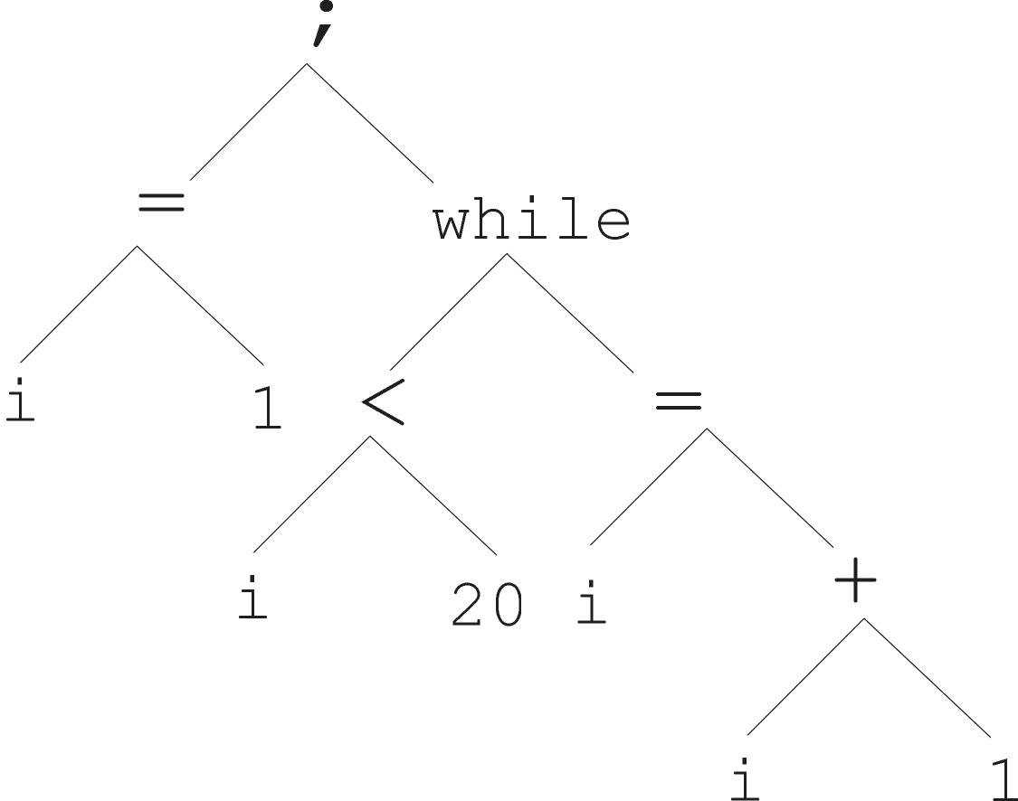
Tree Representation (4/6)
i =1;
while (i < 20)
{
i = i +1
}

Slide 97
Tree Representation (5/6)
In GA, ES, EP chromosomes are linear structures (bit strings, integer string, real-valued vectors, permutations)
Tree shaped chromosomes are non-linear structures
In GA, ES, EP the size of the chromosomes is fixed
Trees in GP may vary in depth and width

Slide 98
Tree Representation (6/6)
Symbolic expressions can be defined by
  Terminal set T
  Function set F (with the arities of function symbols)
Adopting the following general recursive definition:
  Every t ∈ T is a correct expression
  f(e₁, …, e_{n}) is a correct expression if f ∈ F, arity(f)=n and e₁, …, e_{n} are correct expressions
  There are no other forms of correct expressions
In general, expressions in GP are not typed (closure property: any f ∈ F can take any g ∈ F as argument)
In practice, function symbols and terminal symbols are often typed, requiring strongly typed GP.

Slide 99
Tree-based Representations: Initialization
D_{max} = maximum initial tree depth
Ramped-half-and-half employs following methods with equal probability:
  Full method:
    each tree branch has depth D_{max}
    node n is at depth d; if d < D_{max}, n chosen from F, otherwise from T
  Grow method:
    tree branches have variable depth up to D_{max}
    starting at the root, nodes are selected stochastically from F and T if d < D_{max}

Slide 100
GP variation operators
Mutation xor recombination
Low mutation chance (recombination acts as macro-mutation operator)

Slide 101
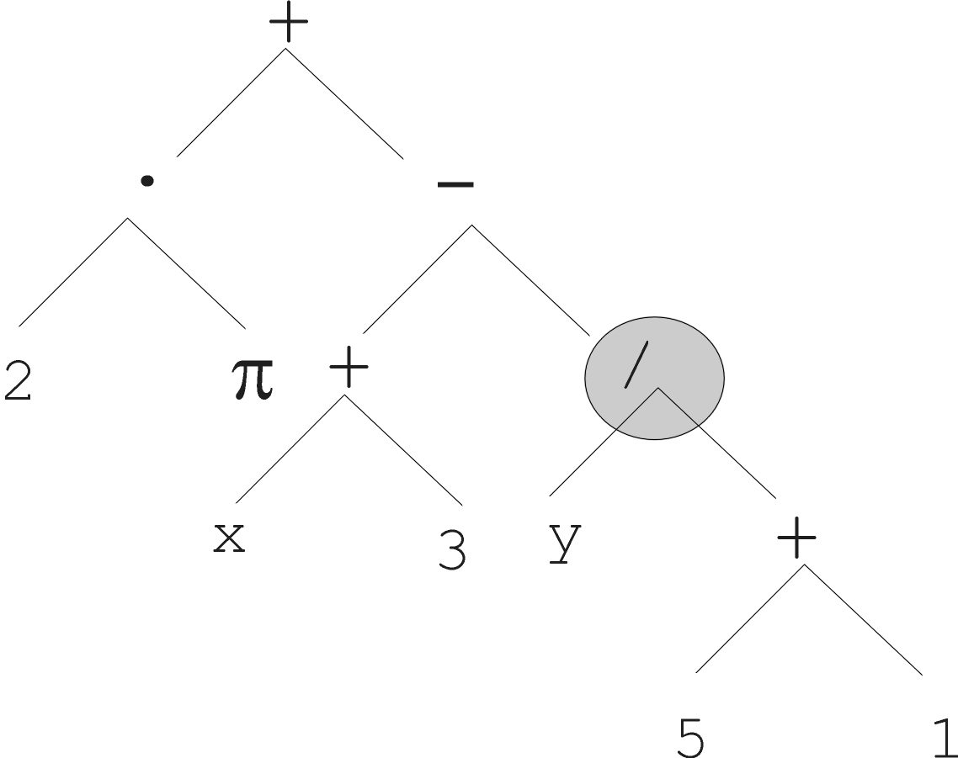
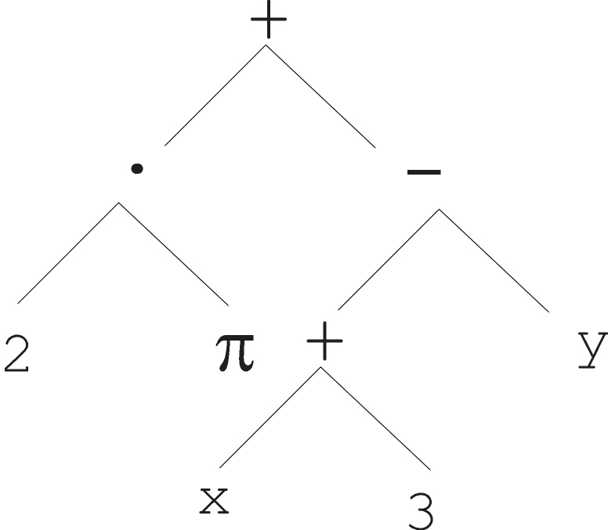
Tree Representation:
Mutation (1/2)
Most common mutation: replace randomly chosen subtree by randomly generated tree

Slide 102
Tree Representation:
Mutation (2/2)
Mutation has two parameters:
  Probability p_{m} to choose mutation
  Probability to chose an internal point as the root of the subtree to be replaced
Remarkably p_{m} is advised to be 0 (Koza’92) or very small, like 0.05 (Banzhaf et al. ’98)
The size of the child can exceed the size of the parent

Slide 103
Tree Representation:
Recombination (1/2)
Most common recombination: exchange two randomly chosen subtrees among the parents
Recombination has two parameters:
  Probability p_{c} to choose recombination
  Probability to chose an internal point within each parent as crossover point
The size of offspring can exceed that of the parents

Slide 104
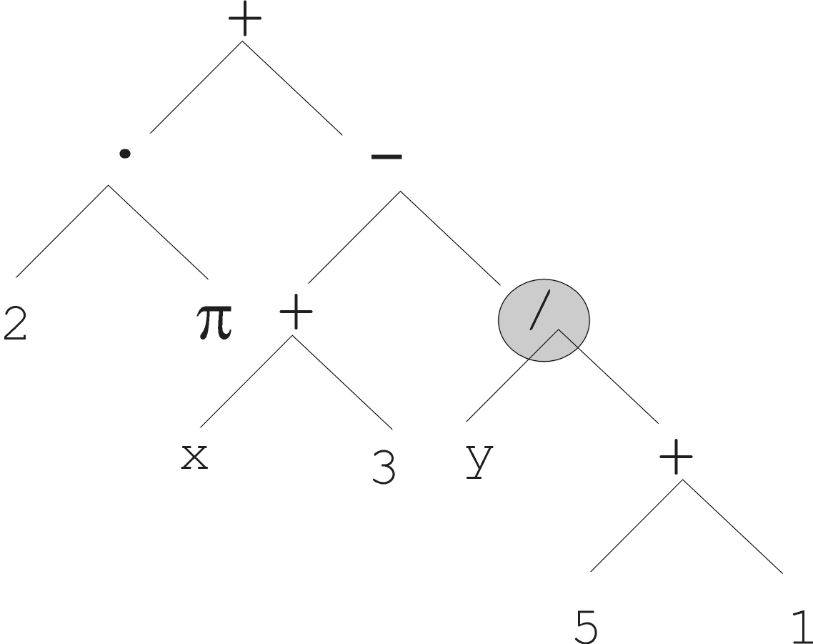
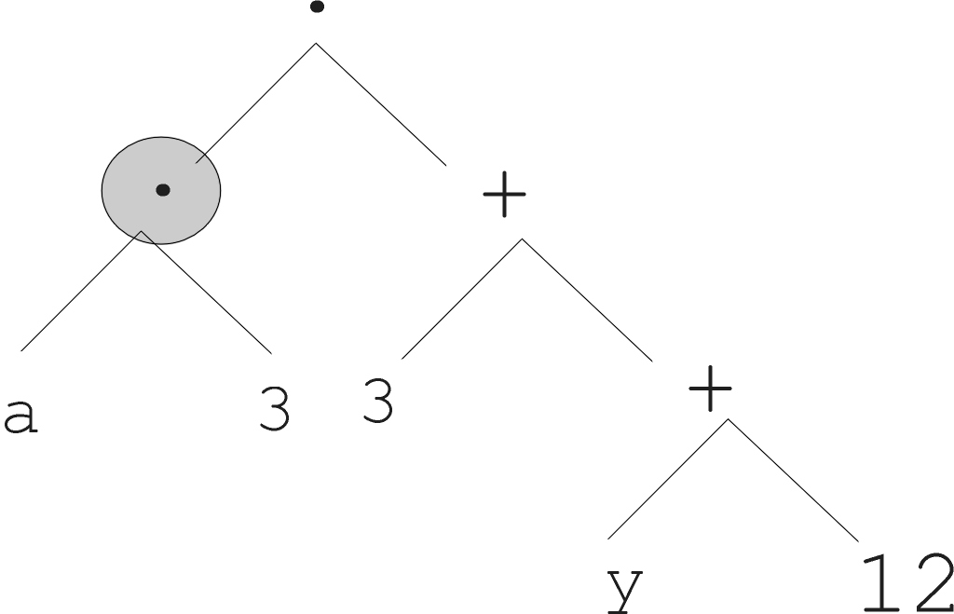
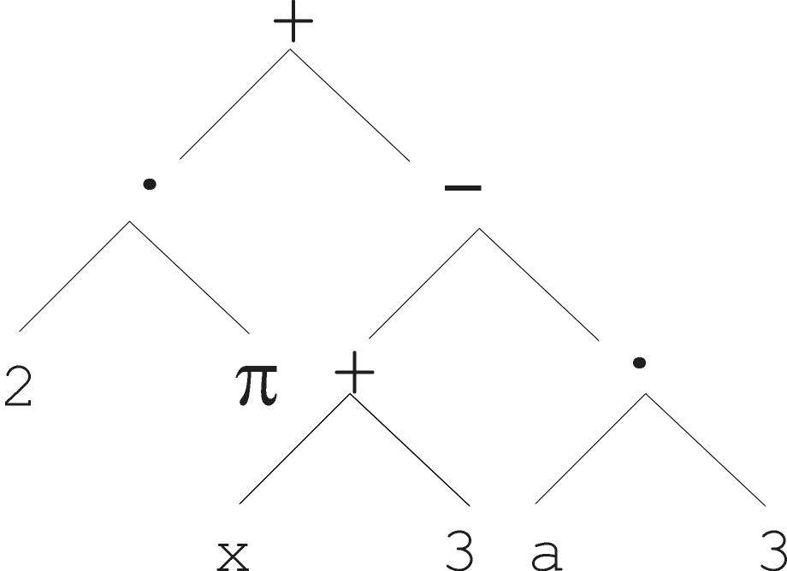
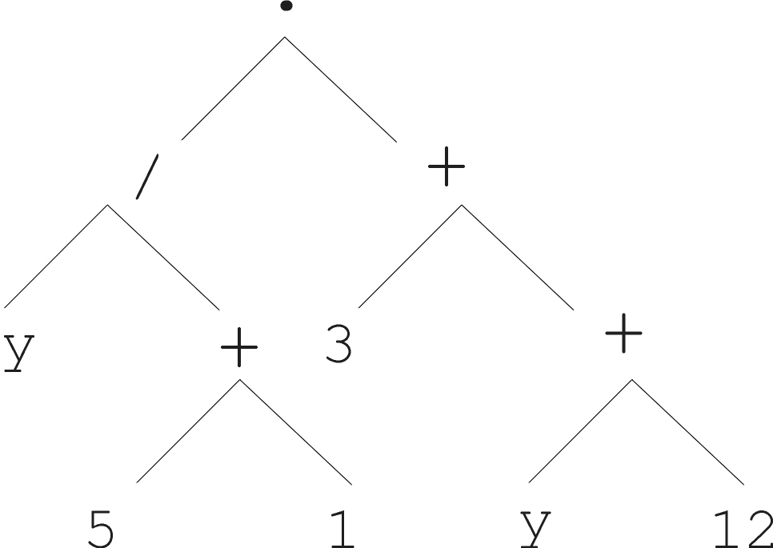
Tree Representation:
Recombination (2/2)
Parent 1
Parent 2
Child 1
Child 2

Slide 105
GP operators (continued)
Over-selection
  Large population sizes
  Split pop into top x% and rest
  80% from first group, 20% from second
  x chosen such that number of parents producing majority of offspring stays constant
  Koza recommends x = 32% for pop of 1000, 16% for pop of 2000, etc.

Slide 106
GP dynamics
Bloat (survival of the fattest)
  Maximum tree size
  Parsimony pressure
    Occam’s razor (14th century)
    Penalty function
    Multi-objective techniques

Slide 107
Learning Classifier Systems (LCS)
Motivation
Expert Systems introduced in 1965 by the Stanford Heuristic Programming Project (DENDRAL, MYCIN)
Condition-Action Rule Based Systems
  rule format: <condition:action>
Drawback: inability to learn

Slide 108
Learning Classifier Systems (LCS)
Illustrative example:
k-bit multiplexer problem

Slide 109
Learning Classifier Systems (LCS)
LCS is technically not a type of EA, but can utilize an EA
Combines Classification with Reinforcement Learning
LCS rule format:
  <condition:action> → predicted payoff
  don’t care symbols

Slide 110
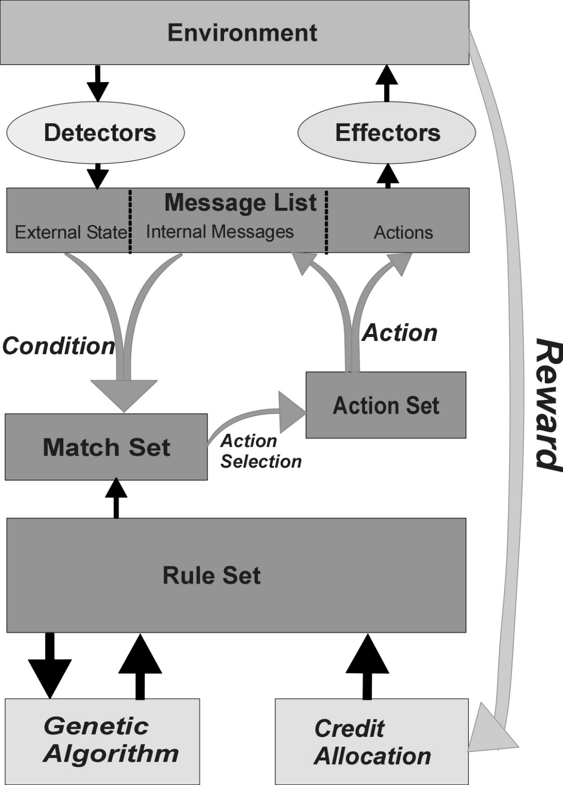

Slide 111
Learning Classifier Systems (LCS)
Illustrative example:
solving k-bit multiplexer problem with LCS

Slide 112

LCS specifics
Multi-step credit allocation – Bucket Brigade algorithm

Slide 113
LCS specifics
Michigan approach: each individual represents a single rule, a population represents the complete rule set
Pittsburgh “Pitt” approach: each individual represents a complete rule set

Slide 114
EAs & Parameters
Symbolic vs numeric parameters
EAs vs EA instances
Utility landscape vs fitness landscape
Configuration vs tuning

Slide 115
Parameter Tuning methods
Start with stock parameter values
Manually adjust based on user intuition
Monte Carlo sampling of parameter values on a few (short) runs
Tuning algorithm (e.g., REVAC which employs an information theoretic measure on how sensitive performance is to the choice of a parameter’s value)
Meta-tuning algorithm (e.g., meta-EA)

Slide 116
Parameter Tuning Challenges
Exhaustive search for optimal values of parameters, even assuming independency, is infeasible
Parameter dependencies
Extremely time consuming
Optimal values are very problem specific

Slide 117
Static vs. dynamic parameters
The optimal value of a parameter can change during evolution
Static parameters remain constant during evolution, dynamic parameters can change
Dynamic parameters require parameter control

Slide 118
Tuning vs Control confusion
Parameter Tuning: A priori optimization of fixed strategy parameters
Parameter Control: On-the-fly optimization of dynamic strategy parameters

Slide 119
Parameter Control
While dynamic parameters can benefit from tuning, performance tends to be much less sensitive to initial values for dynamic parameters than static
Controls dynamic parameters
Three main parameter control classes:
  Blind
  Adaptive
  Self-Adaptive

Slide 120
Parameter Control methods
Blind (termed “deterministic” in textbook)
  Example: replace p_{i} with p_{i}(t)
    akin to cooling schedule in Simulated Annealing
Adaptive
  Example: Rechenberg’s 1/5 success rule
Self-adaptive
  Example: Mutation-step size control in ES

Slide 121
Evaluation Function Control
Example 1: Parsimony Pressure in GP
Example 2: Penalty Functions in Constraint Satisfaction Problems (aka Constrained Optimization Problems)

Slide 122
Penalty Function Control
eval(x)=f(x)+W ·penalty(x)
Blind ex: W=W(t)=(C ·t)^{α} with C,α≥1
Adaptive ex (page 135 of textbook)
Self-adaptive ex (pages 135-136 of textbook)
Note: this allows evolution to cheat!

Slide 123
Parameter Control aspects
What is changed?
  Symbolic vs numeric parameters
How is the change made?
  Blind, adaptive, self-adaptive
Based on what evidence?
  Absolute vs relative evidence
Scope of change
  Population, individual, gene

Slide 124
Parameter Control:
Scope of Change
Gene vs. individual vs. population
Ex: one-bit allele for recombination operator selection (pairwise vs. vote)
Ex:
  Gene: Self-adaptive ES with separate mutation step sizes ⟨ x₁,…,x_{n}, σ₁,…, σ_{n} ⟩
  Individual: Self-adaptive ES with single mutation step size ⟨ x₁,…,x_{n}, σ ⟩
  Population: Blind dynamic mutation control

Slide 125
Parameter control examples
Representation (GP:ADFs, delta coding)
Evaluation function (objective function/…)
Mutation (ES)
Recombination (Davis’ adaptive operator fitness:implicit bucket brigade)
Selection (Boltzmann)
Population
Multiple

Slide 126
Population Size Control
1994 Genetic Algorithm with Varying Population Size (GAVaPS)
2000 Genetic Algorithm with Adaptive Population Size (APGA)
– dynamic population size as emergent behavior of individual survival tied to age
– both introduce two new parameters: MinLT and MaxLT; furthermore, population size converges to 0.5 * λ * (MinLT + MaxLT)
Notes:
In both GAVaPS and APGA, each individual is given a lifetime, which depends on the individual’s fitness. At each generation, individuals’ lifetimes are decreased by one. The main difference between APGA and GAVaPS is that in APGA the lifetime of the fittest individual at each generation remains unchanged, while in GAVaPS the lifetime of all individuals in the population is decreased at each generation.

Slide 127
Population Size Control
1995 (1,λ)-ES with dynamic offspring size employing adaptive control
– adjusts λ based on the second best individual created
– goal is to maximize local serial progress-rate, i.e., expected fitness gain per fitness evaluation
– maximizes convergence rate, which often leads to premature convergence on complex fitness landscapes
Notes:
Hansen, Gawelczyk, and Ostermeier
This paper presents an analysis of the local serial rate of progress with respect to the number of offspring λ for the (1,λ)-evolution strategy. It is shown that local serial progress is maximized when the expected progress of the second best offspring is zero. The theoretical results lead to a simple but efficient adaptation rule for λ, which needs no extra fitness function evaluations and only small computational expense.

Slide 128
Population Size Control
1999 Parameter-less GA
– runs multiple parallel fixed size populations
– the sizes are powers of 2, starting with 4 and doubling the size of the largest population to produce next population
– smaller populations are preferred by allotting them more generations
– a population is deleted if a) its average fitness is exceeded by the average fitness of a larger population, or b) the population has converged
– no limit on number of parallel populations

Slide 129
Population Size Control
2003 self-adaptive selection of reproduction operators
– each individual contains a vector of probabilities of using each reproduction operator defined for the problem
– probability vectors updated every generation
– in the case of a multi-ary reproduction operator, another individual is selected which prefers the same reproduction operator

Slide 130
Population Size Control
2004 Population Resizing on Fitness Improvement GA (PRoFIGA)
– dynamically balances exploration versus exploitation by tying population size to magnitude of fitness increases with a special mechanism to escape local optima
– introduces several new parameters
Notes:
In early generations, fitness increases are large and population size is forced to grow thus utilizing exploration. When improvements in fitness become smaller, population size is forced to shrink and the algorithm focuses on exploitation. If a population is stuck in local optima, population size is increased and exploration is renewed. In the calculation of the growth rate, PRoFIGA uses several parameters that need to be manually set, including an increase factor and the maximum given number of fitness evaluations. To decrease a population size, PRoFIGA uses a decrease factor, set to a small percentage of the current population size (1-5%). To determine whether a population is stuck in local optima, the number of generations or fitness evaluations during which no improvements are made must be specified

Slide 131
Population Size Control
2005 (1+λ)-ES with dynamic offspring size employing adaptive control
– adjusts λ based on the number of offspring fitter than their parent: if none fitter, than double λ; otherwise divide λ by number that are fitter
– idea is to quickly increase λ when it appears to be too small, otherwise to decrease it based on the current success rate
– has problems with complex fitness landscapes that require a large λ to ensure that successful offspring lie on the path to the global optimum
Notes:
Hansen, Gawelczyk, and Ostermeier

Slide 132
Population Size Control
2006 self-adaptation of population size and selective pressure
– employs “voting system” by encoding individual’s contribution to population size in its genotype
– population size is determined by summing up all the individual “votes”
– adds new parameters p_{min} and p_{max} that determine an individual’s vote value range

Slide 133
Motivation for new type of EA
Selection operators are not commonly used in an adaptive manner
Most selection pressure mechanisms are based on Boltzmann selection
Framework for creating Parameterless EAs
Centralized population size control, parent selection, mate pairing, offspring size control, and survival selection are highly unnatural!

Slide 134
Approach for new type of EA
Remove unnatural centralized control by:
Letting individuals select their own mates
Letting couples decide how many offspring to have
Giving each individual its own survival chance

Slide 135
Autonomous EAs (AutoEAs)
An AutoEA is an EA where all the operators work at the individual level (as opposed to traditional EAs where parent selection and survival selection work at the population level in a decidedly unnatural centralized manner)
Population & offspring size become dynamic derived variables determined by the emergent behavior of the system

Slide 136
Evolution Strategies (ES)
Birth year: 1963
Birth place: Technical University of Berlin, Germany
Parents: Ingo Rechenberg & Hans-Paul Schwefel

Slide 137
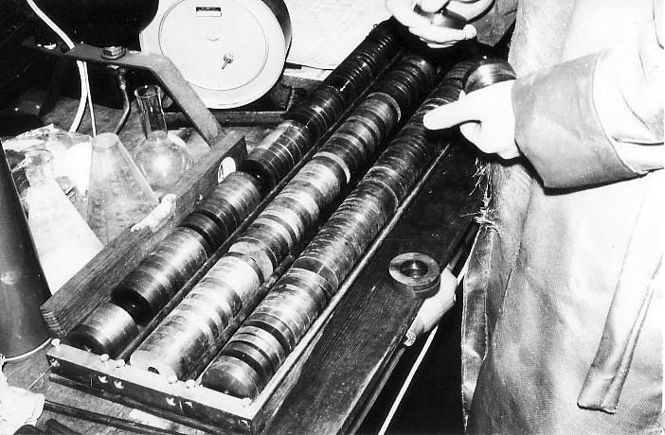
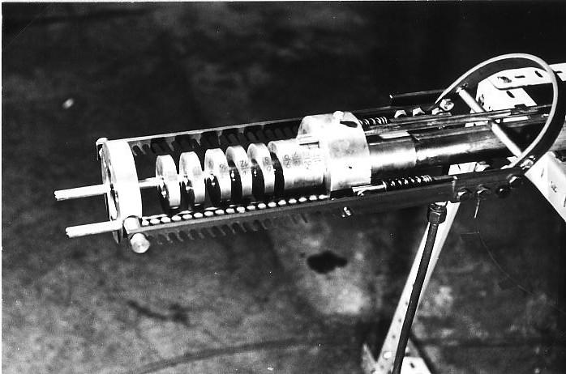
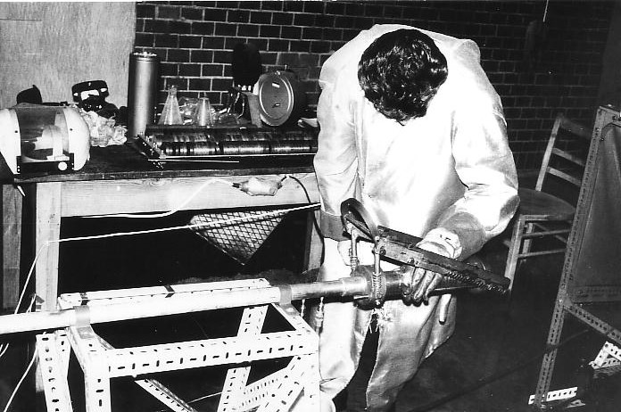
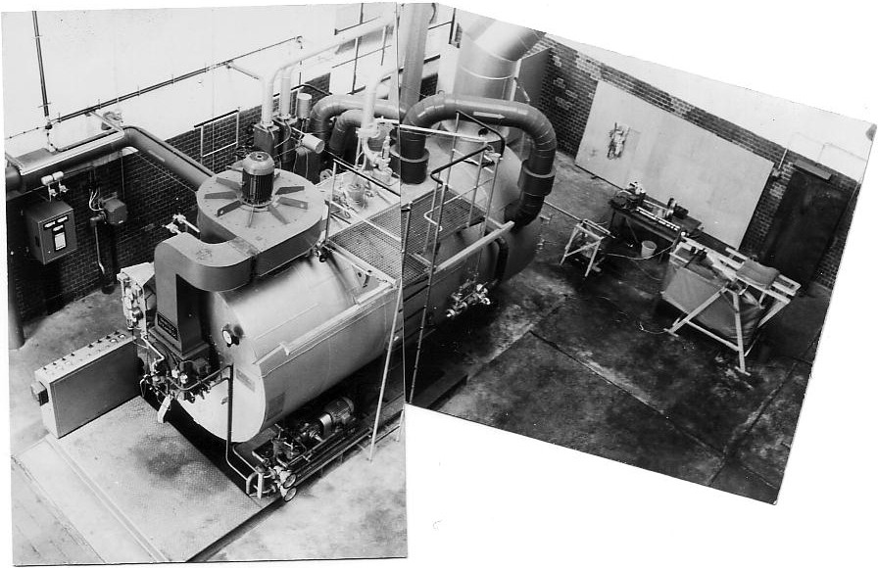
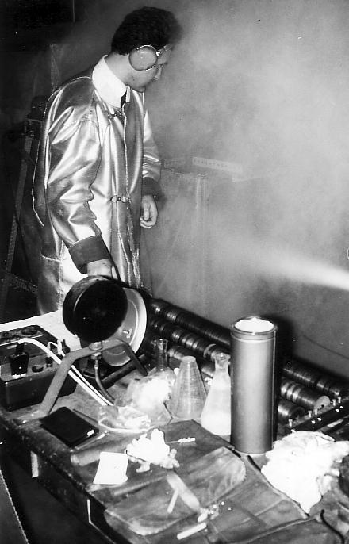
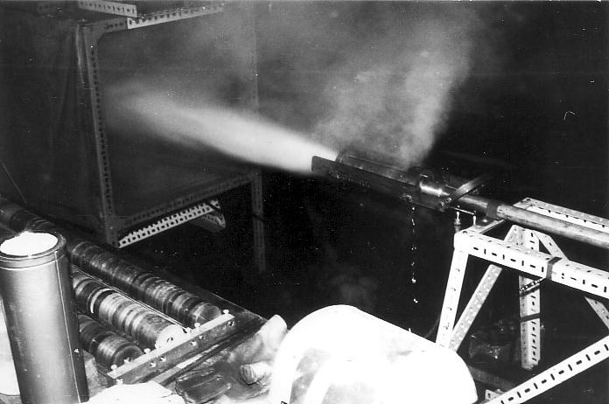
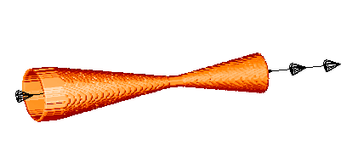

What if … You Had Very Few Trials?
All photos courtesy of Hans-Paul Schwefel.
255 experiments
J. Klockgether and H.-P. Schwefel: Two-phase nozzle and hollow core jet experiments. In Proc. 11th Symp. Engineering Aspects of Magnetohydrodynamcis. Ed. D. Elliott, pp. 141-148. California Institute of Technology, Pasadena, CA, 1970.
32% efficiency improvement!

Slide 138
ES history & parameter control
Two-membered ES: (1+1)
Original multi-membered ES: (µ+1)
Multi-membered ES: (µ+λ), (µ,λ)
Parameter tuning vs. parameter control
Adaptive parameter control
  Rechenberg’s 1/5 success rule
Self-adaptation
  Mutation Step control
Notes:
Originally, the one-ﬁfth rule was designed to control the step size of evolution strategies. In intuitive terms, it suggests that if the probability to create an oﬀspring of better than current-best ﬁtness is greater than 1/5, then the step size should be increased, while it should be decreased if the probability is lower than 1/5.

Slide 139
  Rechenberg’s 1/5 success rule
Fill in details from section 8.2.1
Notes:
Originally, the one-ﬁfth rule was designed to control the step size of evolution strategies. In intuitive terms, it suggests that if the probability to create an oﬀspring of better than current-best ﬁtness is greater than 1/5, then the step size should be increased, while it should be decreased if the probability is lower than 1/5.

Slide 140
Uncorrelated mutation with one step size
Chromosomes: ⟨ x₁,…,x_{n}, σ ⟩
σ’ = σ • exp(τ • N(0,1))
x’_{i} = x_{i} + σ’ • N(0,1)
Typically the “learning rate” τ ∝ 1/ n^{½}
And we have a boundary rule σ’ < ε₀ ⇒ σ’ = ε₀

Slide 141
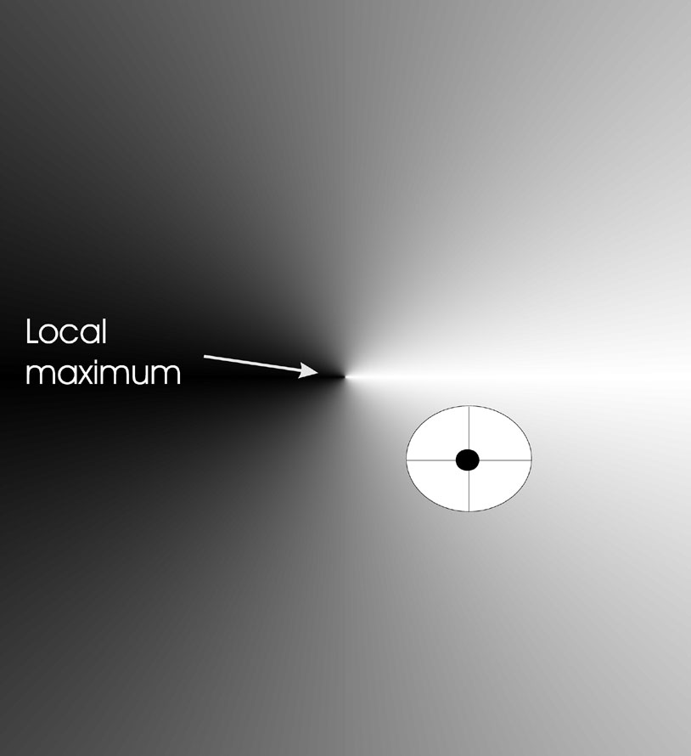
Mutants with equal likelihood
Circle: mutants having same chance to be created

Slide 142
Mutation case 2:
Uncorrelated mutation with n σ’s
Genotype: ⟨x₁,…,x_{n},σ₁,…,σ_{n}⟩
σ’_{i} = σ_{i} • exp(τ’ • N(0,1) + τ • N_{i} (0,1))
x’_{i} = x_{i} + σ’_{i} • N_{i} (0,1)
Two learning rate parameters:
  τ’ overall learning rate
  τ coordinate wise learning rate
τ’ ∝ 1/(2 n)^{½} and τ ∝ 1/(2 n^{½})^{½}
τ’ and τ have individual proportionality constants which both have default values of 1
σ_{i}’ < ε₀ ⇒ σ_{i}’ = ε₀

Slide 143
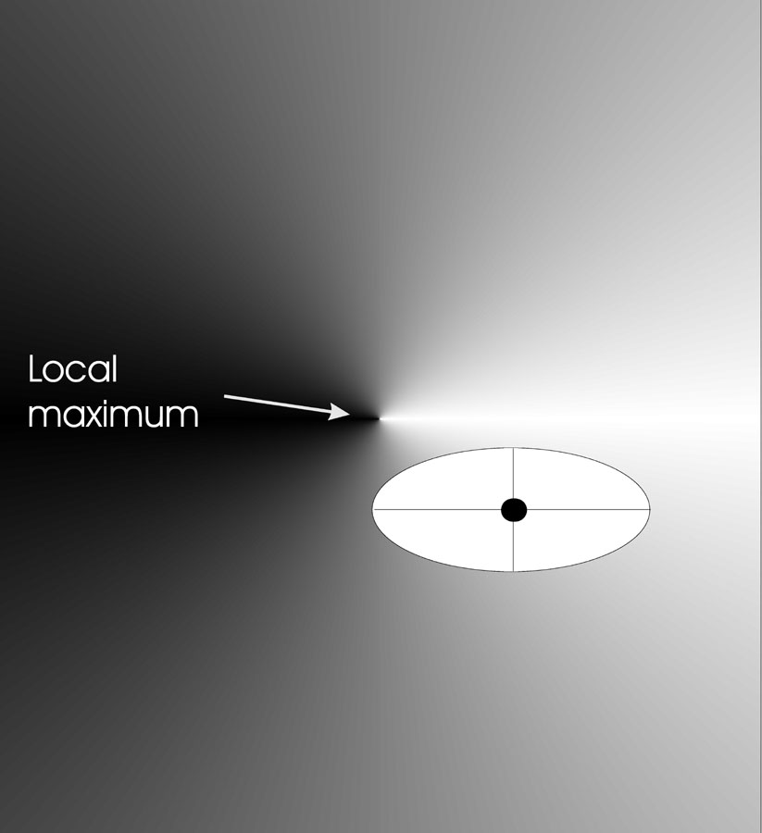
Mutants with equal likelihood
Ellipse: mutants having the same chance to be created

Slide 144
Mutation case 3:
Correlated mutations
Genotype: ⟨x₁,…,x_{n},σ₁,…,σ_{n},α₁,…, α_{k}⟩
where k = n • (n-1)/2
and the covariance matrix C is defined as:
  c_{ii} = σ_{i}²
  c_{ij} = 0 if i and j are not correlated
  c_{ij} = ½ • ( σ_{i}² - σ_{j}² ) • tan(2 α_{ij}) if i and j are correlated
Note the numbering/indices of the α‘s

Slide 145
Correlated mutations cont’d
The mutation mechanism is then:
σ’_{i} = σ_{i} • exp(τ’ • N(0,1) + τ • N_{i} (0,1))
α’_{j} = α_{j} + β • N (0,1)
x ’ = x + N(0,C’)
  x stands for the vector ⟨ x₁,…,x_{n} ⟩
  C’ is the covariance matrix C after mutation of the α values
τ ∝ 1/(2 n)^{½} and τ ∝ 1/(2 n^{½}) ^{½} and β ≈ 5°
σ_{i}’ < ε₀ ⇒ σ_{i}’ = ε₀ and
| α’_{j} | > π ⇒ α’_{j} = α’_{j} - 2 π sign(α’_{j})

Slide 146
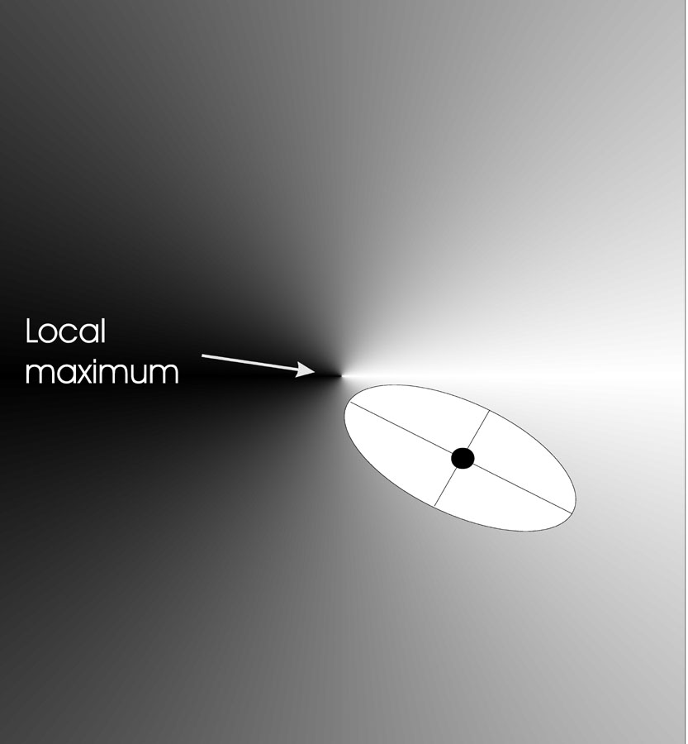
Mutants with equal likelihood
Ellipse: mutants having the same chance to be created

Slide 147
Recombination
Creates one child
Acts per variable / position by either
  Averaging parental values, or
  Selecting one of the parental values
From two or more parents by either:
  Using two selected parents to make a child
  Selecting two parents for each position anew

Slide 148
Names of recombinations
 | Two fixed parents | Two parents selected for each i
z_{i} = (x_{i} + y_{i})/2 | Local intermediary | Global intermediary
z_{i} is x_{i} or y_{i} chosen randomly | Local discrete | Global discrete

Slide 149
Modern ES configuration
Fill out details from Section 6.2

Slide 150
Multimodal Problems
Multimodal def.: multiple local optima and at least one local optimum is not globally optimal
Adaptive landscapes & neighborhoods
Basins of attraction & Niches
Motivation for identifying a diverse set of high quality solutions:
  Allow for human judgment
  Sharp peak niches may be overfitted

Slide 151
Restricted Mating
Panmictic vs. restricted mating
Finite pop size + panmictic mating -> genetic drift
Local Adaptation (environmental niche)
Punctuated Equilibria
  Evolutionary Stasis
  Demes
Speciation (end result of increasingly specialized adaptation to particular environmental niches)

Slide 152
EA spaces
Biology | EA
Geographical | Algorithmic
Genotype | Representation
Phenotype | Solution

Slide 153
Implicit diverse solution identification
Multiple runs of standard EA
  Pro: No additional coding needed
  Con: Non-uniform basins of attraction problematic
Island Model EAs
Cellular EAs
Automatic Speciation

Slide 154
Island Model
Island Model (coarse-grain parallel)
  Punctuated Equilibria
  Epoch, migration
  Communication characteristics
    How often to exchange individuals?
    Which and how many individuals to exchange?
  Initialization: number of islands and respective population sizes
  Injection Island Models

Slide 155
Cellular EAs
Automatic Speciation
Cellular (aka Diffusion Model) EAs
  Single Population, Single Species
  Overlapping demes distributed within Algorithmic Space (e.g., grid)
  Equivalent to cellular automata
Automatic Speciation
  Genotype/phenotype mating restrictions
  Tags

Slide 156
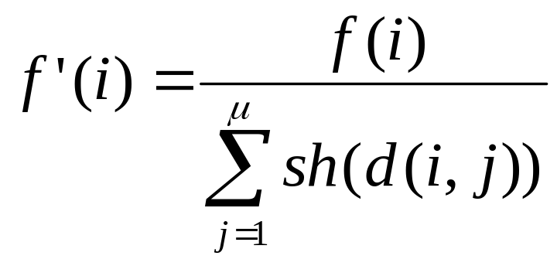
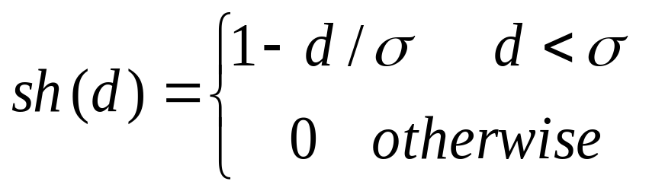
Explicit 1: Fitness Sharing
Restricts the number of individuals within a given niche by “sharing” their fitness, so as to allocate individuals to niches in proportion to the niche fitness
need to set the size of the niche σ_{share} in either genotype or phenotype space
run EA as normal but after each gen set

Slide 157
Explicit 2: Crowding
Attempts to distribute individuals evenly amongst niches
relies on the assumption that offspring will tend to be close to parents
uses a distance metric in ph/g enotype space
randomly shuffle and pair parents, produce 2 offspring
2 parent/offspring tournaments - pair so that d(p1,o1)+d(p2,o2) < d(p1,02) + d(p2,o1)

Slide 158
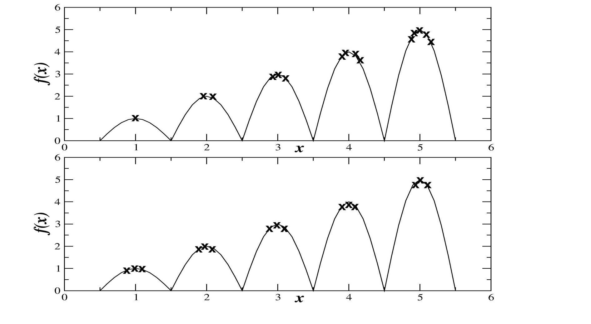
Fitness Sharing vs. Crowding

Slide 159
Differential Evolution
Introduced by Storm & Price in 1995
Application domain: optimizing multidimensional real-valued vectors
Parameters:
  n: dimensionality
  NP: population size (NP >= 4) 10n typical
  CR: crossover rate ([0,1]) 0.9 typical
  F: differential weight (0<F<=2]) 0.8 typical

Slide 160
DE Algorithm
Until termination criteria met do:
  For each individual (target agent) do:
    Pick three other distinct individuals a, b, and c
    Pick a random index R in [1,n]
    For each i in [1,n] compute trial vector y:
      Pick r_{i} in [0,1]
      If r_{i} < CR or i = R
        then y_{i} = a_{i} + F x (b_{i} - c_{i});
        otherwise y_{i} = x_{i}
    If f(y) <= f(x), then replace x with y

Slide 161
Game-Theoretic Problems
Adversarial search: multi-agent problem with conflicting utility functions
Ultimatum Game
Select two subjects, A and B
Subject A gets 10 units of currency
A has to make an offer (ultimatum) to B, anywhere from 0 to 10 of his units
B has the option to accept or reject (no negotiation)
If B accepts, A keeps the remaining units and B the offered units; otherwise they both loose all units

Slide 162
Real-World Game-Theoretic Problems
Real-world examples:
  economic & military strategy
  arms control
  cyber security
  bargaining
Common problem: real-world games are typically incomputable

Slide 163
Armsraces
Military armsraces
Prisoner’s Dilemma
Biological armsraces

Slide 164
Approximating incomputable games
Consider the space of each user’s actions
Perform local search in these spaces
Solution quality in one space is dependent on the search in the other spaces
The simultaneous search of co-dependent spaces is naturally modeled as an armsrace

Slide 165
Evolutionary armsraces
Iterated evolutionary armsraces
Biological armsraces revisited
Iterated armsrace optimization is doomed!

Slide 166
Coevolutionary Algorithm (CoEA)
A special type of EAs where the fitness of an individual is dependent on other individuals. (i.e., individuals are explicitely part of the environment)
Single species vs. multiple species
Cooperative vs. competitive coevolution

Slide 167
CoEA difficulties (1)
Disengagement
Occurs when one population evolves so much faster than the other that all individuals of the other are utterly defeated, making it impossible to differentiate between better and worse individuals without which there can be no evolution
Rosin’s Phantom Parasite

Slide 168
CoEA difficulties (2)
Cycling
Occurs when populations have lost the genetic knowledge of how to defeat an earlier generation adversary and that adversary re-evolves
Potentially this can cause an infinite loop in which the populations continue to evolve but do not improve
Rosin’s Hall of Fame

Slide 169
CoEA difficulties (3)
Suboptimal Equilibrium
(aka Mediocre Stability)
Occurs when the system stabilizes in a suboptimal equilibrium

Slide 170
CoEA difficulties (4)
Overspecialization
Occurs when coevolving populations become too focused on exploiting idiosyncratic weaknesses of opponents
Analogous to overfitting in machine learning
Avoid by maintaining genetic diversity

Slide 171
Case Study from Critical Infrastructure Protection
Infrastructure Hardening
Hardenings (defenders) versus contingencies (attackers)
Hardenings need to balance spare flow capacity with flow control

Slide 172
Case Study from Automated Software Engineering
Automated Software Correction
Programs (defenders) versus test cases (attackers)
Programs encoded with Genetic Programming
Program specification encoded in fitness function (correctness critical!)

Slide 173
No Free Lunch theorem (NFL)
Published in 1997 by David Wolpert and William Macready
“averaged over the space of all possible discrete functions, all non-revisiting BBSAs exhibit the same performance”
In 2001, Schumacher, Vose, and Whitley published a sharpened NFL showing that it holds on function sets closed under permutation

Slide 174
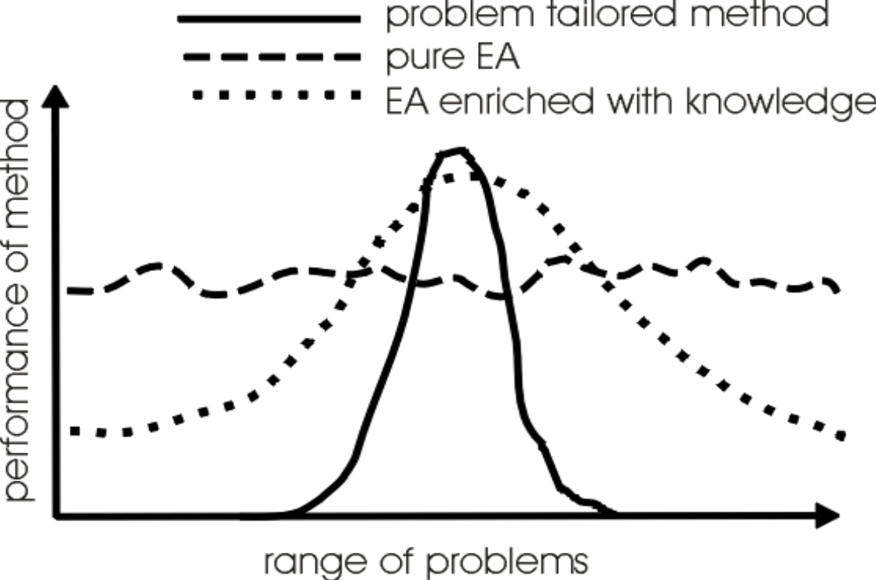
Michalewicz’s view on EA performance

Slide 175
Memetic Algorithms (MAs)
Hybrid EAs (OneMax example)
Dawkins’ Meme: unit of cultural transmission
Addition of developmental phase (meme-gene interaction)
Term MA coined to cover wide range of techniques where evolutionary search is augmented by addition of local search, or by the use of problem-specific information

Slide 176
Local Search
Neighborhood generating function
Pivot rule
Local search depth
Performance of MA’s employing local search dependent on both problem instance/class & state of evolutionary search

Slide 177
Memetic Algorithms (MAs)
Baldwinian EAs vs. Lamarckian EAs
Baldwin Effect
Probabilistic hybrid

Slide 178
Structure of a Memetic Algorithm
Heuristic Initialization
  Seeding
  Selective Initialization
  Locally optimized random initialization
  Mass Mutation
Heuristic Variation
  Variation operators employ problem specific knowledge
Heuristic Decoder or Repair Function
Local Search

Slide 179
Adaptive Memetic Algorithms
Multi-MAs, Coevolving MAs, Meta-Lamarckian MAs, Hyper-Heuristics, Self-Generating MAs, etc.
1st generation MAs: global search + local search
2nd generation MAs: global search + multiple local optimizers + Lamarckian
3rd generation MAs: 2nd generation MAs + learns mapping between evolutionary trajectory and choice of local optimizer

Slide 180
Memetic Algorithm Design Issues
Exacerbation of premature convergence
  Limited seeding
  Diversity preserving recombination operators
  Non-duplicating selection operators
  Boltzmann selection for preserving diversity (Metropolis criterion – page 142 in textbook)
Local Search neighborhood structure vs. variation operators
Multiple local search algorithms (coevolving)

Slide 181
Black-Box Search Algorithms
Many complex real-world problems can be formulated as generate-and-test problems
Black-Box Search Algorithms (BBSAs) iteratively generate trial solutions employing solely the information gained from previous trial solutions, but no explicit problem knowledge
Notes:
Performance is measured in terms of the quality of the individuals discovered by the search heuristic. Formally, a performance metric maps sequences of objective values to a real number indicating how well a heuristic which observed that sequence performed. Examples of performance metrics include the last objective value discovered by the algorithm or the greatest objective value discovered so far.

Slide 182
Practitioner’s Dilemma
How to decide for given real-world problem whether beneficial to formulate as black-box search problem?
How to formulate real-world problem as black-box search problem?
How to select/create BBSA?
How to configure BBSA?
How to interpret result?
All of the above are interdependent!
Notes:
Performance is measured in terms of the quality of the individuals discovered by the search heuristic. Formally, a performance metric maps sequences of objective values to a real number indicating how well a heuristic which observed that sequence performed. Examples of performance metrics include the last objective value discovered by the algorithm or the greatest objective value discovered so far.

Slide 183
Theory-Practice Gap
While BBSAs, including EAs, steadily are improving in scope and performance, their impact on routine real-world problem solving remains underwhelming
A scalable solution enabling domain-expert practitioners to routinely solve real-world problems with BBSAs is needed

Slide 184
Two typical real-world problem categories
Solving a single-instance problem:
automated BBSA selection
Repeatedly solving instances of a problem class:
evolve custom BBSA

Slide 185
Part I: Solving Single-Instance Problems Employing Automated BBSA Selection

Slide 186
Requirements
Need diverse set of high-performance BBSAs
Need automated approach to select most appropriate BBSA from set for a given problem
Need automated approach to configure selected BBSA

Slide 187
Automated BBSA Selection
Given a set of BBSAs, a priori evolve a set of benchmark functions which cluster the BBSAs by performance
Given a real-world problem, create a surrogate fitness function
Find the benchmark function most similar to the surrogate
Execute the corresponding BBSA on the real-world problem

Slide 188
A Priori, Once Per BBSA Set
BBSA₁
BBSA₂
…
BBSA_{n}
Benchmark Generator
BBSA₁
BP₁
BBSA₂
BP₂
…
BBSA_{n}
BP_{n}
Notes:
A priori, for each BBSA in a set of BBSAs, generate a benchmark problem where that BBSA consistently produces a better result than any other BBSA in the set and also generate a heuristic to classify the benchmark problems.
Given a real-world problem, sample its objective function space to create a surrogate objective function. Employ the aforementioned heuristic to classify the real-world problem based on its surrogate objective function and select the corresponding most appropriate BBSA.

Slide 189
Per Problem Instance
Real-World Problem
Sampling Mechanism
Surrogate Objective Function
Match with most “similar” BP_{k}
Apply appropriate BBSA_{k}
Notes:
A priori, for each BBSA in a set of BBSAs, generate a benchmark problem where that BBSA consistently produces a better result than any other BBSA in the set and also generate a heuristic to classify the benchmark problems.
Given a real-world problem, sample its objective function space to create a surrogate objective function. Employ the aforementioned heuristic to classify the real-world problem based on its surrogate objective function and select the corresponding most appropriate BBSA.

Slide 190
Part II: Repeatedly Solving Instances from the same Problem Class:
Employ Hyper-heuristics

Slide 191
Related Spring’22 classes
COMP 5630/6630 - Machine Learning
COMP 5650/6650 – Deep Learning
COMP 5970/6970 – AI4Sec Foundations
COMP 7970 – Research Methods in EC

