Slide 1
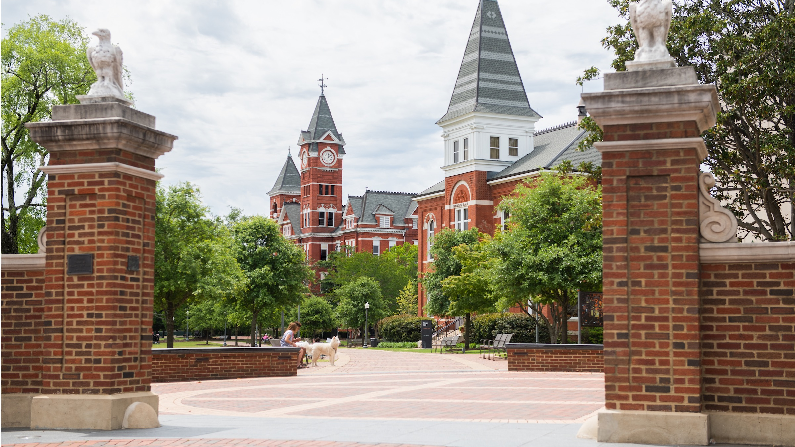

COMP 5660/6660 evolutionary computing
Fall 2026 introduction
Daniel R. Tauritz, Ph.D.

Slide 2
Today’s agenda
Course introduction
Instructor introduction
Course motivation
Course overview (Canvas, syllabus, website)
TA introduction
Assignment 0

Slide 3
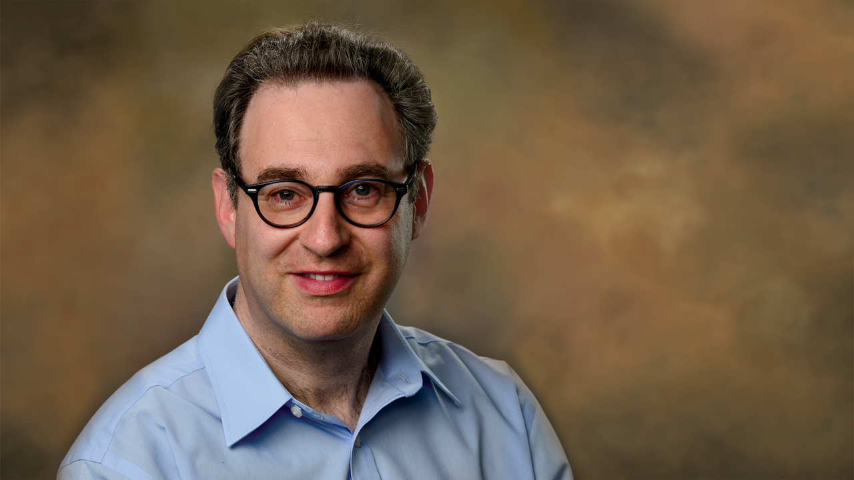
Instructor introduction
Welcome to the wonderful world of dr. T

Slide 4


1991: enrolled at leiden university
Leiden university was founded in 1575

Slide 5
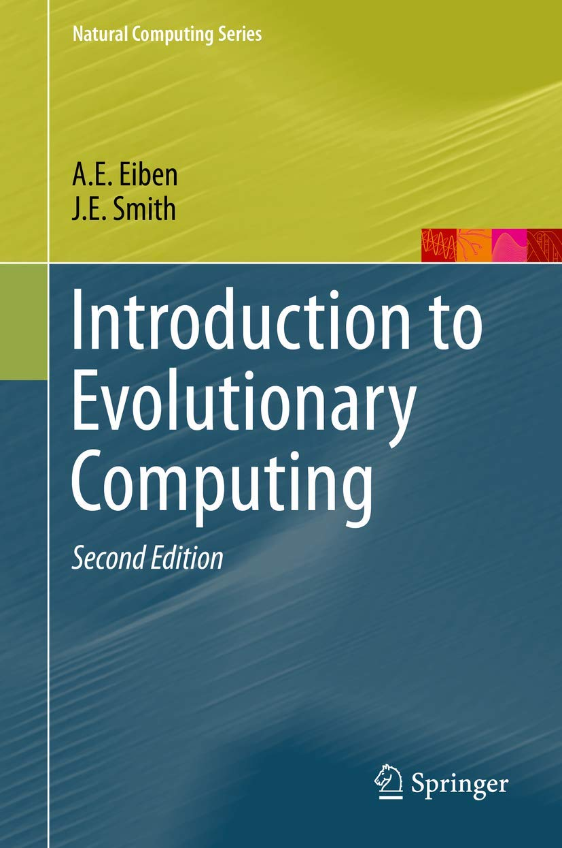
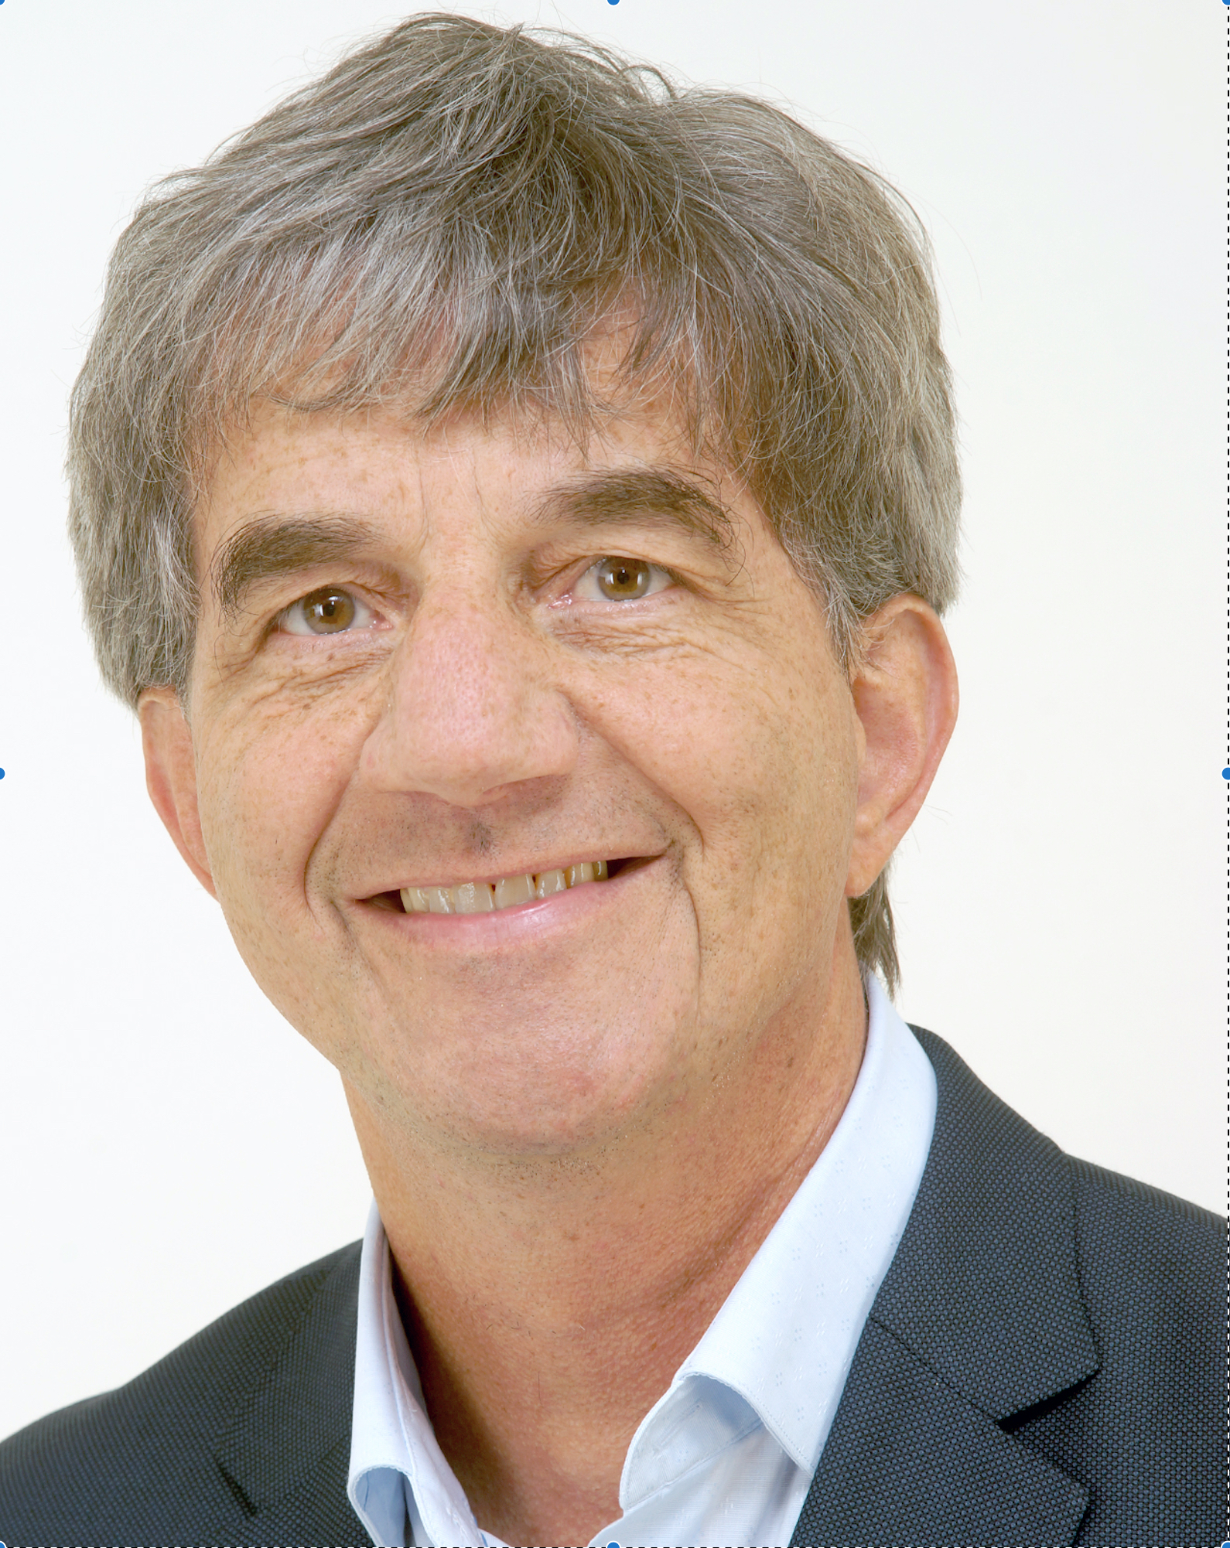
1995: took class on evolutionary computing
Dr. guszti eiben’s first class at leiden university

Slide 6


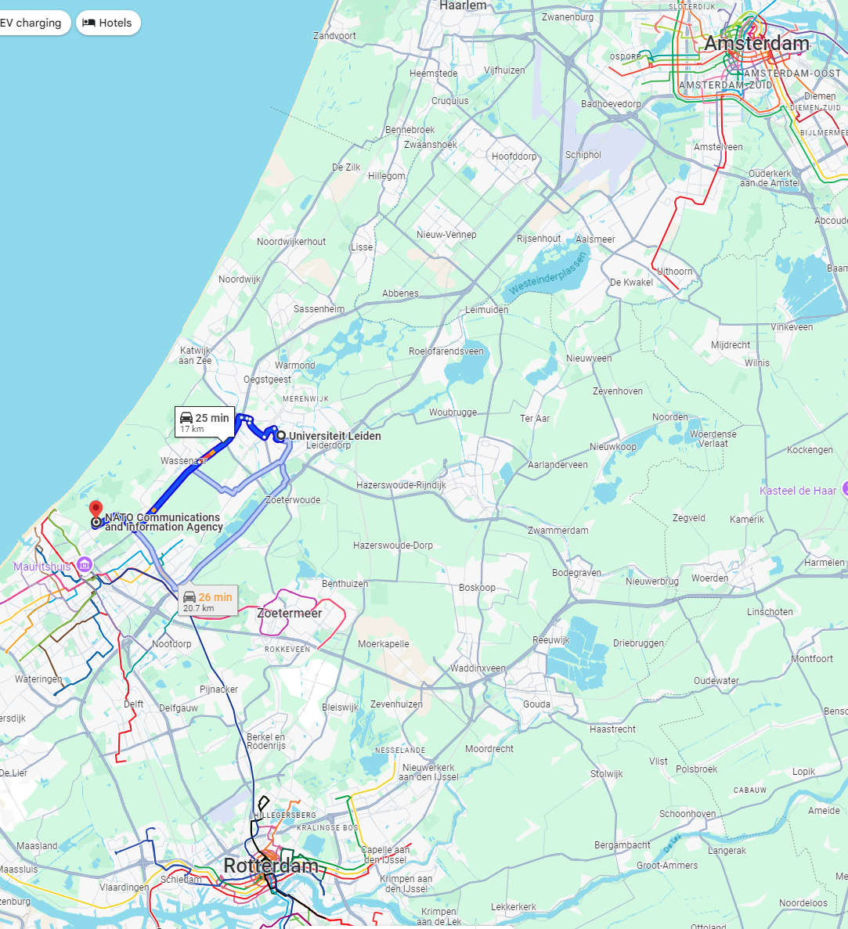
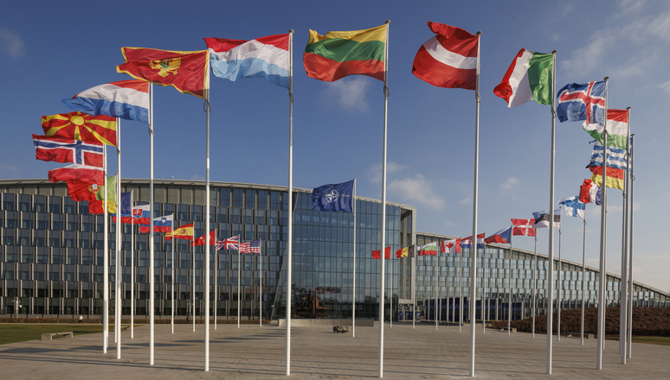
1996: Internship at NATO + Masters
The north Atlantic treaty organization (NATO) was founded in 1949

Slide 7
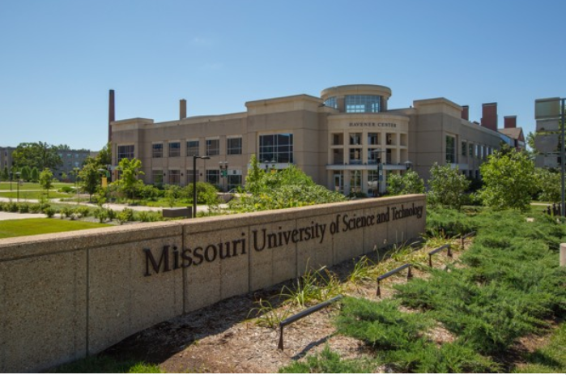
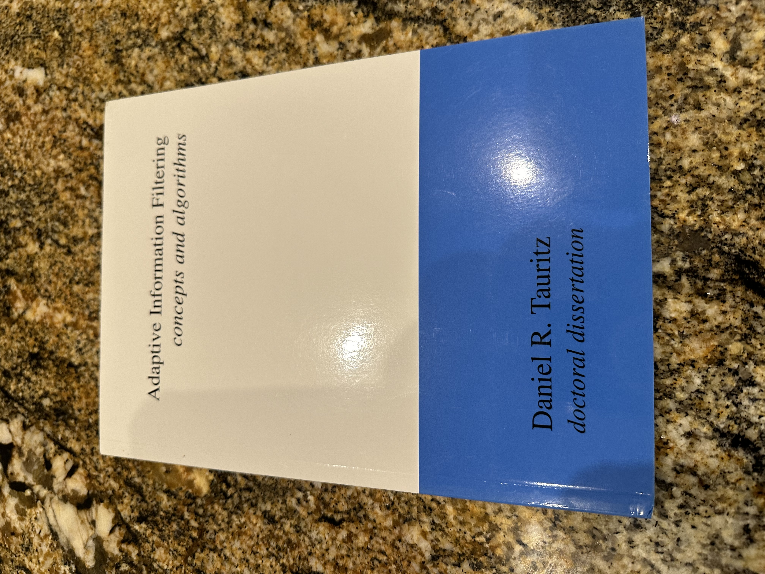

2002: Phd + assistant professor, UMR CS department
University of Missouri – rolla (UMR) became Missouri university of science and technology (Missouri S&T) on January 1, 2008
Natural Computation Laboratory (NC-LAB)

Slide 8
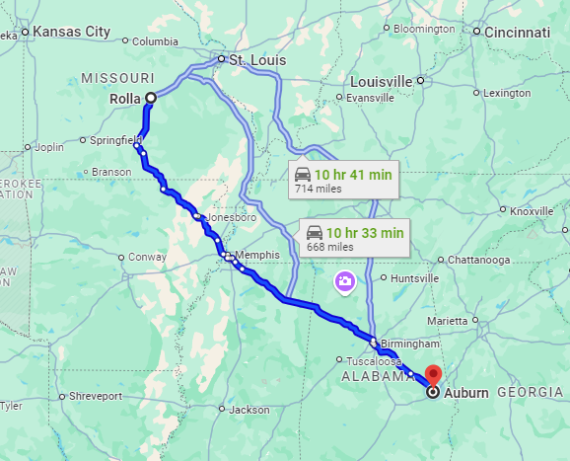
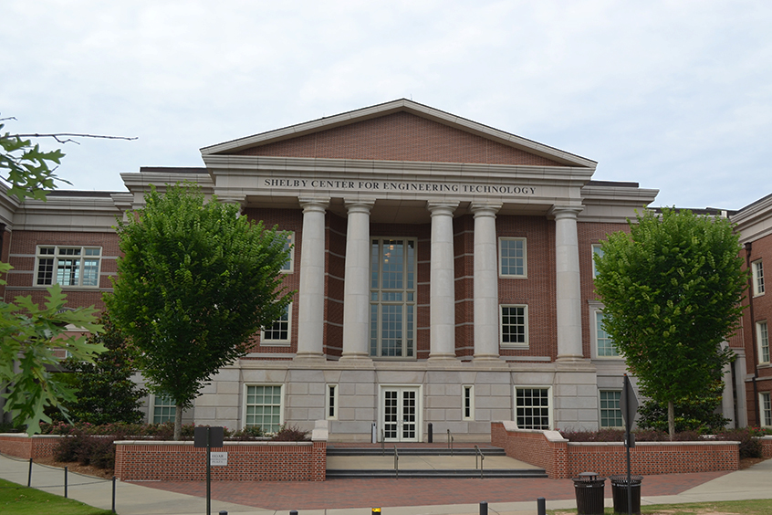
2019: Dr. t moves from S&T to auburn university
Au is one of 187 universities in the nation classified as r1 – very high RESEARCH SpENDING & DOCTORATE PRODUCTION AMONG 3,927 universities (so just 4.76% are R1)

Slide 9
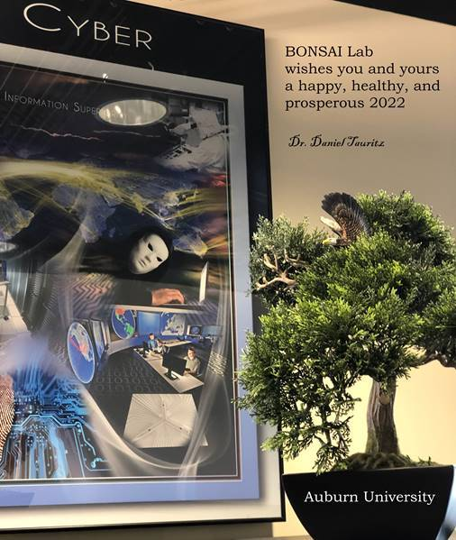
2019: dr. t founds the biomimetic national security artificial intelligence (bonsai) lab

Slide 10
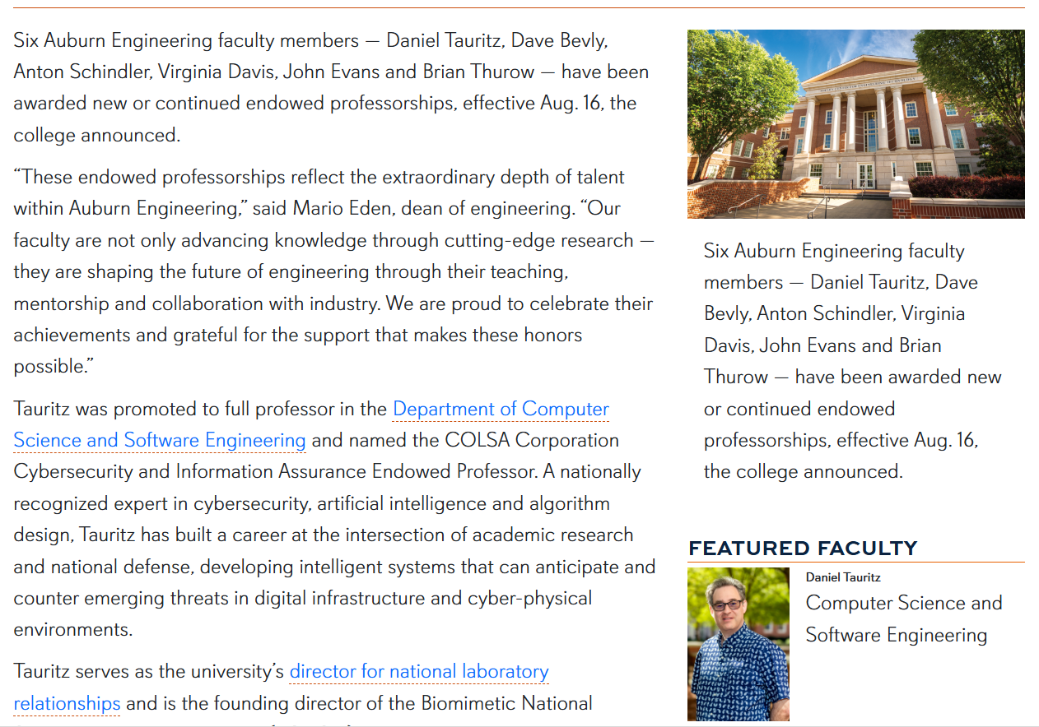
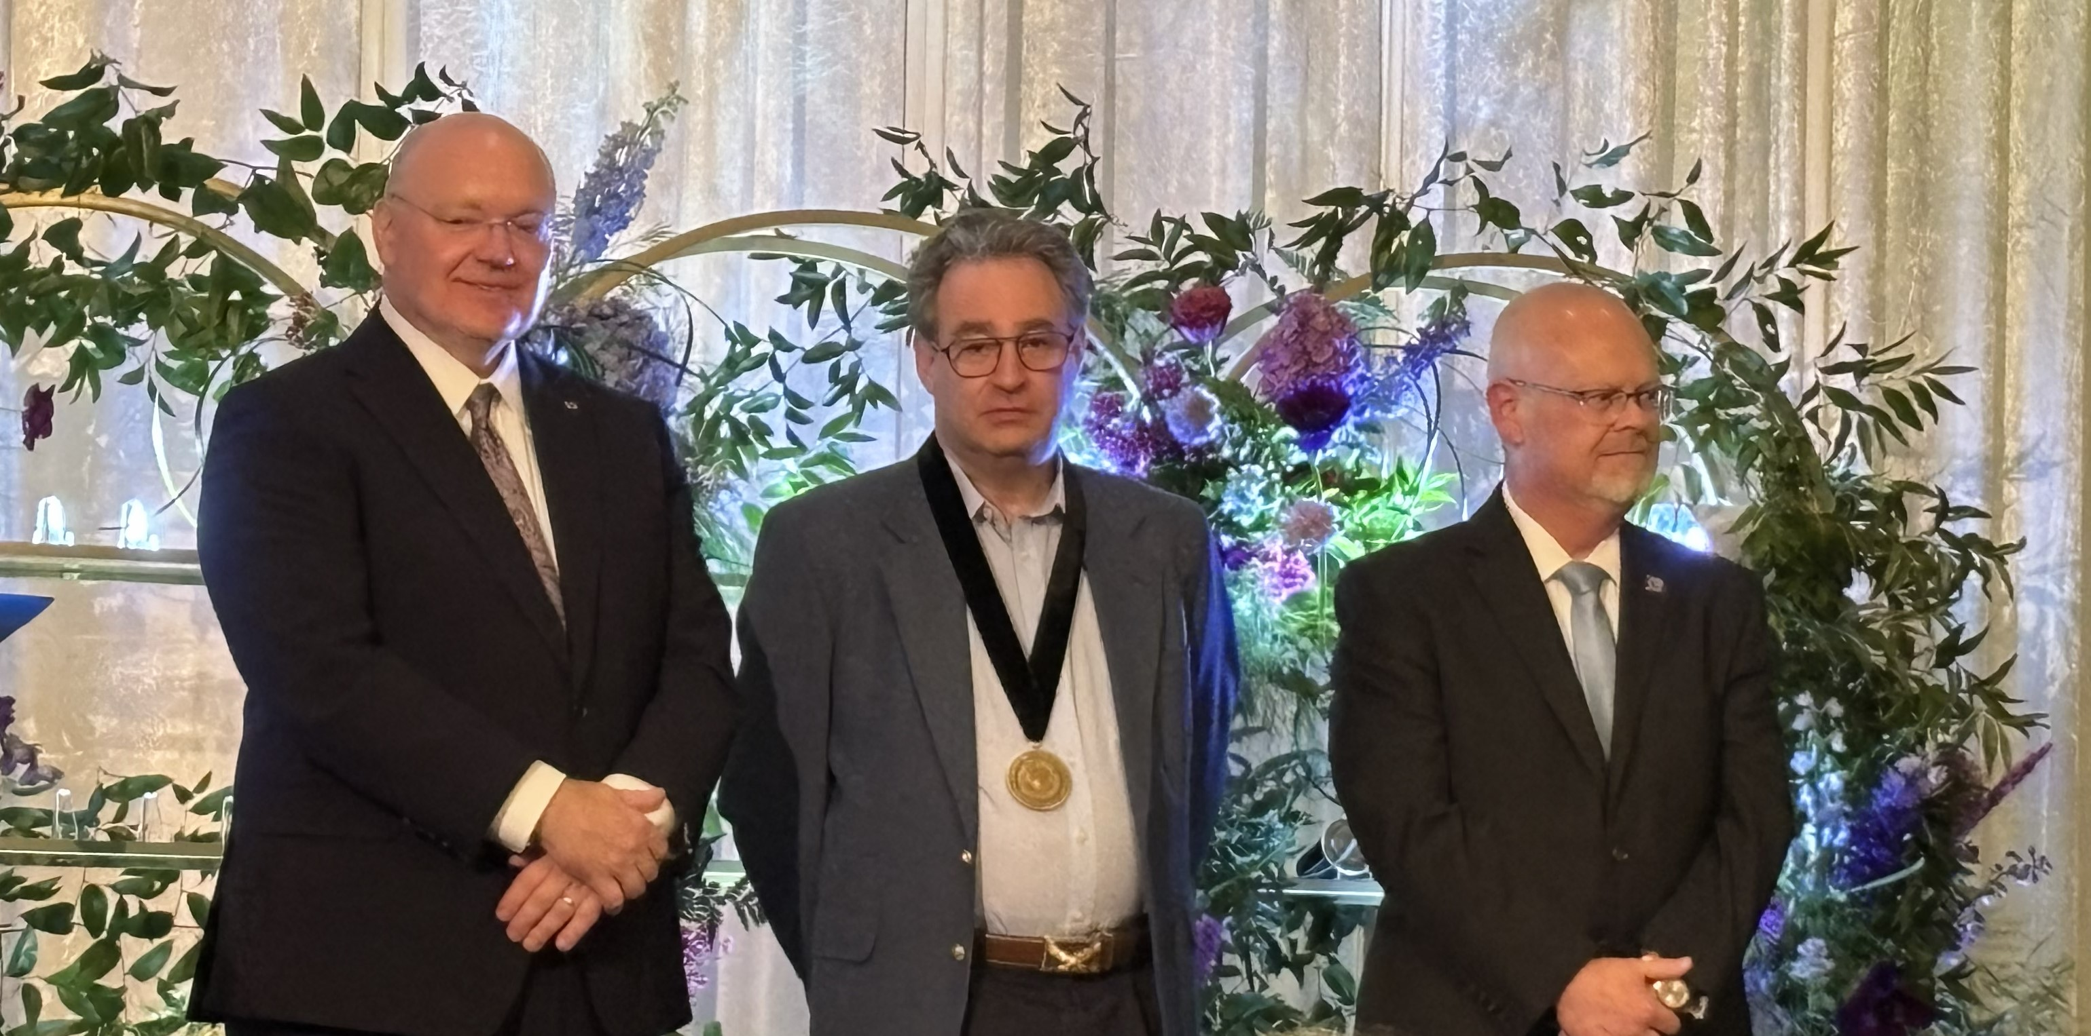
2025: Dr. T promoted to professor & ENDOWED
ENDOWED Professorships are prestigious faculty positions sponsored by a donor

Slide 11

Dr. T’s Many Hats
Who is Dr. T?
Director for National Laboratory Relationships (DNLR)
COLSA Corporation Cyber Security and Information Assurance Endowed Professor
Director, Biomimetic National Security Artificial Intelligence Laboratory (BONSAI Lab)
Head, Biomimetic Artificial Intelligence Research Group (BioAI Group)
Department of Computer Science and Software Engineering (CSSE)
Samuel Ginn College of Engineering (SGCOE)
Auburn University (AU)
Contract Scientist, Los Alamos National Laboratory (LANL)
Cyber Consultant, Department 09373 – Cyber Security Initiatives, Sandia National Laboratories (SNL)

Slide 12
Dr. T’s primary research foci
EC is nature’s algorithm
Computational Game Theory employing Co-Evolutionary Algorithms for identifying high-consequence adversarial strategies and corresponding defense strategies
Hyper-heuristics employing Evolutionary Computation for the Automated Design of Algorithms tailored for high-performance on targeted problem classes
Evolutionary Algorithms for Simulating Molecular Evolution (EASME)

Slide 13
Course motivation
"Begin at the beginning," the King said, very gravely, "and go on till you come to the end: then stop.“ – Alice’s adventures in wonderland
Why students typically take this course
  Interest in evolutionary computing
  Need an AI elective
  Fits class schedule
  Liked previous Dr. T class
Additional reasons to take this course
  Become a better computer scientist
  Become a better programmer

Slide 14
Course overview
"If you don't know where you are going, any road will get you there.“ – alice in wonderland
Course platforms:
  Canvas
  World Wide Web
  Discord
  GitHub+Classroom 50
Syllabus
Schedule
Textbook

Slide 15
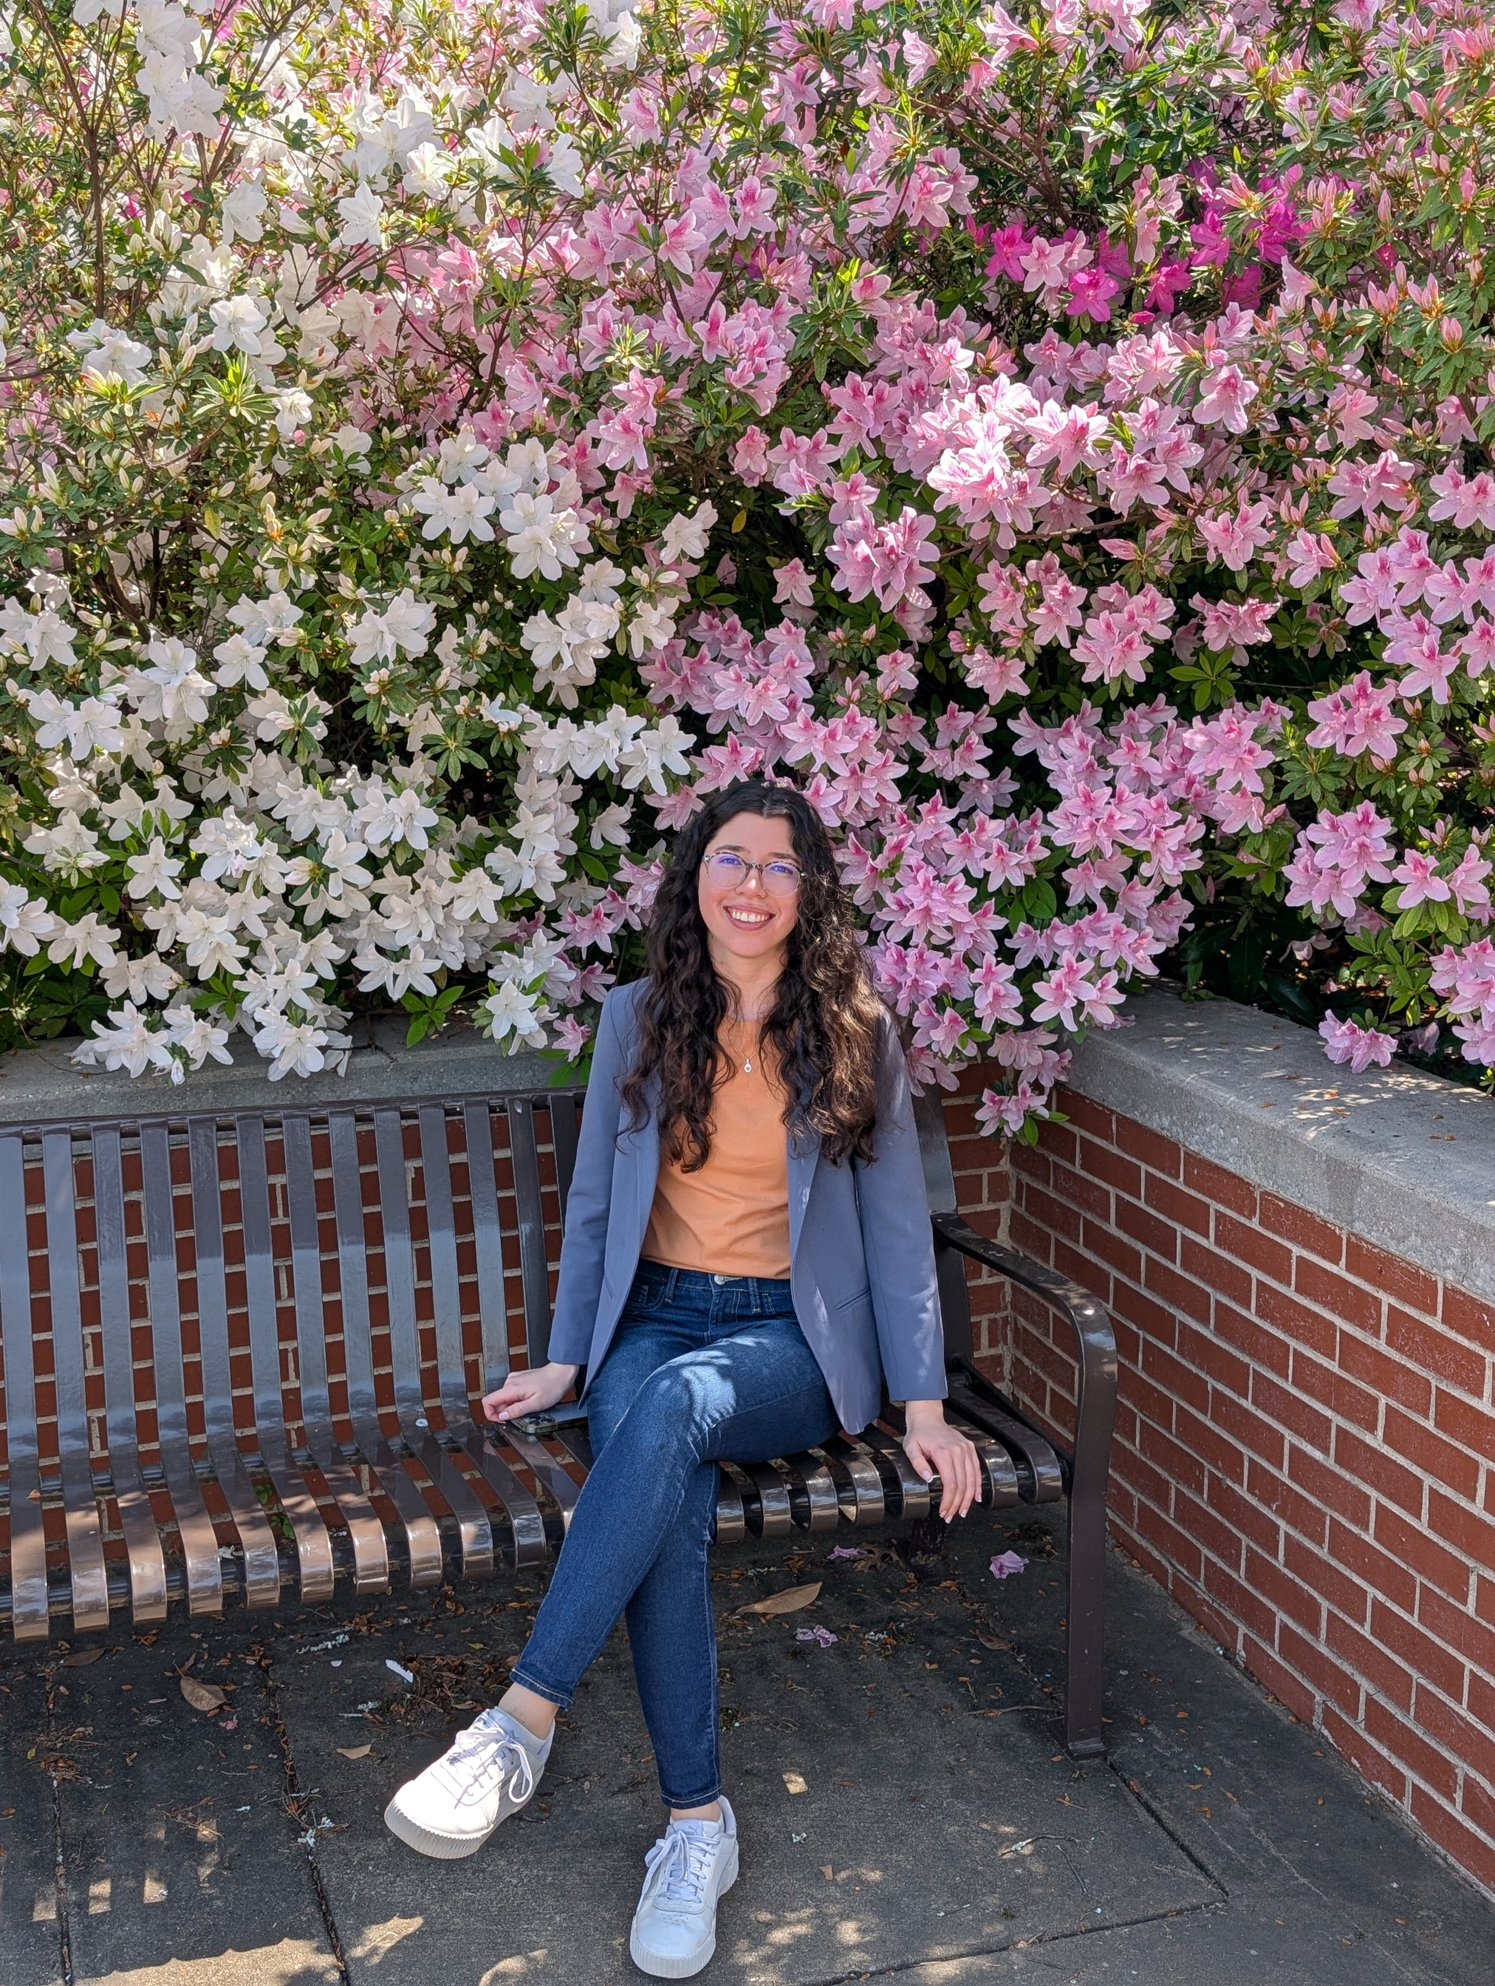
TA introduction
"Would you tell me, please, which way I ought to go from here?“ – alice in wonderland
María Victoria Liendro
Fall 2026 TA
First time COMP 5660/6660 TA
PhD student in BioAI Lab on EASME project

Slide 16
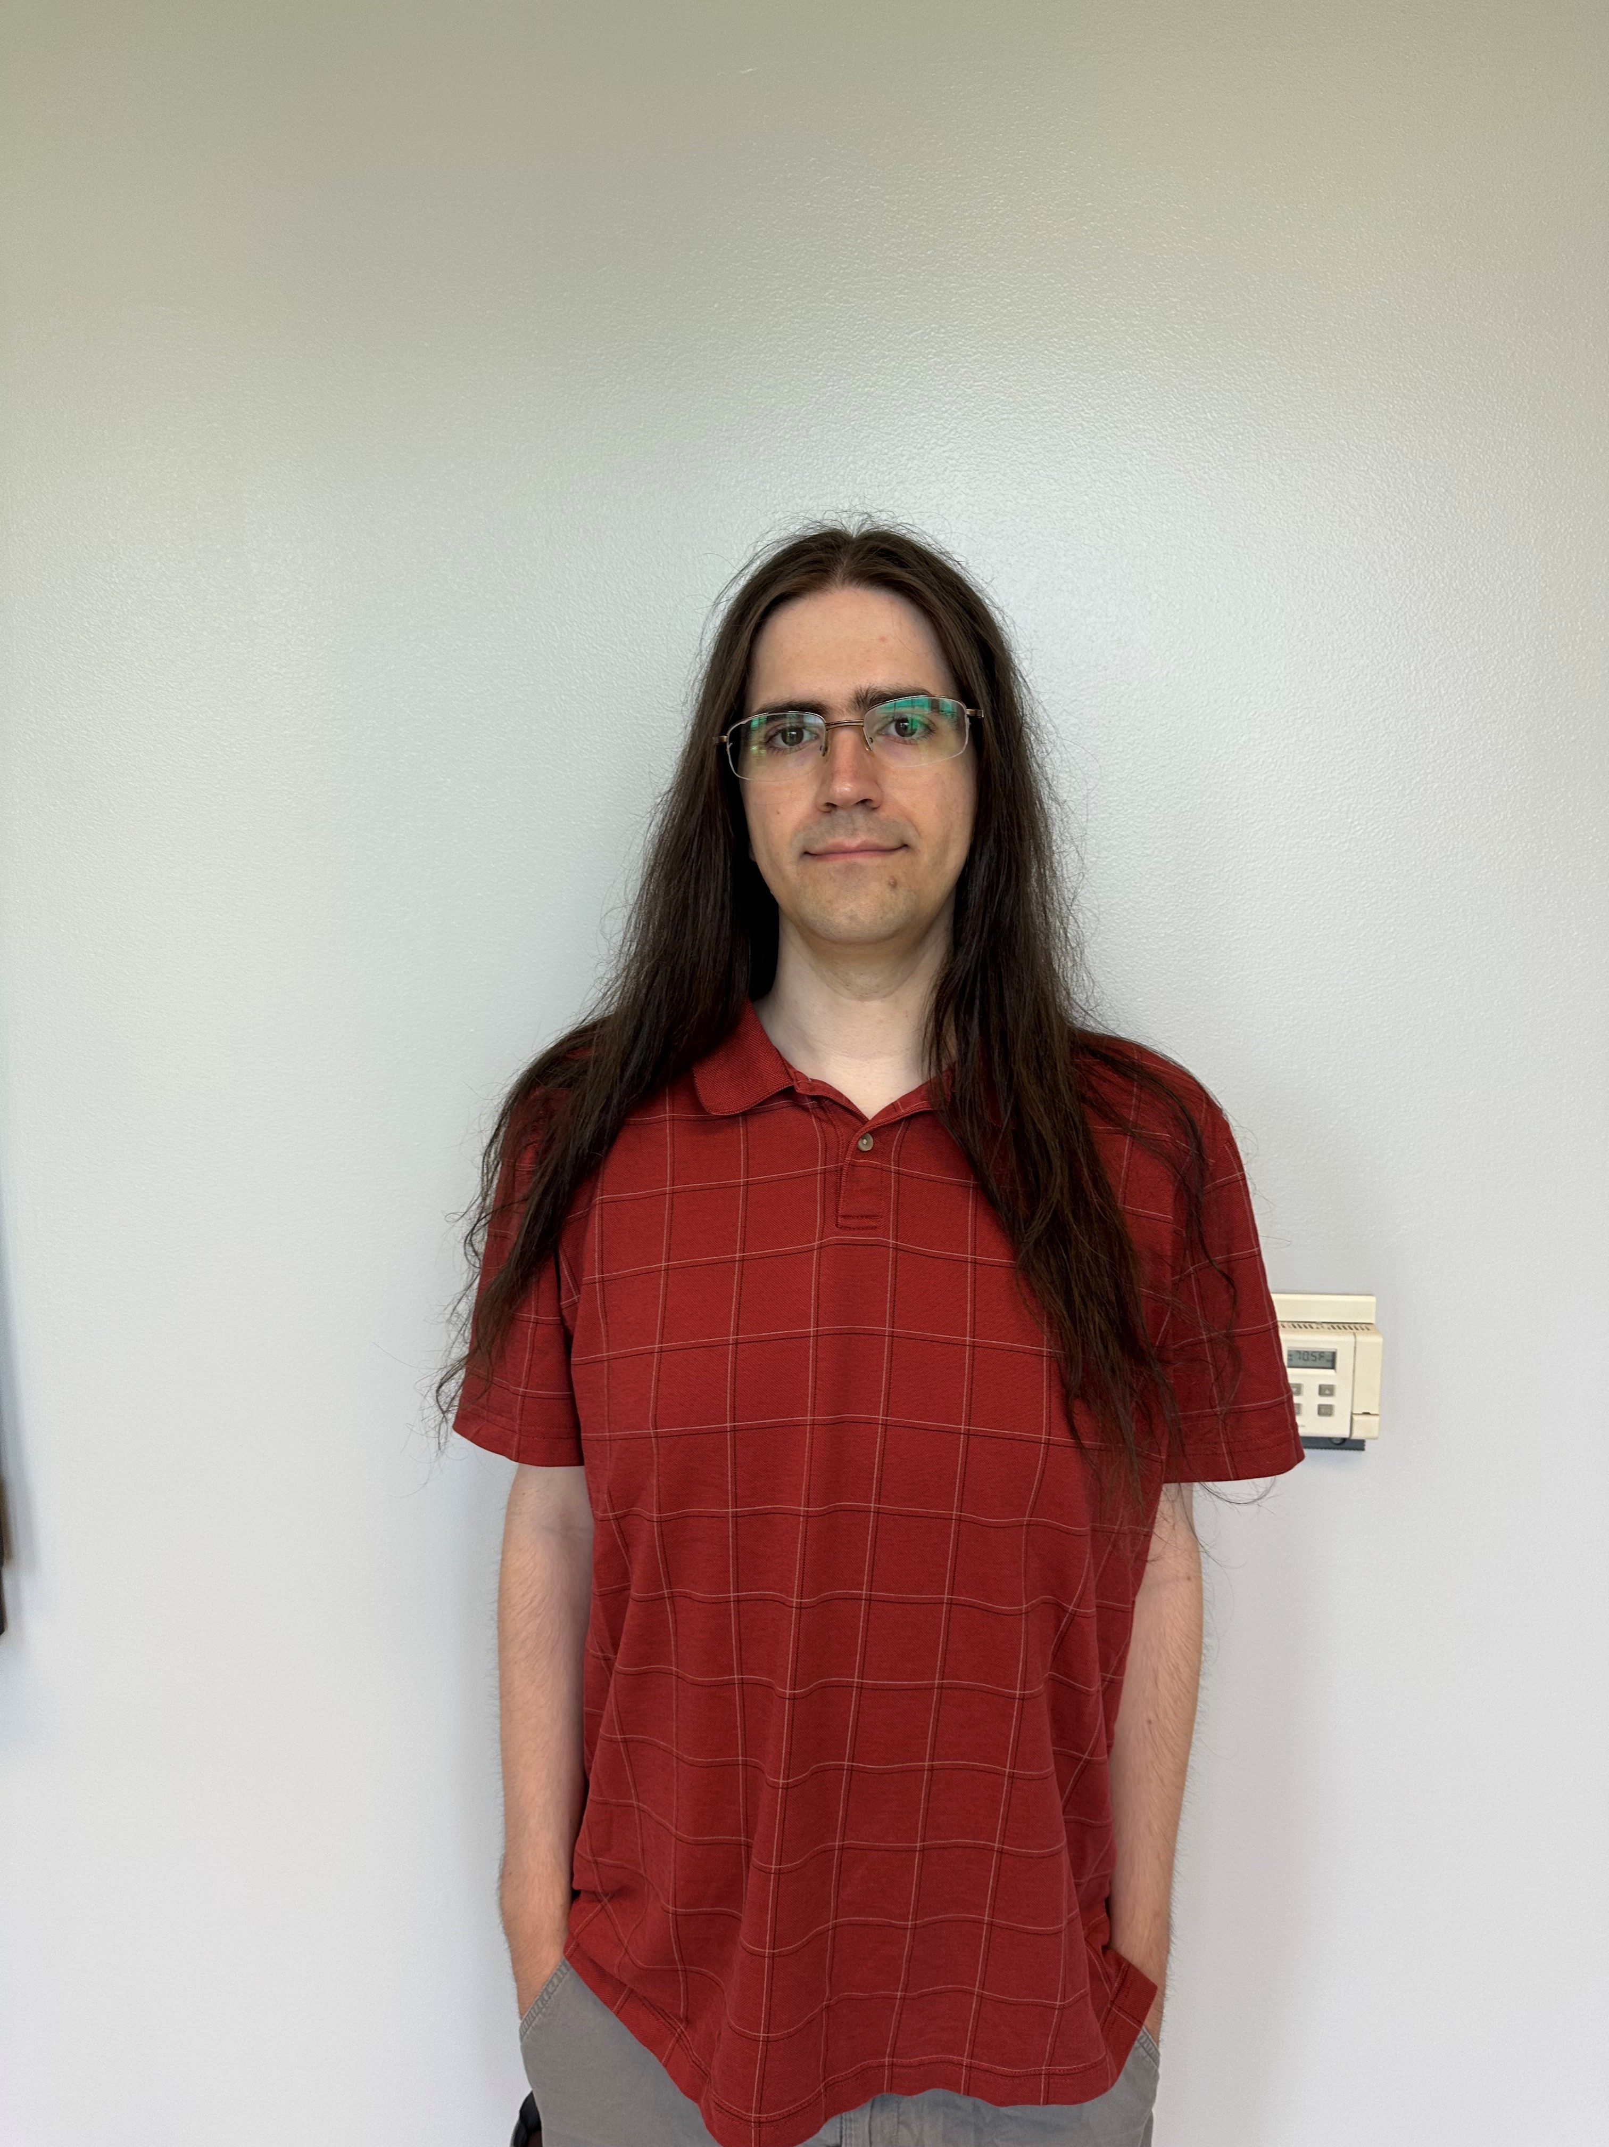
TA introduction
"Would you tell me, please, which way I ought to go from here?“ – alice in wonderland
Sean Harris
Fall 2026 TA
COMP 5660/6660 TA since 2019
PhD candidate in BONSAI Lab on Co-Evolutionary Attacker and Defender Strategies (CEADS) and Adversarial Threats to LArge Satellite Networks (ATLAS-N) projects

Slide 17
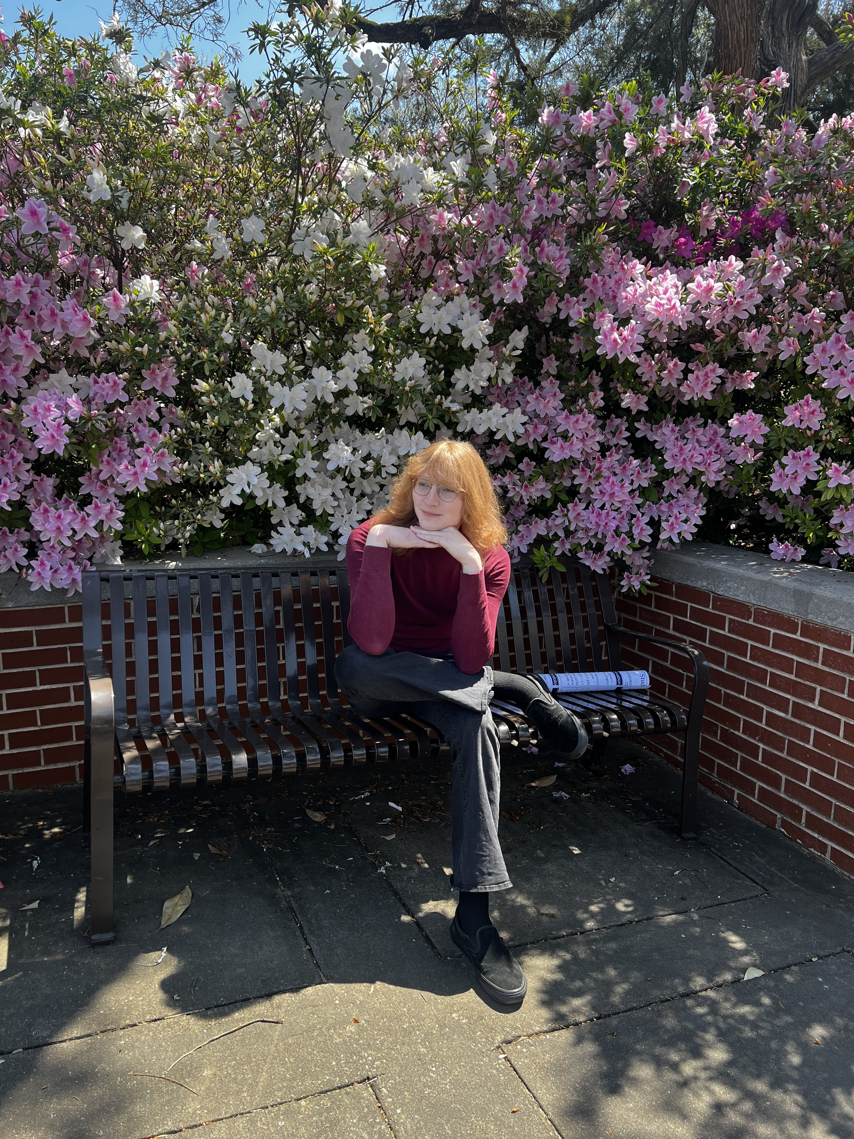
TA introduction
"Would you tell me, please, which way I ought to go from here?“ – alice in wonderland
Ruby Browning
Fall 2026 Lead TA
COMP 5660/6660 TA since 2024
PhD student (almost candidate!) in BioAI Lab on EASME project

