Slide 1
Being smarter than a black-box optimizer:
How to Interpret Results and Tune Intelligently
Presented by Ruby Browning
Written by Braden Tisdale

Slide 2
Your EA is not a black box!
Learn to reason about your EA’s parameters.
Develop an intuition about your EA’s behavior.
Interpret experimental results.

Slide 3
Population Sizes
mu (μ)
  Adult population size
lambda (λ)
  Children per generation
  num_children in the code
1b note: EVALUATIONS ARE NOT GENERATIONS
Balancing exploration vs. exploitation.

Slide 4

Mutation rate
Mutation rate is prob. for each child to be mutated.
  $p∈[0,1]$
  $E\left[mutants\right]=λ∗p$
Mutation necessary for a complete search.
Balancing exploration vs. exploitation.

Slide 5
Selection
Selective pressure
Understand your selection algorithms.
Understand the effect of k.
Balancing exploration vs. exploitation.

Slide 6
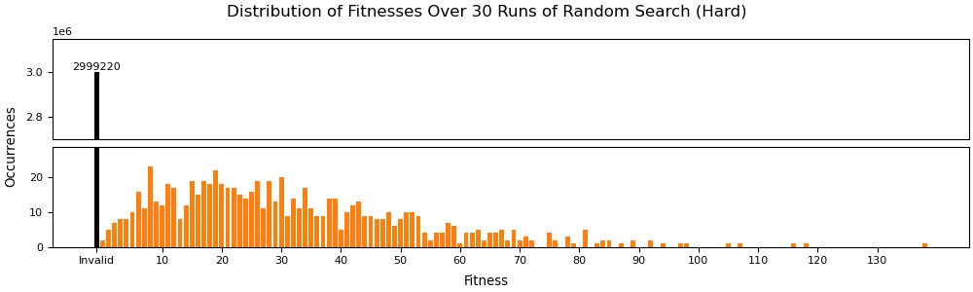
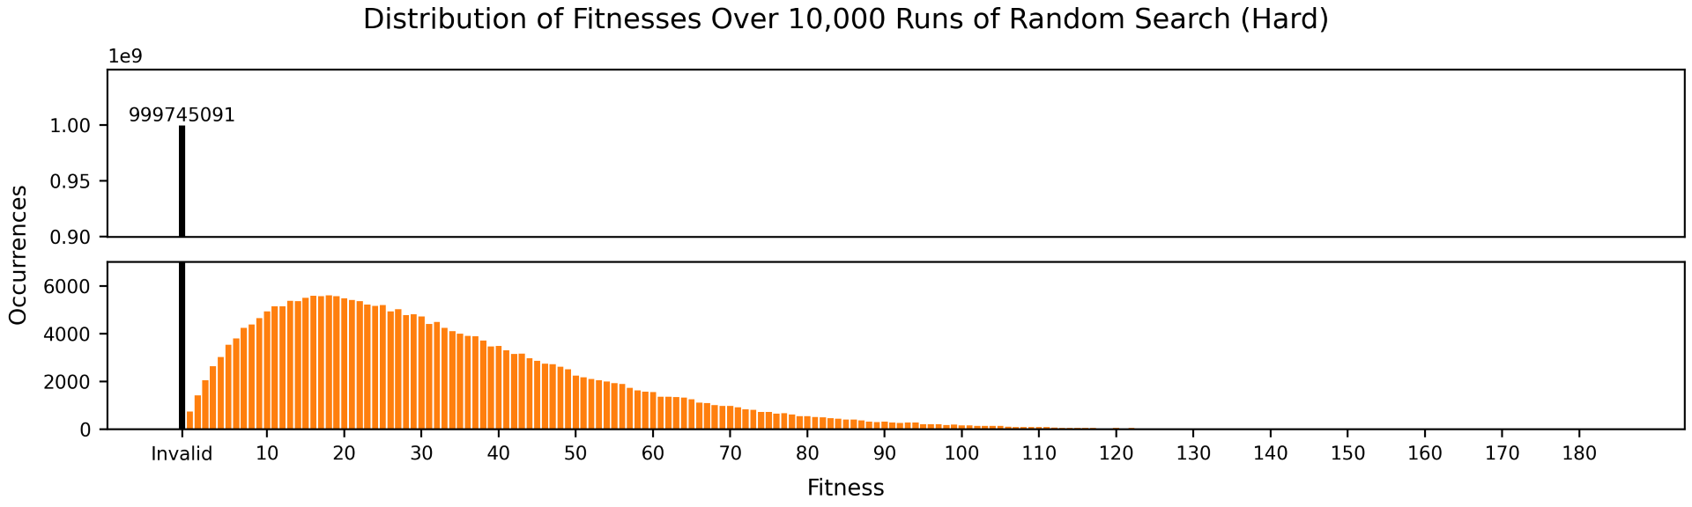
Stochasticity & Noise

Slide 7
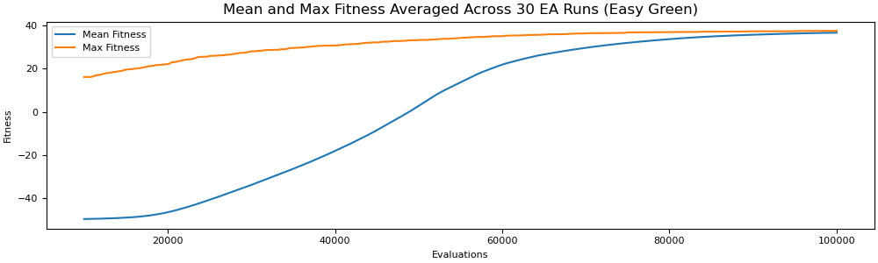
Evals-vs-Fitness Plots

Slide 8
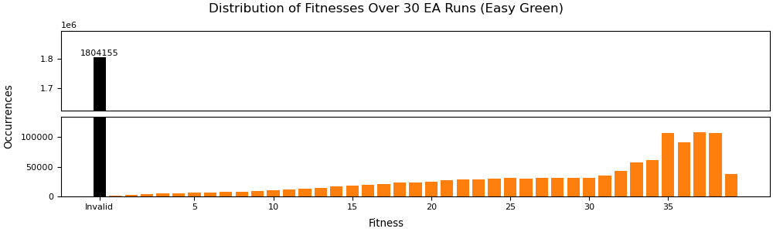
Fitness Histograms

Slide 9
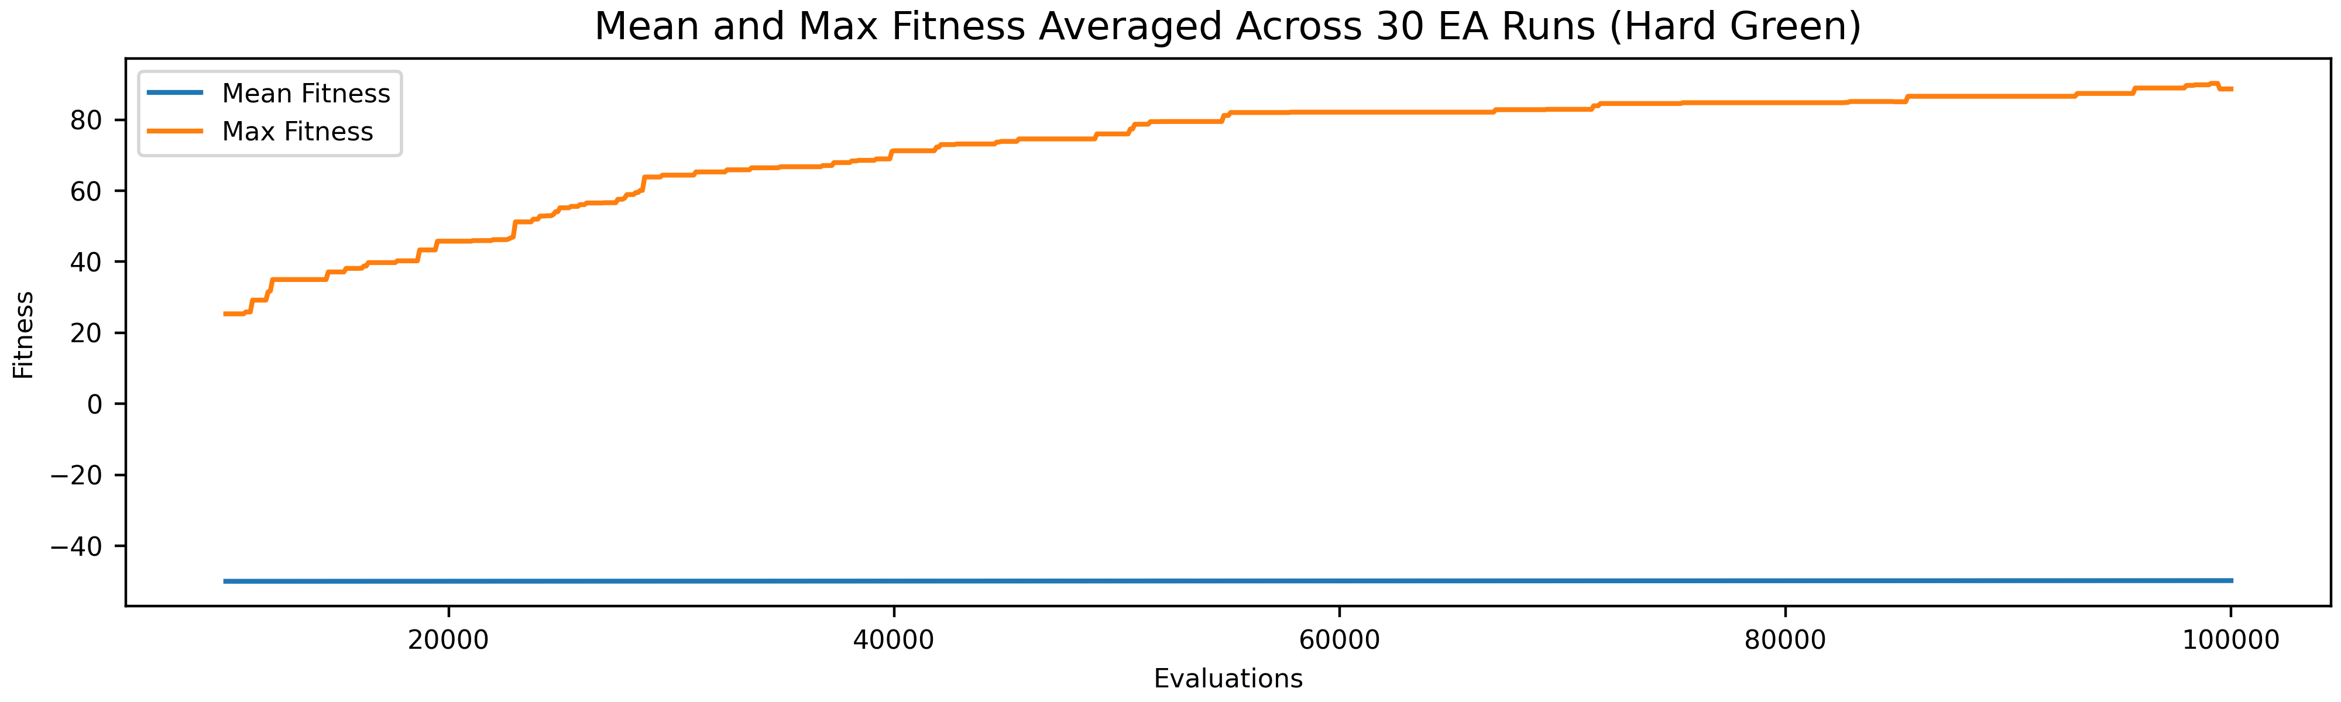
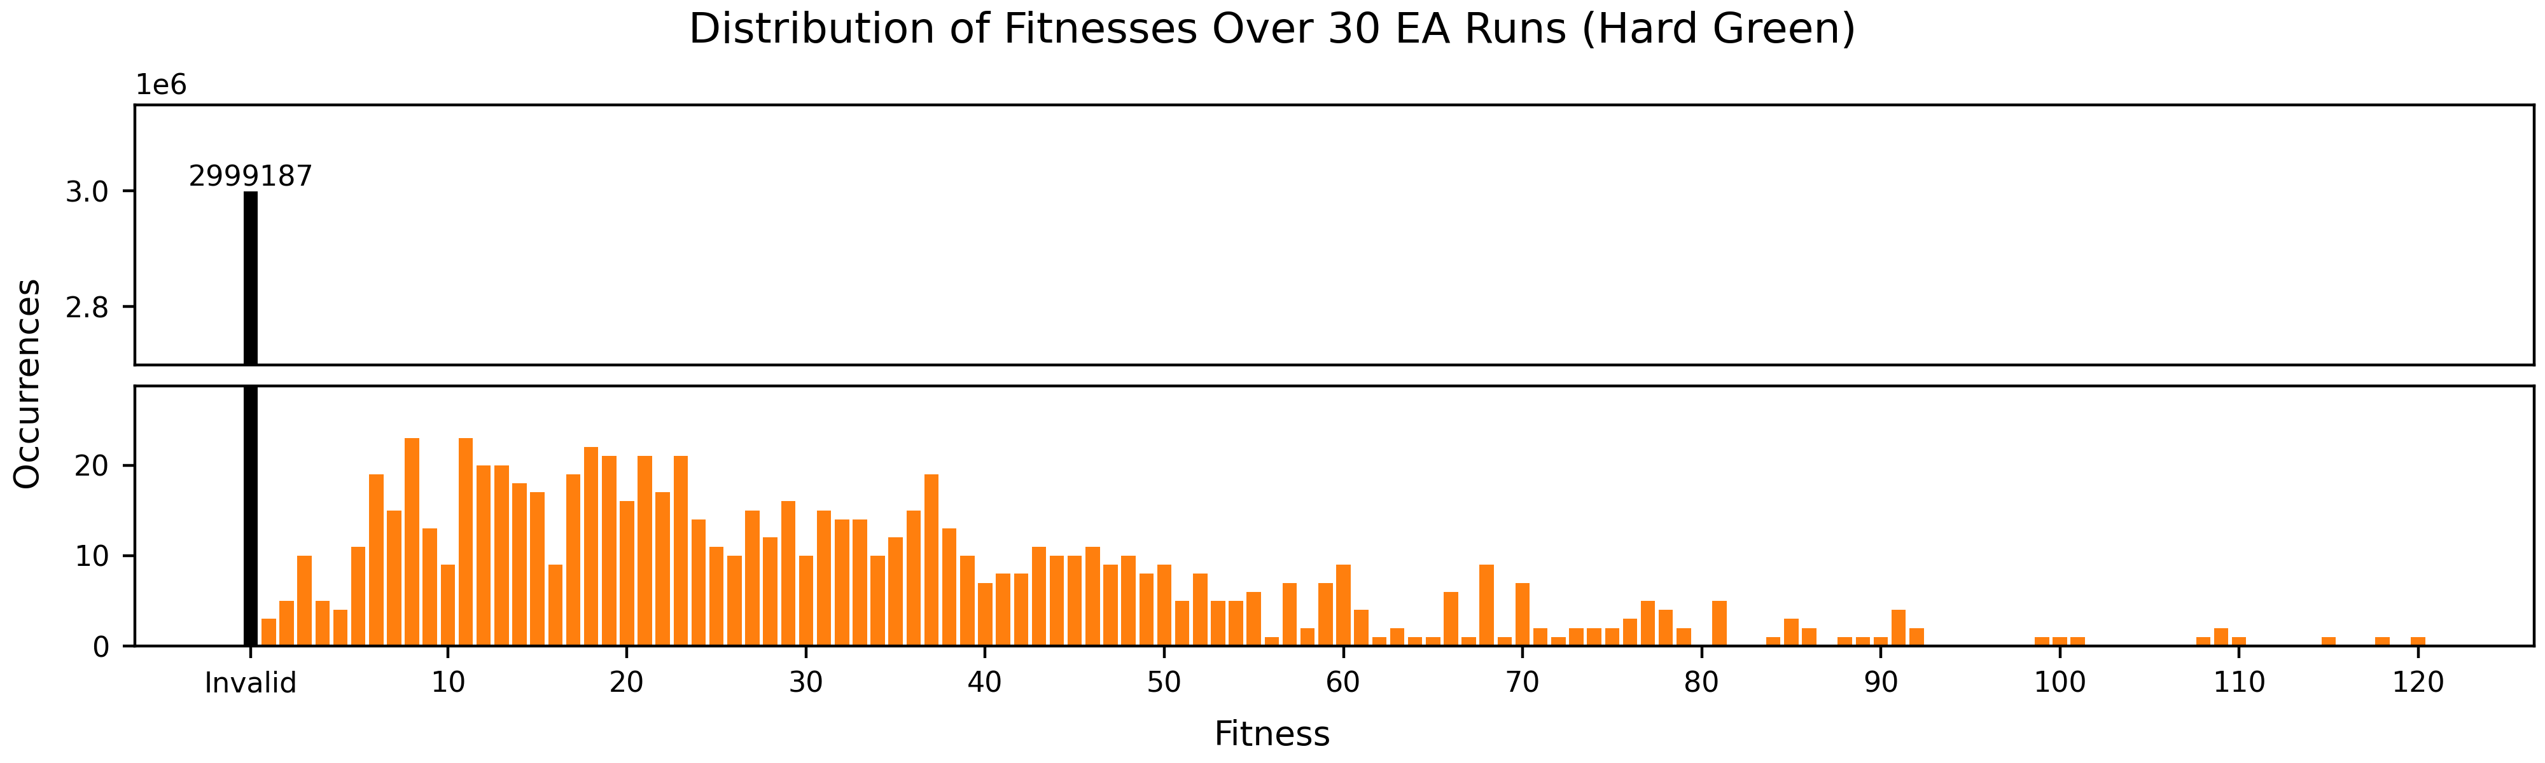
mu = 10,000
num_children = 100
mutation_rate = 1.0
parent_selection = uniform_random_selection
survival_selection = k_tournament_without_replacement
  k = 2

Slide 10
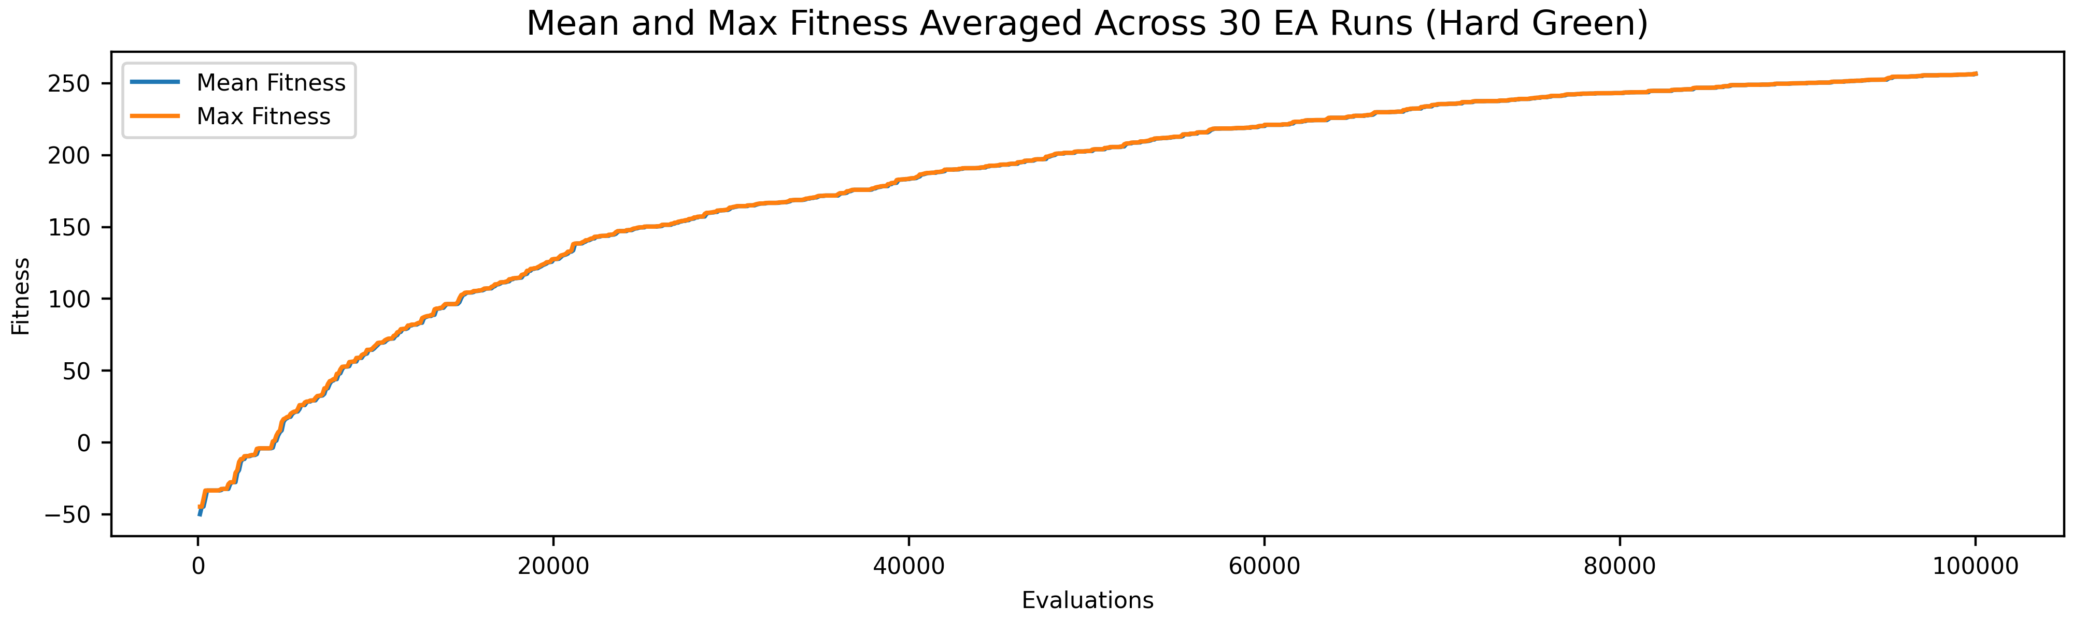
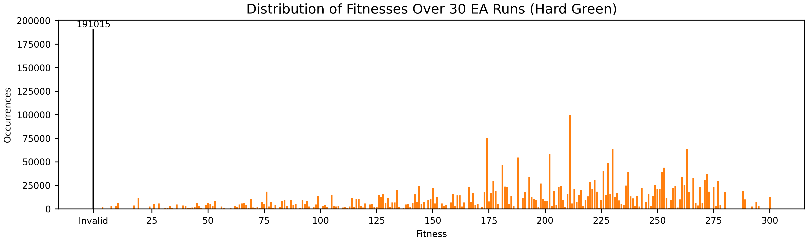
mu = 100
num_children = 100
mutation_rate = 0.01
parent_selection = k_tournament_with_replacement
  k = 100
survival_selection = truncation

