Slide 1
Introduction to Neuroevolution
Slides originally by Deacon Seals
Presented today by James Browning and Sean Harris

Slide 2
Disclaimer
You could make an entire course on neuroevolution.
This is not our direct area of expertise.
There are multiple generations of research on neuroevolution.
There are many tangential research areas that relate to and sometimes intermingle with neuroevolution.
Due to the success of deep learning, neuroevolution appears to be booming in the EC community.
Many great examples of up-and-coming researchers.
Hybridizing deep learning and EC.
Discovering new areas where EC can offer novel contributions.

Slide 3
What is Neuroevolution?
The application of evolutionary algorithms to tune the numerical parameters within a neural network.
Some of these techniques also involve autonomous design of the network topology.
Many of these algorithms originated for generic numerical optimization tasks.
Architecture search algorithms may explore topology space and leave network tuning to other algorithms.
E.g., training with deep learning
This is distinct from neuroevolution (as far as we know).

Slide 4
Agenda
A Brief Intro to Neural Networks
Neuroevolution
Comparison with Deep Learning
Simple GA/ES
CMA-ES
NEAT
Quality Diversity
MAP-Elites

Slide 5
A Brief Intro to Neural Networks
(Non-exhaustive!)

Slide 6
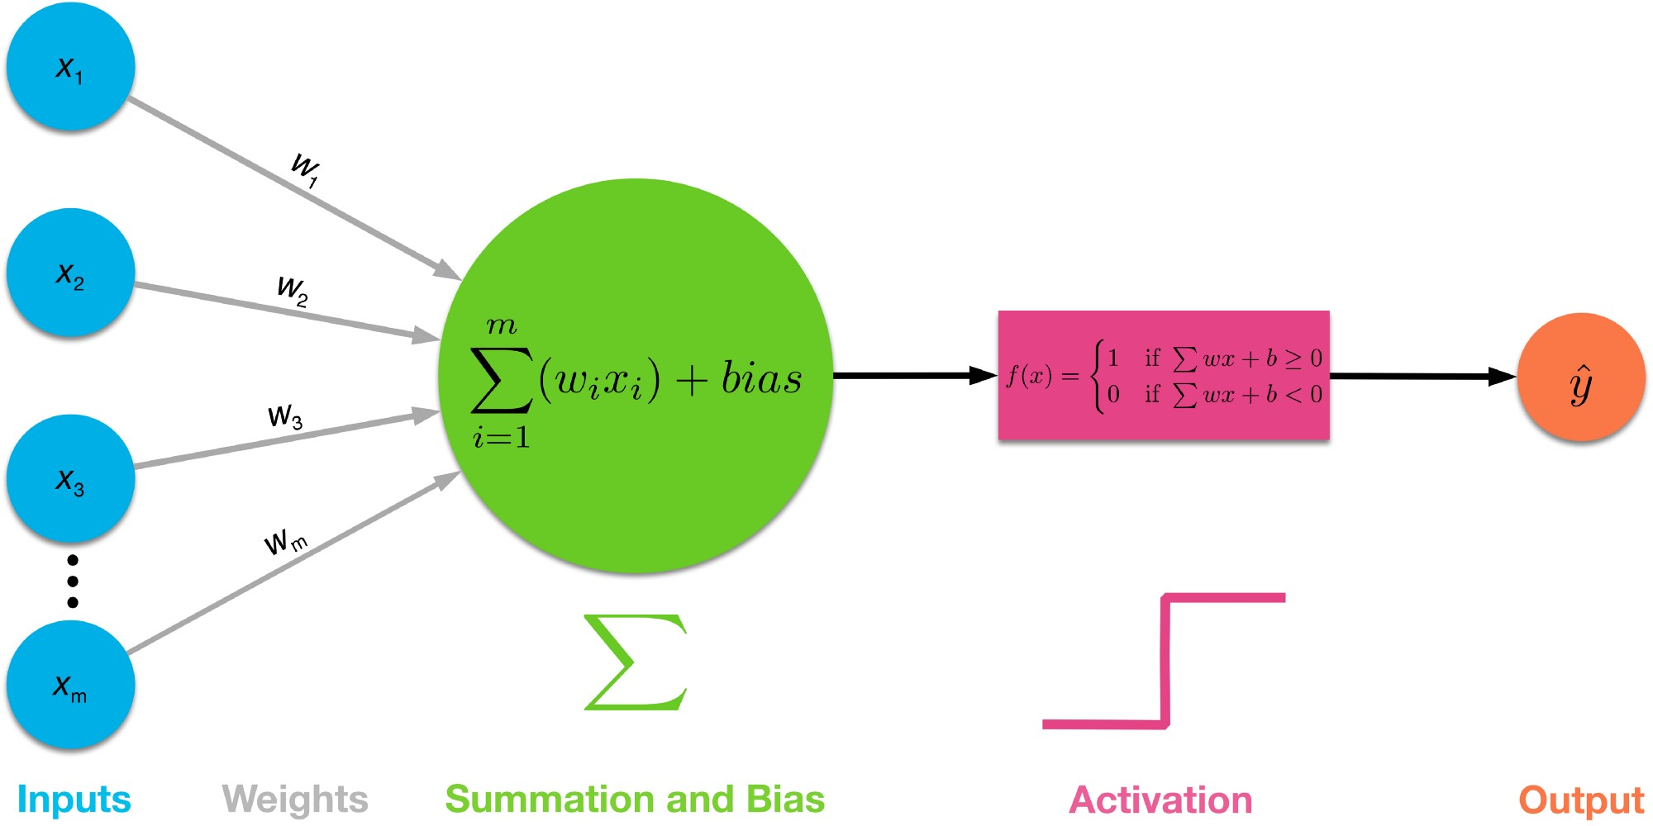
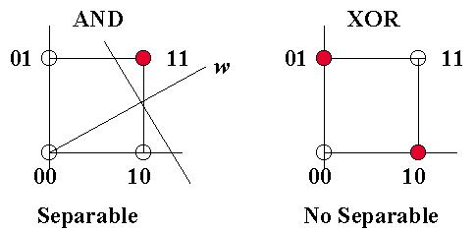
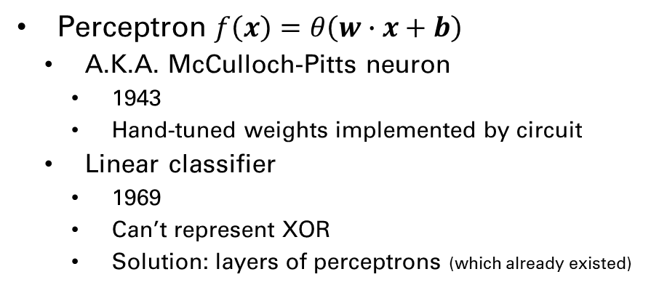
Brief History
Perceptron $f\left(x\right)=θ\left(w∙x+b\right)$
A.K.A. McCulloch-Pitts neuron
1943
Hand-tuned weights implemented by circuit
Linear classifier
1969
Can’t represent XOR
Solution: layers of perceptrons (which already existed)
This Photo by Unknown Author is licensed under CC BY-SA
This Photo by Unknown Author is licensed under CC BY-SA-NC

Slide 7
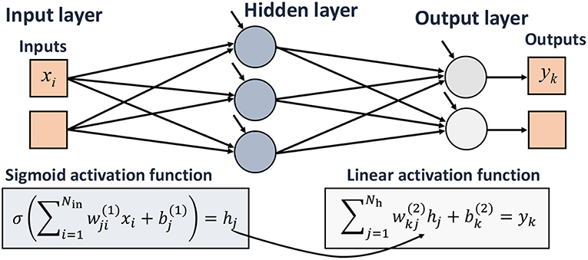
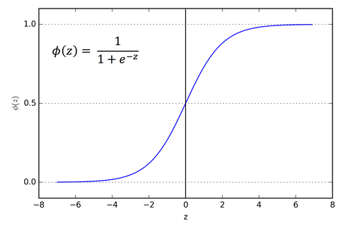
Brief History
Multi-layer Perceptron (MLP)
A.K.A. Dense Neural Network
1958 - Frank Rosenblatt
Also introduced learnable weights and threshold
Eventually incorporated nonlinear activation functions
1986 – Rumelhart, Hinton, Williams
Modern gradient-based tuning
Use chain rule to backpropagate though nonlinear activation functions
This Photo by Unknown Author is licensed under CC BY
This Photo by Unknown Author is licensed under CC BY-SA

Slide 8
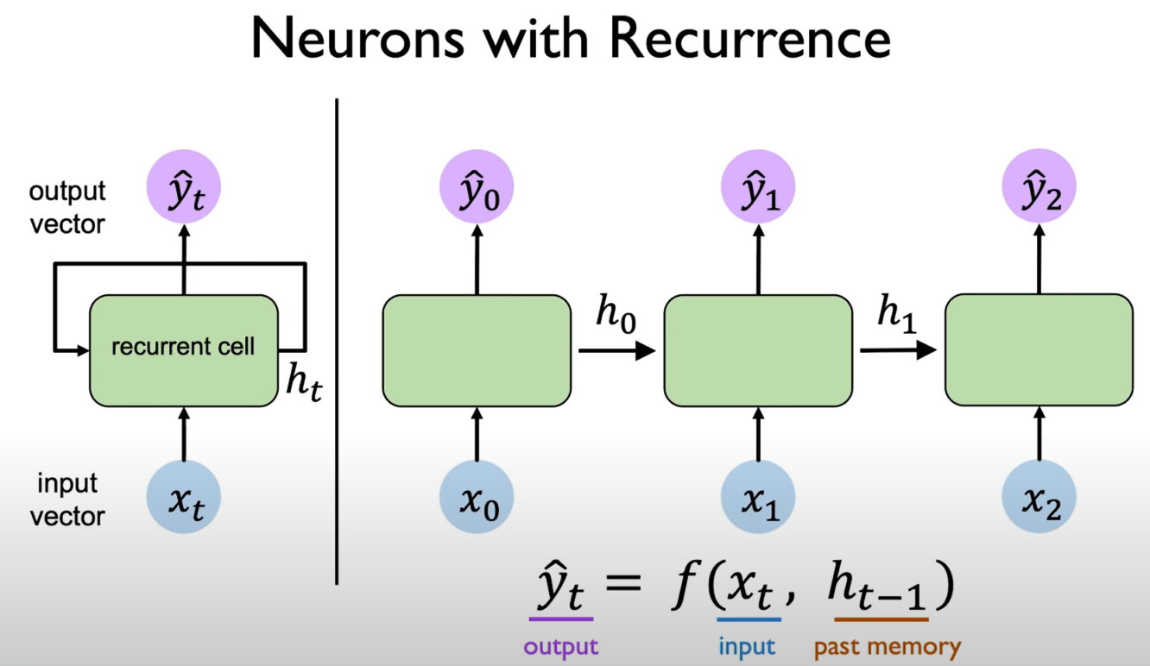
Brief History
Recurrent Neural Network (RNN)
Provides memory to networks
Starts with a state of all zeros
Outputs new state which is fed back in
1997 – Long short-term memory (LSTM)
Hochreiter and Schmidhuber
Not the first, but the most famous.
This Photo by Unknown Author is licensed under CC BY-SA

Slide 9
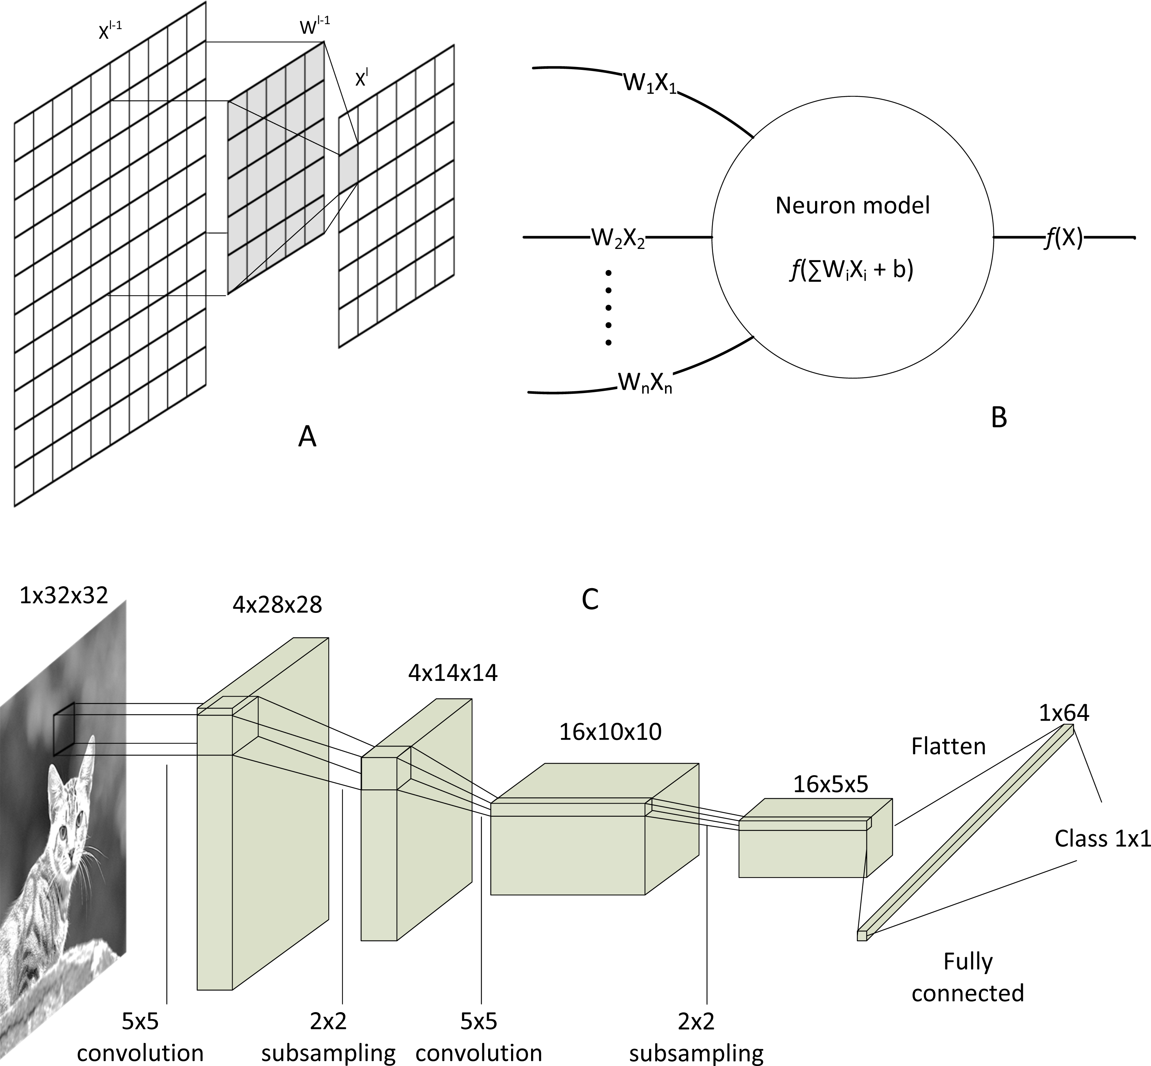
Brief History
Convolutional Neural Network (CNN)
Slides a filter of weights about a 2D input.
Generates a subsampled 2D output (i.e., smaller 2D output unless filter is 1x1).
Multiple filters may be used, and the 2D output of each are stacked to a 3D output.
Outputs typically flattened to 1 dimension and passed through dense layer.
Popularized by LeNet.
1995 – LeCun et al.
This Photo by Unknown Author is licensed under CC BY

Slide 10
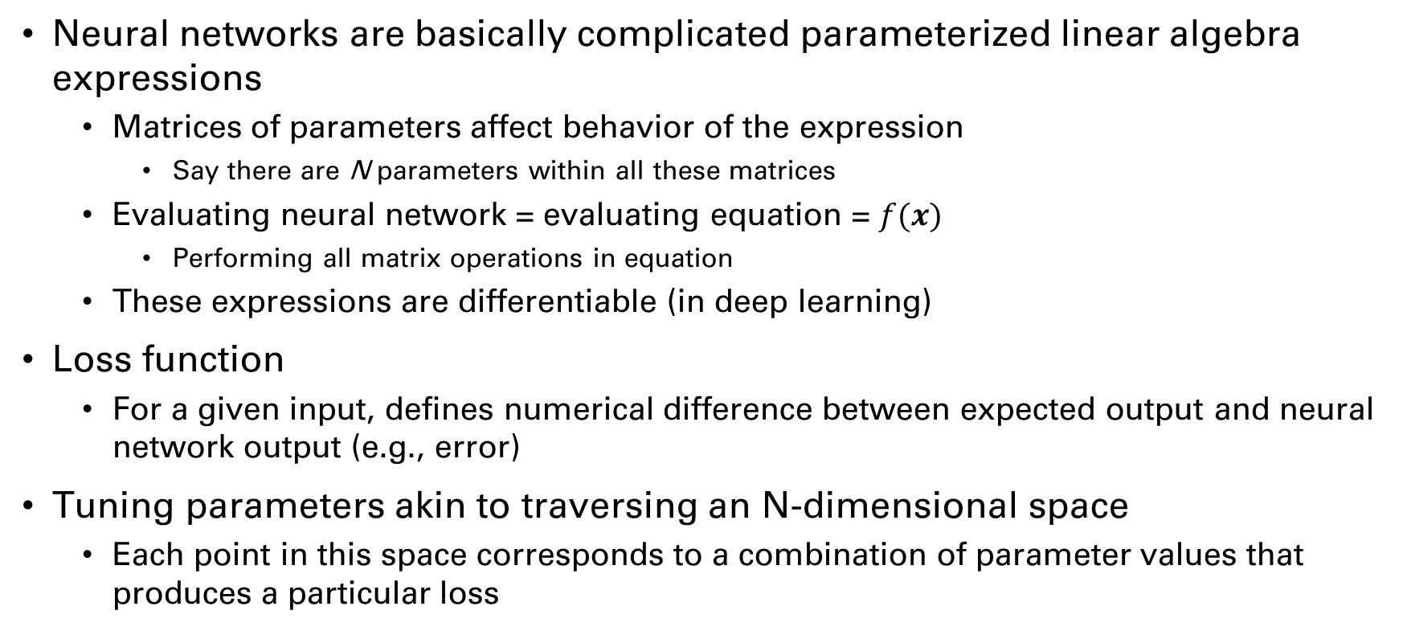
Deep Learning TL;DR
Neural networks are basically complicated parameterized linear algebra expressions
Matrices of parameters affect behavior of the expression
Say there are N parameters within all these matrices
Evaluating neural network = evaluating equation = $f(x)$
Performing all matrix operations in equation
These expressions are differentiable (in deep learning)
Loss function
For a given input, defines numerical difference between expected output and neural network output (e.g., error)
Tuning parameters akin to traversing an N-dimensional space
Each point in this space corresponds to a combination of parameter values that produces a particular loss

Slide 11
Deep Learning TL;DR
Backpropagation
Partial derivative of loss function w.r.t. network parameters
Broken down to smaller, easier problems via chain rule
Computes a gradient w.r.t. constants in neural network
Like calculating the slope of a curve, but in N-dimensional space
Gradient contains a value for every network parameter
Basically, an N-dimensional heading/direction that causes an increase of the loss function
This direction does not have a magnitude, so we multiply it by some step size
Update parameters by adding or subtracting gradient
Subtract for gradient descent (minimize loss/error)
Add for gradient ascent (maximize loss/reward)

Slide 12
Notable Additional Events
2013 – AlexNet demonstrates GPU training
Drastically improved performance on image classification task afforded by efficient training
Deep learning wins the “hardware lottery”
Kickstarts current AI boom
2017 – Transformer networks
Uses attention mechanism to replace memory
Outperforms LSTMs on most applicable tasks
Benefits from gradient-based optimization more than RNNs
Revolutionizes natural language processing (NLP)
E.g., foundation of ChatGPT
GPT: generative pre-trained transformer

Slide 13
Fine Points
Neural networks consist of numerical parameters which can be tuned
Deep learning is a gradient-based tuning approach
Neuroevolution is a gradient-free tuning approach
Architectural advances to neural networks are directly impactful to neuroevolution
The use of dense, CNN, and LSTM components
Some of these advances are biased towards deep learning methods
E.g., transformers make more effective use of backpropagation than LSTMs
Transformers may still lend themselves to neuroevolution though

Slide 14
Neuroevolution

Slide 15
Comparison With Deep Learning
Deep Learning
Neuroevolution
Requires differentiability of all components
Allows for clear indicators of search direction
Requires differentiable loss or reward functions
Can optimize during multi-step tasks (e.g., games)
Does not require differentiability
Enables non-differentiable network components
Spiking neural networks
Allows for non-differentiable problems
Meaningfully more flexible
Requires many full episodes of multi-step tasks (e.g., games)

Slide 16
Comparison With Deep Learning
Deep Learning
Neuroevolution
Explicitly calculates a performance gradient
Cannot tolerate discontinuities
Uses hill-climbing-like gradient traversal algorithms
Benefits from making gradient smoother
Incorporates mechanisms to leave local optima
Optimizes about an implicit search gradient
Still stumbles with deceptive fitness landscapes
E.g., discontinuities
Meaningfully less sample efficient on many problems
I.e., requires more fitness evaluations than deep learning
Can operate on arbitrary non-binary performance metrics

Slide 17
Simple GA/ES
Linear genotype of floats
Translated into more complex geometries based on network architecture at evaluation time
Mutation only variation operators
Gaussian noise is very common
Genetic Algorithm (GA)
Parent selection to form a child pool
Some sort of survival selection
Evolutionary Strategy (ES)
Most or all individuals generate a child
Child directly replaces their parent if better
Common in competitive coevolution
μ+λ: steady-state model
μ,λ: generational model
μ*λ

Slide 18
CMA-ES
Covariance Matrix Adaptation Evolutionary Strategy
Covariance matrix describes variances between dimensions in a multivariate normal distribution
Does not adhere to typical EA loop
Uses ask-eval-tell loop instead
Does not adhere to typical EA population-based search
Population is generational
Children are not directly created from parents
Akin to searching for a multivariate normal distribution
Sampling this distribution yields good solutions

Slide 19
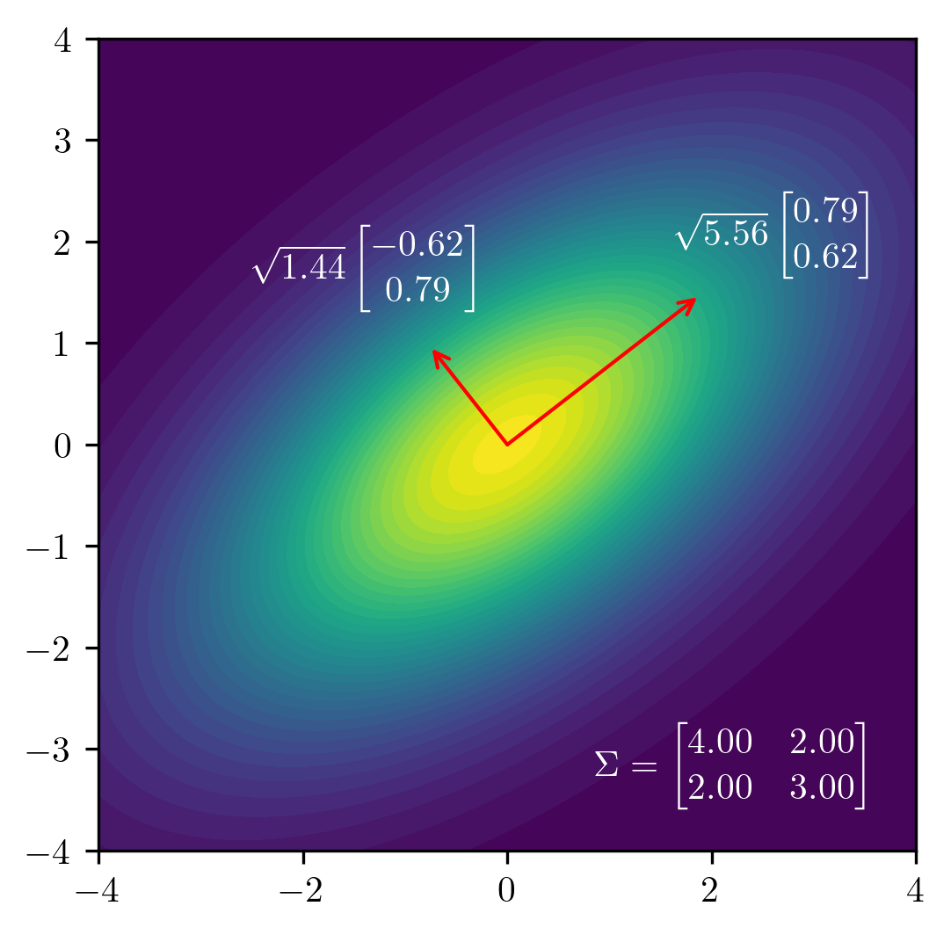
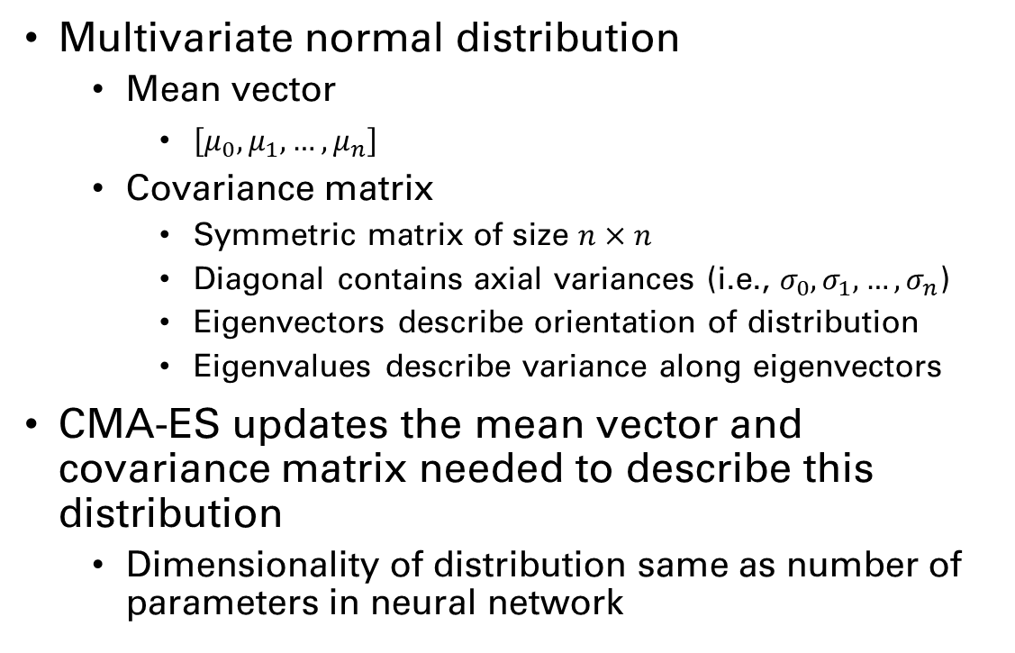
CMA-ES
Multivariate normal distribution
Mean vector
$\left[μ_{0}, μ_{1},…,μ_{n}\right]$
Covariance matrix
Symmetric matrix of size $n×n$
Diagonal contains axial variances (i.e., $σ_{0}, σ_{1},…,σ_{n}$)
Eigenvectors describe orientation of distribution
Eigenvalues describe variance along eigenvectors
CMA-ES updates the mean vector and covariance matrix needed to describe this distribution
Dimensionality of distribution same as number of parameters in neural network
A multivariate normal distribution centered at the origin, displayed with eigenvectors and standard deviations.
Notes:
Image by Sean Harris

Slide 20
CMA-ES
Ask
Randomly sample solutions from multivariate normal distribution
Utilizes covariance matrix and vector of per-dimension means
Eval
Evaluate population of solutions sampled from distribution
Tell
Rank solutions based on performance
Calculate a weighted update to means and covariance matrix based on solution values
Shift distribution towards known good solutions, away from bad

Slide 21
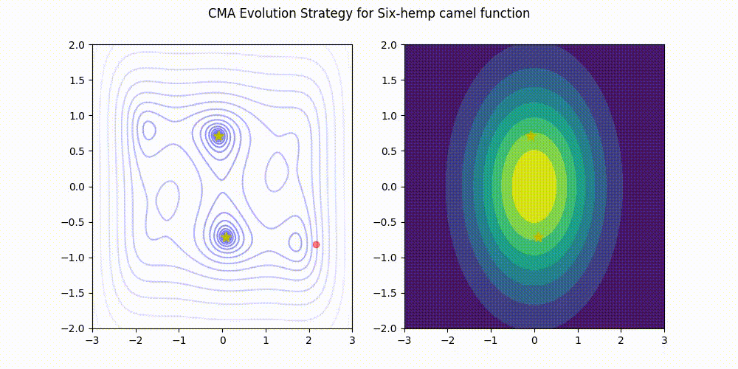
CMA-ES
Image from cmaes : A Simple yet Practical Python Library for CMA-ES by Masahiro Nomura, Masashi Shibata

Slide 22
CMA-ES Population Size
Number of times distribution is sampled each generation
Smaller population -> local search
Most samples near current means
Larger population -> global search
Greater chance of samples farther from current means
Some CMA-ES variants alternate use of large and small population sizes
Use global search until improvement stagnates
Use local search to fine tune on current means until convergence
Double population size from global search step
Repeat

Slide 23
NEAT
Neuroevolution of augmenting topologies
2002 – Kenneth Stanley and Risto Mikkulainen
GA approach
Maintains a persistent population (as opposed to CMA-ES)
Uses a direct encoding scheme
Directly represents every neuron and connection in a neural network
Variations introduced by Mikkulainen, Stanley, and others
Particularly HyperNEAT, which scales NEAT to larger network sizes

Slide 24
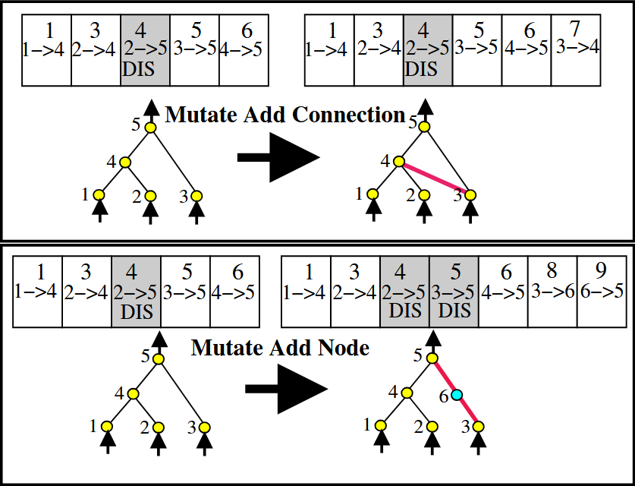
NEAT
Starts with a minimal neural network, only inputs/outputs
Mutation can:
Adjust connection weights
Disable or re-enable a connection
Add a new node
Add a new connection
Crossover of homologous structures, tracking phylogeny
Explicit speciation and fitness sharing
Image from Efficient Evolution of Neural Network Topologies by Kenneth O. Stanley and Risto Miikkulainen
Notes:
Briefly describe HyperNEAT

Slide 25
Quality Diversity
(Pause for questions.)

Slide 26
Quality Diversity
Potentially one of the most promising areas of active research
Originally based in research into artificial life (A.K.A. ALife)
Open-ended evolution based on diversity
Typically used to study environment dynamics rather than optimization
Novelty Search (Lehman and Stanley, 2008)
Argued that searching purely for diversity could outperform direct searches for quality

Slide 27
Quality Diversity
Optimize with respect to behavioral diversity
Emphasis on direct performance is often secondary
Allows for alternate definitions of success that may be further optimized
Can outperform direct optimization
Commonly uses neuroevolution
Underlying methodology not inherently restricted to neuroevolution
E.g., QD algorithms for GP are possible

Slide 28
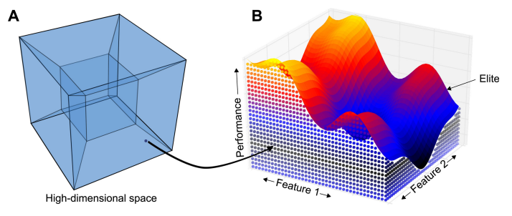
MAP-Elites
Multi-dimensional Archive of Phenotypic Elites
Archive model population
Define grid based on discretized behavioral features
E.g., percentage of time a bipedal robot had each foot off ground
Phenotype corresponds to specific archive location
Save solution to archive location if empty or fitness is better
Randomly select parent from archive
Mutate selected parent to generate child
Image from Mouret, J. B., & Clune, J. (2015). Illuminating search spaces by mapping elites. arXiv preprint arXiv:1504.04909.

Slide 29
MAP-Elites
Requires careful definition of behavioral features
Define structure of archive
Indirectly related to performance
Studies typically perform ablation with combinations of features
Too many features hinders optimization performance
Predicated on effective mutation operations
Hallmark of neuroevolution
More akin to GA than ES
Children can replace population members other than parent
A persistent (steady-state) population is maintained be archive

Slide 30
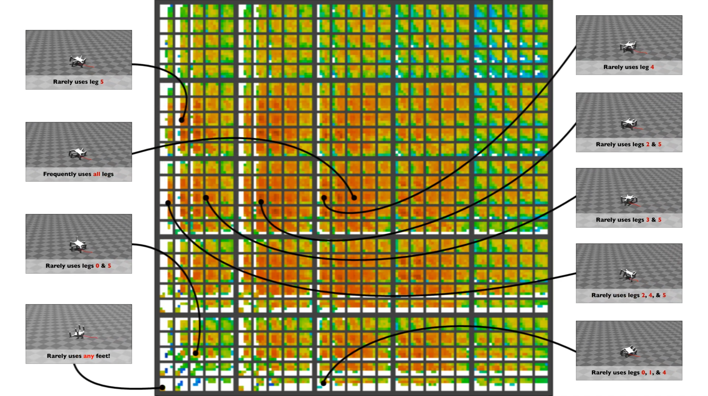
MAP-Elites
Example – robot locomotion
6-dimensional behavioral archive
Based on contact with ground per-leg
MAP-elites encourages exploration to find many different gaits
Evolved gaits can be applied if the robot has one or more damaged legs
Image from Robots that can adapt like animals by Cully, A., Clune, J., Tarapore, D., and Mouret, J.-B., licensed under CC BY

Slide 31
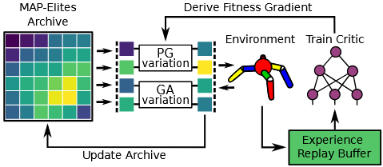
PGA-MAP-Elites
Policy Gradient Assisted MAP-Elites
Hybridizes MAP-Elites with reinforcement learning (TD3)
Train critic networks on the archive to predict action-rewards
Apply gradient descent to some children based on critics
Vary the rest with normal EA operators
MAP-Elites provides much stronger exploration than pure RL
Policy gradient allows stronger exploitation than pure MAP-Elites
Image from Policy gradient assisted MAP-Elites by Olle Nilsson and Antoine Cully

Slide 32
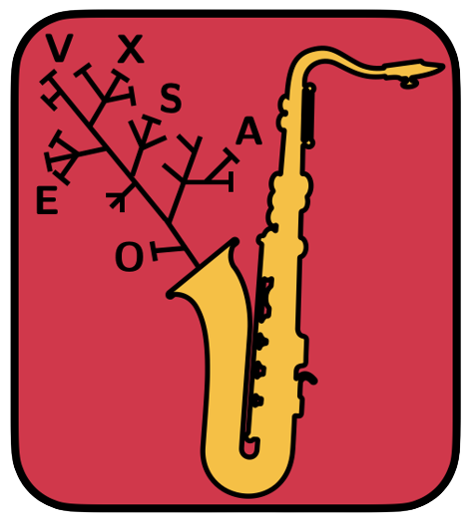

Recommended Tools
evosax
QDax
JAX-Based Evolution Strategies
https://github.com/RobertTLange/evosax
Accelerated Quality-Diversity
https://github.com/adaptive-intelligent-robotics/QDax

Slide 33
Closing remarks
Problems well-suited to deep learning
Deep learning is typically faster and more performant
No small amount of effort goes into reformatting problems to become well-suited (the results should not be dismissed though)
Neuroevolution can do some things deep learning can’t
Optimize non-differentiable network architectures (e.g., spiking neural networks)
Optimize problems with no or ill-suited loss/reward functions
Neuroevolution benefits from architectural advances in neural networks (typically brought about by deep learning)

Slide 34
Closing remarks
Newer variants of neuroevolution and quality diversity algorithms are adding deep learning mechanisms
Some domains like NLP are gaining interest in neuroevolution to evolve novel neural network architectures
Neural networks aren’t necessarily the best solution to some problems
E.g., discrete optimization, combinatorial optimization, certain ill-suited automated design problems (at least currently)
This presentation only scratches the surface of these topics
AI isn’t magic.

Slide 35
Questions?

