Slide 1
EVOLUTIONARY ALGORITHMS SIMULATING MOLECULAR EVOLUTION
COMP 5660/6660 11:00-11:50 AM 345 W. Magnolia Ave.
11/12/2025
(Yeah, it’s kind of a mouthful.)
(Just call it “EASME.”)
guacguacucagucagauccagcuacgaagcuauuaguacguacucagucagauccagcuacgaagcuauuaggc
gcattacgatgcatgctagctagctacgatcgcatacgatcgataatggcattacgatgcatgctagctagctacgatcgcatacgatcgataat
Gly
Presented by
James Satterthwaite Larkin Browning
+
María Victoria Liendro Dalinger

Slide 2
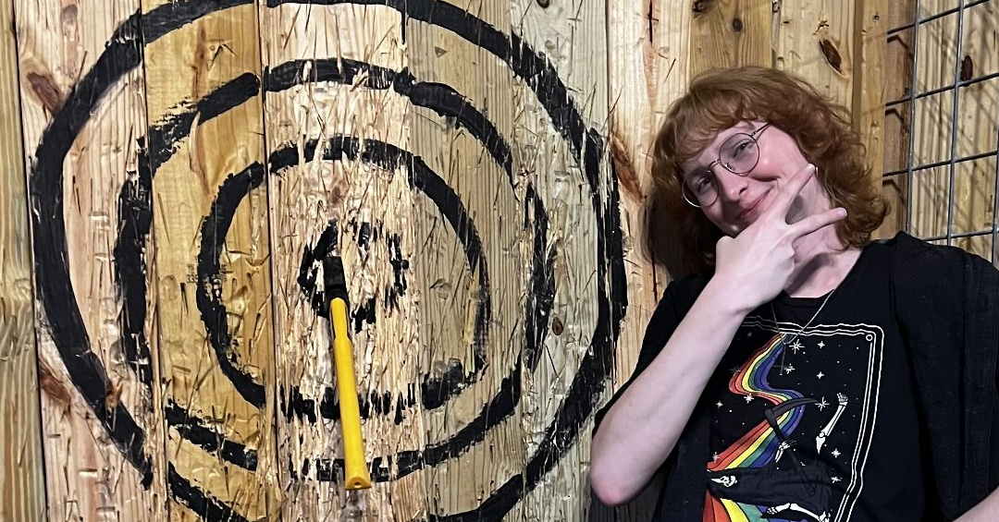
About James
James & Victoria
COMP 5660/6660 11:00-11:50 AM 345 W. Magnolia Ave.
11/12/2025
Bachelor’s in CS from UAB 🐲 in 2020
Minor in neurobiology
Master’s in CSSE from Auburn 🐯 in 2022
Doctorate in CSSE now ongoing
Research focus on evolutionary algorithms (EAs) and their application to biology
I have two lizards, a ball python, and a tortoise.
Insufferable Letterboxd guy.
Fun Facts

Slide 3


About Victoria
James & Victoria
COMP 5660/6660 11:00-11:50 AM 345 W. Magnolia Ave.
11/12/2025
Bachelor’s in biomedical engineering from Universidad Nacional de Córdoba in 2022
Master’s in data science from Auburn now ongoing
Doctorate in CSSE coming up
Research focus on bioinformatics applications of data science and machine learning
Only ever watches a movie once.
Also watches them in two halves.
Fun Facts

Slide 4
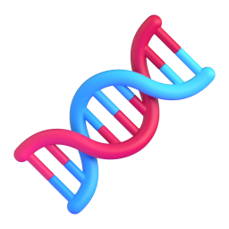
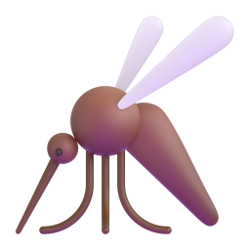
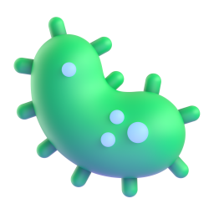
What’s on the agenda?
James & Victoria
COMP 5660/6660 11:00-11:50 AM 345 W. Magnolia Ave.
11/12/2025
Bio 101: A Quick Refresh
Where it All Began
What We’re Up to Now
I’m sure it’s been a while.
The very first EASME project.
I promise we’re not creating bioweapons.

Slide 5
1.Biology 101
(Just the Important Stuff)
James & Victoria
COMP 5660/6660 11:00-11:50 AM 345 W. Magnolia Ave.
11/12/2025
The idea that information flows from DNA to RNA to proteins is the “central dogma” of biology.
Most of your cells contain deoxyribonucleic acid, or DNA, made up of four base pairs: adenine (A), thymine (T), guanine (G), and cytosine (C).
Transcription converts double-helix DNA into single-helix RNA, which replaces thymine (T) with uracil (U).
Ribosomes in your cells translate RNA into a string of amino acids, which then folds into a unique shape — this folded structure is a protein.
Three base pairs of RNA are translated into one amino acid. There are 64 possible RNA “codons,” which map to 20 amino acids — so it’s a hash table!
Notes:
Proteins comprise most of the dry weight of your body, as they do all life on Earth. The hash table of codons to amino acids is the “genetic code,” not your actual DNA as the term is often used to refer.

Slide 6
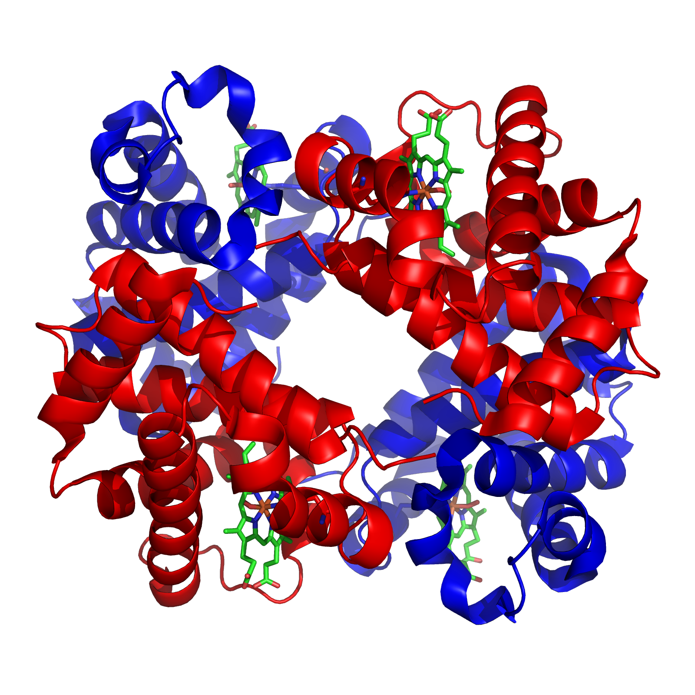
Proteins in More Detail
James & Victoria
COMP 5660/6660 11:00-11:50 AM 345 W. Magnolia Ave.
11/12/2025
Hemoglobin
Notes:
Hemoglobin comprises 35% (96% dry) of a red blood cell’s weight (these cells also lack nuclei – they’re just bags for oxygen).

Slide 7
Evolution
(The Old-Fashioned Way)
James & Victoria
COMP 5660/6660 11:00-11:50 AM 345 W. Magnolia Ave.
11/12/2025
Trillions of mutations happen inside your body every single day. Luckily, your cells automatically fix most of them — just hope “most” is enough!
Evolutionary computing was inspired by the natural process of evolution.
In nature, factors like radiation can cause one base pair in a DNA molecule to mutate into another.
Transition (A⬌G, C⬌T) is more common than transversion.
As in evolutionary computing, some mutations are harmful, some are beneficial, and some are completely neutral.
As multiple, often similar codons map to the same amino acid, most mutations in biology are neutral.
The codons CGA, CGC, CGG, and CGU all map to the amino acid arginine (R).
AUG is the start codon, and UAA, UAG, and UGA are the stop codons.
So what would happen if a CGA mutated to UGA…?

Slide 8
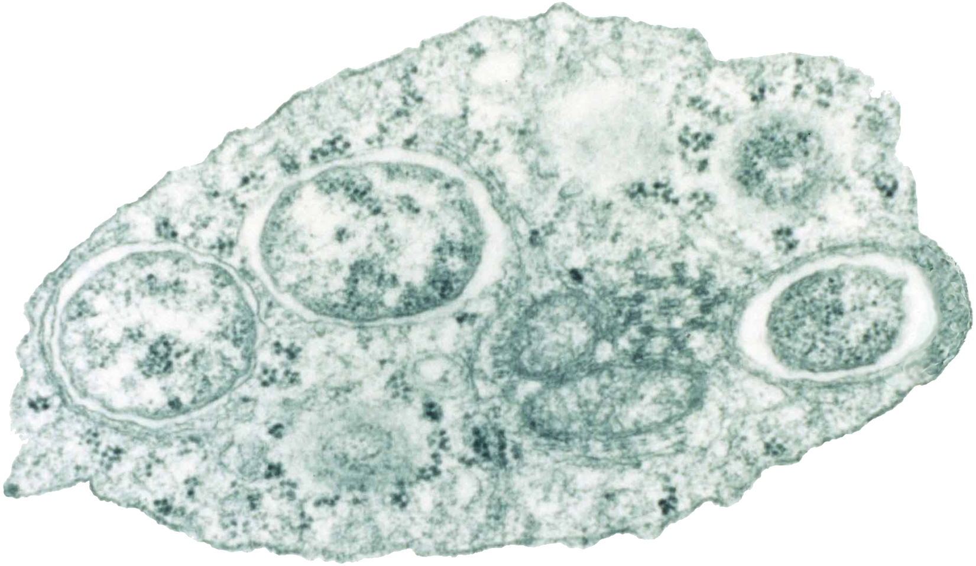
2.The First Project
James & Victoria
COMP 5660/6660 11:00-11:50 AM 345 W. Magnolia Ave.
11/12/2025
feat. Wolbachia pipientis
The first EASME project, developed by Auburn faculty member John Beckmann and Dr. T, used an EA to simulate the evolution of cytoplasmic incompatibility in Wolbachia-infected mosquitoes.
That’s a lot of words! But what do they mean?
Wolbachia in an infected host cell

Slide 9
Cytoplasmic Incompatibility Explained
James & Victoria
COMP 5660/6660 11:00-11:50 AM 345 W. Magnolia Ave.
11/12/2025
 | Uninfected Female | Infected Female
Uninfected Male | Uninfected Offspring | Infected Offspring
Infected Male | No Offspring ☠️ | Infected Offspring
Inside the sperm of an infected male, the Wolbachia bacteria will produce a toxin that will kill the offspring if left unattended.
Inside the egg of an infected female, however, that very same bacteria will produce an antidote to that toxin!
Through this simple toxin-antidote system, Wolbachia has become the single most common reproductive parasite in Earth’s biosphere.
Which came first, the 🐔 or the 🥚?
Which evolved first, the toxin or the antidote?

Slide 10
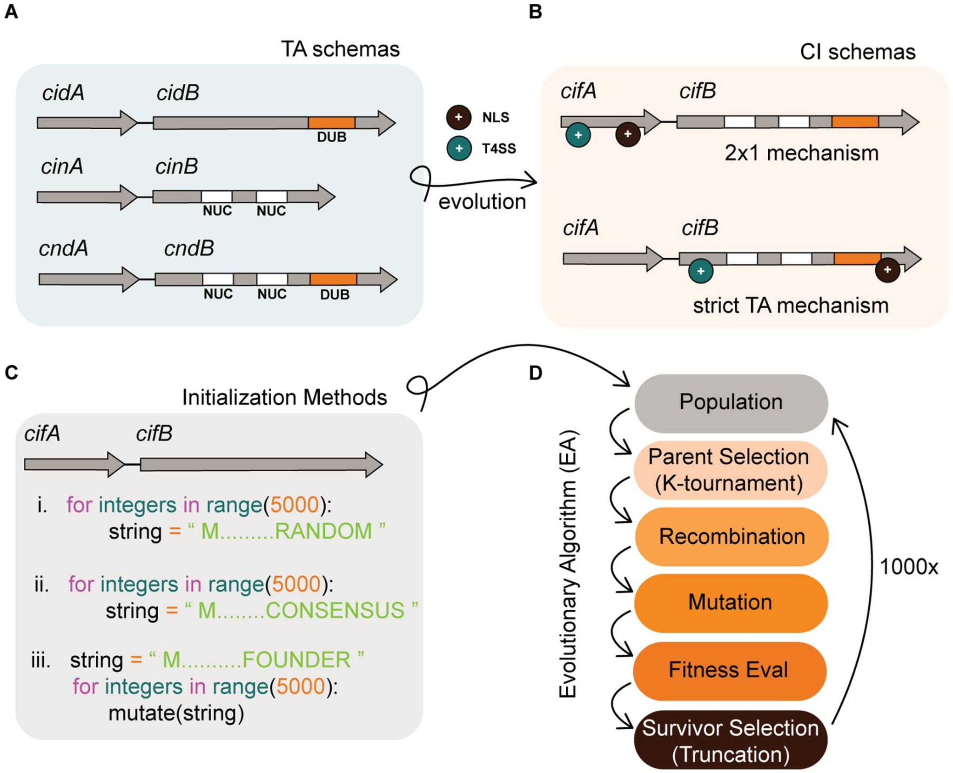
Modeling the Emergence of TA Protein Functions
James & Victoria
COMP 5660/6660 11:00-11:50 AM 345 W. Magnolia Ave.
11/12/2025
Rather than evolve some abstract representation, this project directly encoded, evolved, and evaluated DNA strings (using the A, T, G, C primitives).
The toxin-antidote system is controlled by a “lock and key” mechanism between the two proteins, which is easy to model.
Algorithm initialized a population of random sequences, then attempted to evolve them towards the modern wild-type sequences.
Fitness was determined by the presence of certain enzymatic domains, a “sliding window” search for binding residues, and the presence of NLS/T4SS.
Both wild-type mechanisms can be reached from the random initializations, but starting conditions will determine which one is reached first, and one is easier than the other.
Notes:
-genome is two genes, toxin and antidote.
-toxicity is controlled by a domain in the c-terminus of the protein in dub or nucleus
-binding of b to a is regulated by 15 charged residues
-three "locks" with five key sites
-consensus sequences for a and b is the skeleton we check fitness against
-algorithm initiates random sequences for a and b
-how close are we getting to domains the b protein?
-sliding window algorithm
-fitness composed of enzymatic domains, binding residues, and presence of t4ss/nls
-t4ss and nls need to evolve for the mechanism to work
-where are these sequences most likely to arise? is the core question
-fifteen binding sites determine ability to rescue
-first ea to use actual genes and functionality for every component
-mutation would pick a random spot and then pick a random mutation (snip (replace), deletion, insertion)
-recombination (single-point, quadruple-point, etc.) swap on homologs
-trade-off between speed and biological accuracy
-successful digital validation
-actually addressed conflict in literature -- simulation generated both wild-type models based on starting conditions
-weaknesses: no modelling of structure

Slide 11
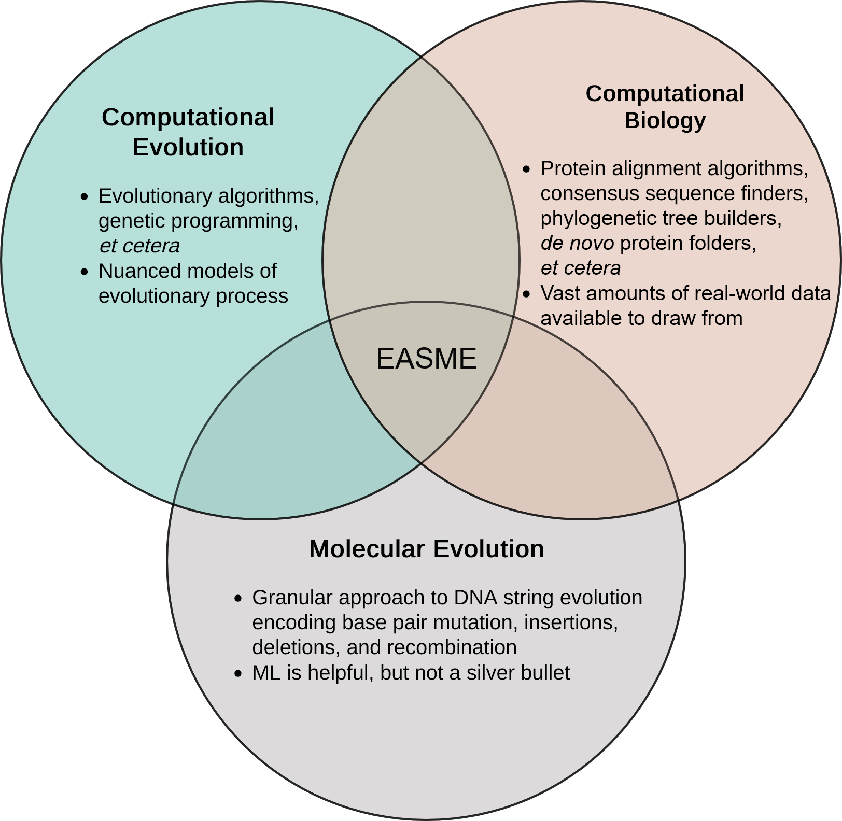
3.EASME
James & Victoria
COMP 5660/6660 11:00-11:50 AM 345 W. Magnolia Ave.
11/12/2025
EASME only became possible recently, due to the computational costs associated w/ many biological problems.
More sophisticated bioinformatics algorithms take better advantage of hardware.
Wet lab experiments are a rarity in the CS field, and somewhat unique to EASME.

Slide 12
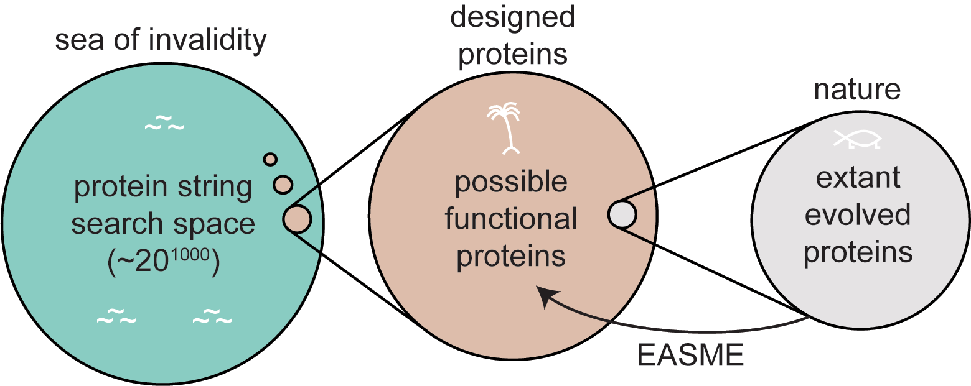
Search Space
James & Victoria
COMP 5660/6660 11:00-11:50 AM 345 W. Magnolia Ave.
11/12/2025

Slide 13
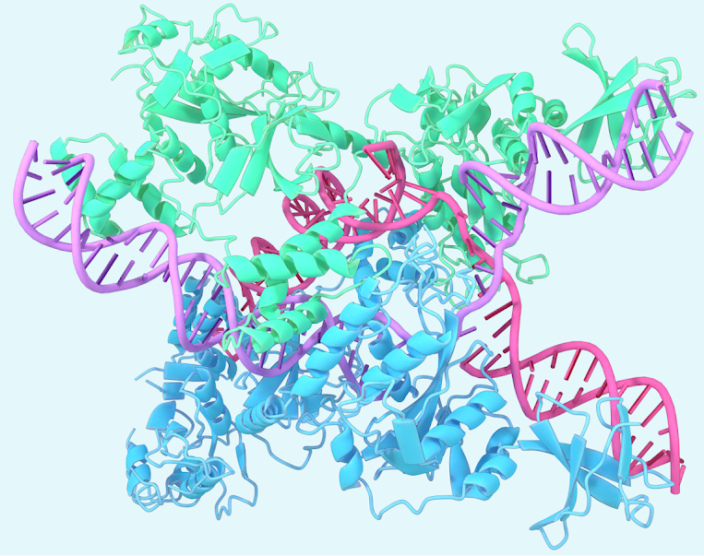
Why Not ML?
James & Victoria
COMP 5660/6660 11:00-11:50 AM 345 W. Magnolia Ave.
11/12/2025
“Well, probably because this is a class on EC, not a class on ML…”
Machine learning has been making a lot of waves in biology recently, especially with the release of Google’s AlphaFold 3.
However, EC is naturally a better fit for evolving new proteins, as it models the natural process that created existing proteins.
ML models can be useful components of fitness functions, but would be somewhat limited by their own training data if tasked with designing entirely new proteins.
Worth noting that EC arguably is a form of ML, just at the level of a population rather than individual.
A protein folded by AlphaFold 3

Slide 14
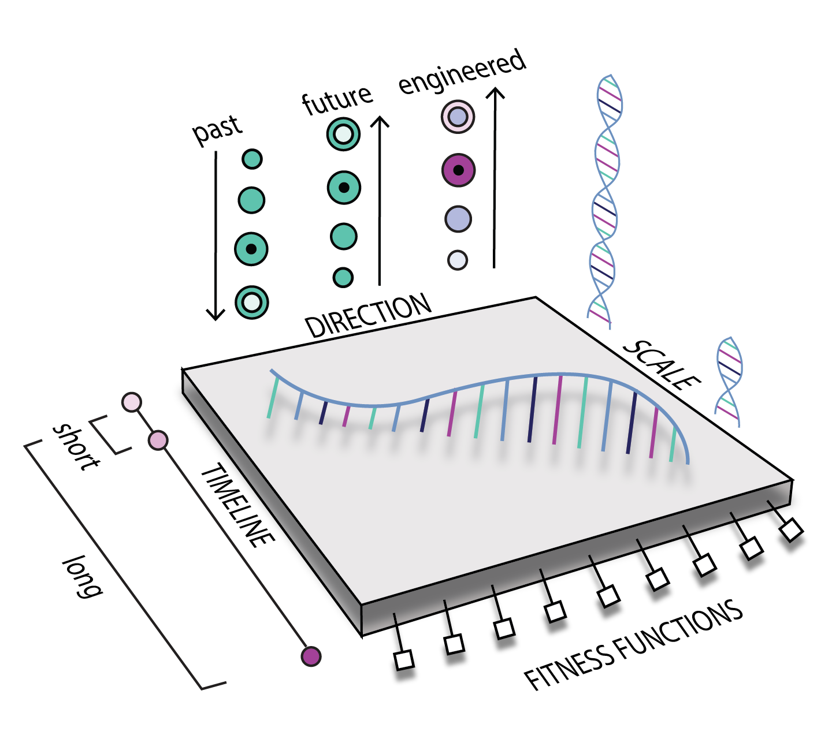
Categorizing Projects
James & Victoria
COMP 5660/6660 11:00-11:50 AM 345 W. Magnolia Ave.
11/12/2025

Slide 15
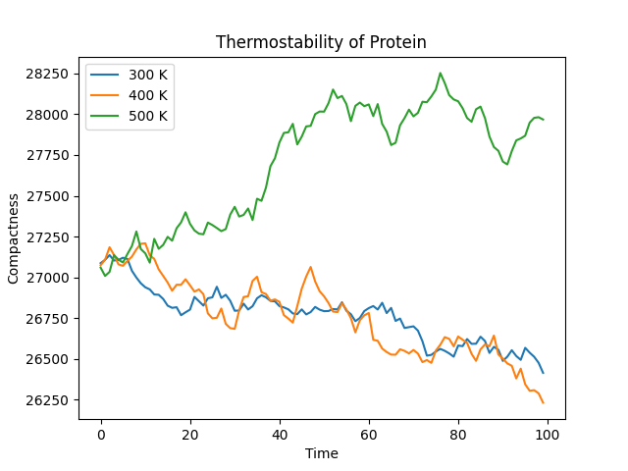
The Big Question:
Fitness
James & Victoria
COMP 5660/6660 11:00-11:50 AM 345 W. Magnolia Ave.
11/12/2025
How does one calculate the fitness of a protein?
Protein folding is one of the biggest unsolved problems in science, but machine learning models can help us approximate structures.
Approximated foldings and simple simulations can serve as rudimentary fitness functions.

Slide 16
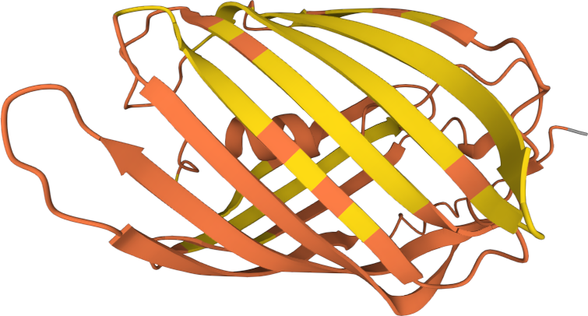
Next Step: Lab Testing
James & Victoria
COMP 5660/6660 11:00-11:50 AM 345 W. Magnolia Ave.
11/12/2025
pMagenta

Slide 17
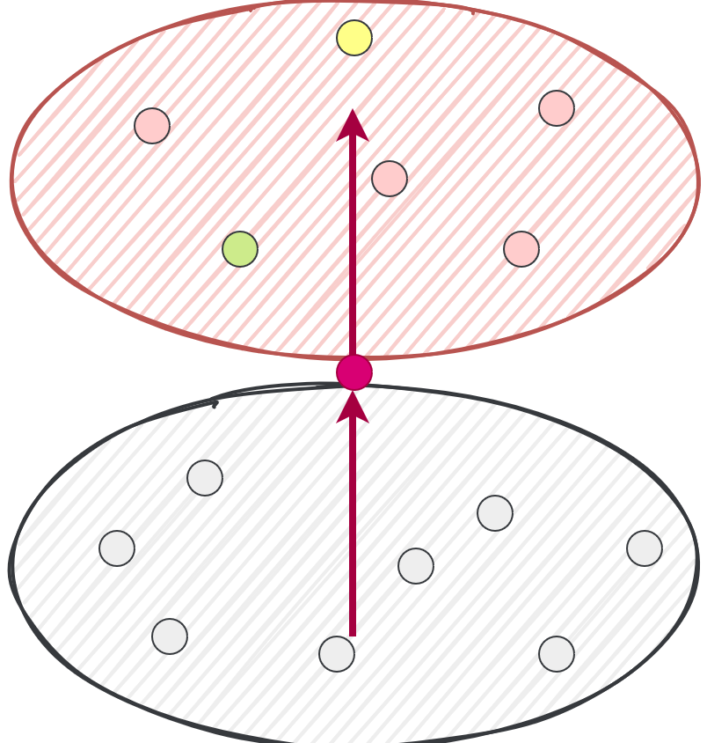
Fluorescent
Space
James & Victoria
COMP 5660/6660 11:00-11:50 AM 345 W. Magnolia Ave.
11/12/2025
Download proteins similar to pMagenta from UniProt, some fluorescent, some not.
Group based on fluorescence.
Judge fitness of new variants by alignment to all specimens — homology to fluorescents is positive, homology to non-fluorescents is negative.
Ideally, new variants will move towards higher fluorescence in this high-dimensional space.

Slide 18
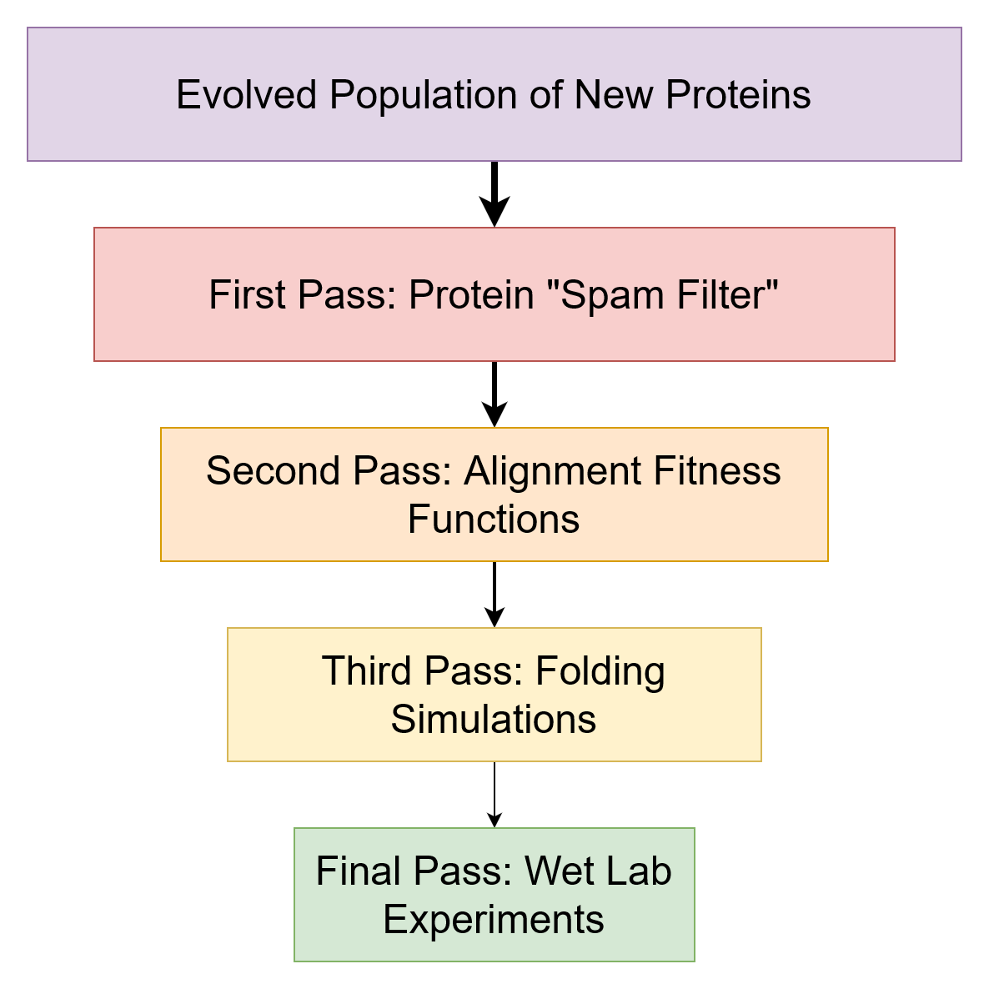
James & Victoria
COMP 5660/6660 11:00-11:50 AM 345 W. Magnolia Ave.
11/12/2025

Slide 19
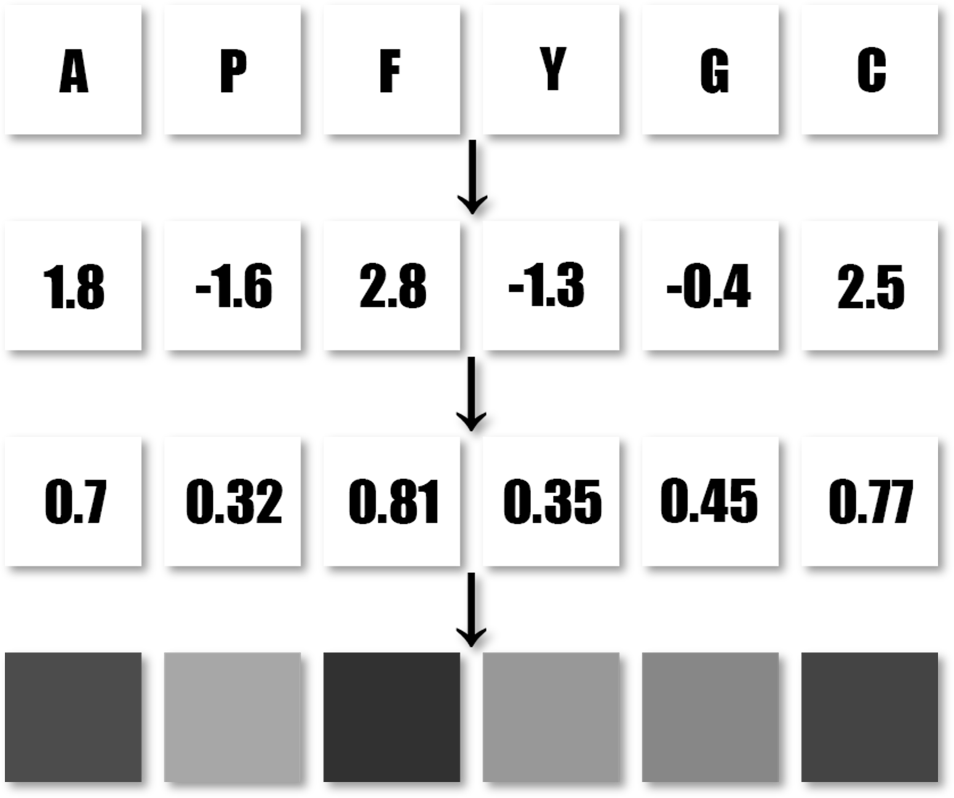
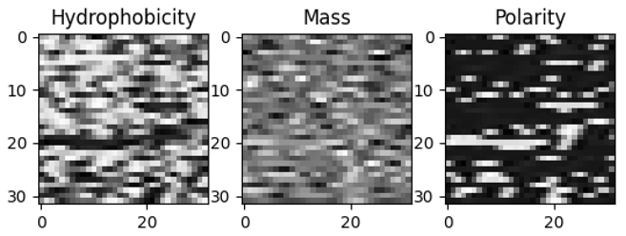
Protein “Spam Filter”
James & Victoria
COMP 5660/6660 11:00-11:50 AM 345 W. Magnolia Ave.
11/12/2025
An amino acid sequence is used to generate a 32 x 32 x 3 matrix of noteworthy values:​
Hydropathy of AAs​
Charge of AAs​
Mass of AAs​
Each unique amino acid has a distinct value for each of these traits — we scale them from 0 to 1, then compress into a 32 x 32 "image."​
The conversion process from protein to “image”
Several protein properties converted to machine-interpretable “images”

Slide 20
Training Process Summary
James & Victoria
COMP 5660/6660 11:00-11:50 AM 345 W. Magnolia Ave.
11/12/2025
The hemoglobin beta subunit is a protein found in human red blood cells.
We could generate 100 variants of this protein, each with a mutation rate from 1% to 100%, defining how likely each amino acid was to be randomly replaced.
(The 100% mutant is essentially a completely random protein.)
Ideally, the mutation rate will inversely correlate with the predicted fitness, which will correlate with some "ground truth" of actual chemical stability.

Slide 21
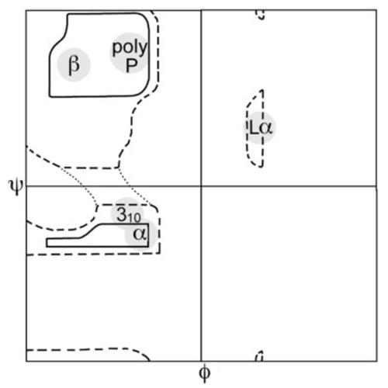
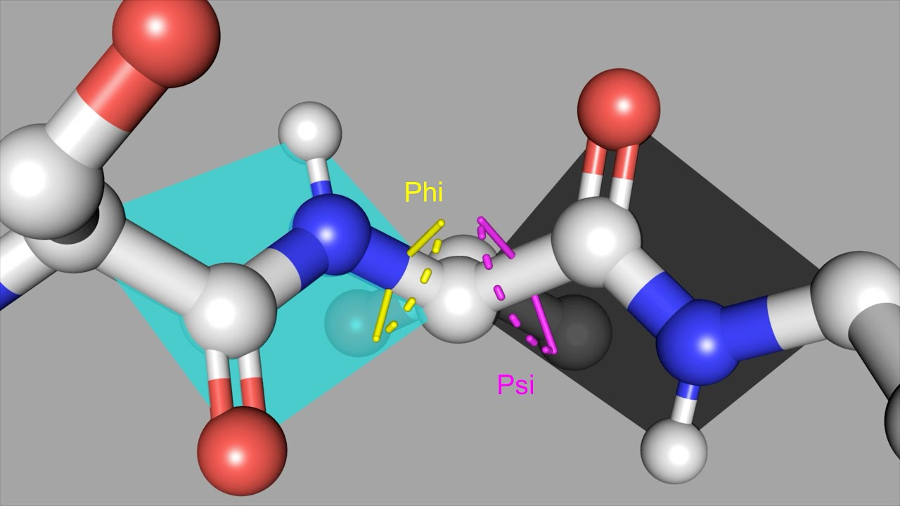
What is a Ramachandran Plot?
James & Victoria
COMP 5660/6660 11:00-11:50 AM 345 W. Magnolia Ave.
11/12/2025
A Ramachandran plot analyzes the angles between atoms in a protein backbone and determines which are “energetically allowed.”
I.e., which are likely to be stable and unstressed.
Angles can be “favored,” “allowed,” or “disallowed.”
Original Ramachandran plot (meant to be universal, see Ramachandran et al. 1968)
Angles that constitute a Ramachandran pair

Slide 22
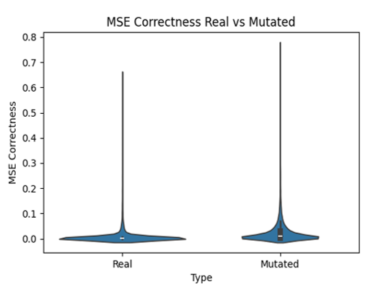
What Does This Mean?
James & Victoria
COMP 5660/6660 11:00-11:50 AM 345 W. Magnolia Ave.
11/12/2025
The spam filter trained off real proteins from model organisms, as well as randomly-mutated proteins (where the fitness was set at 1-MUT_RATE), predicted fitness scores consistent with Ramachandran "ground truth" values.

Slide 23
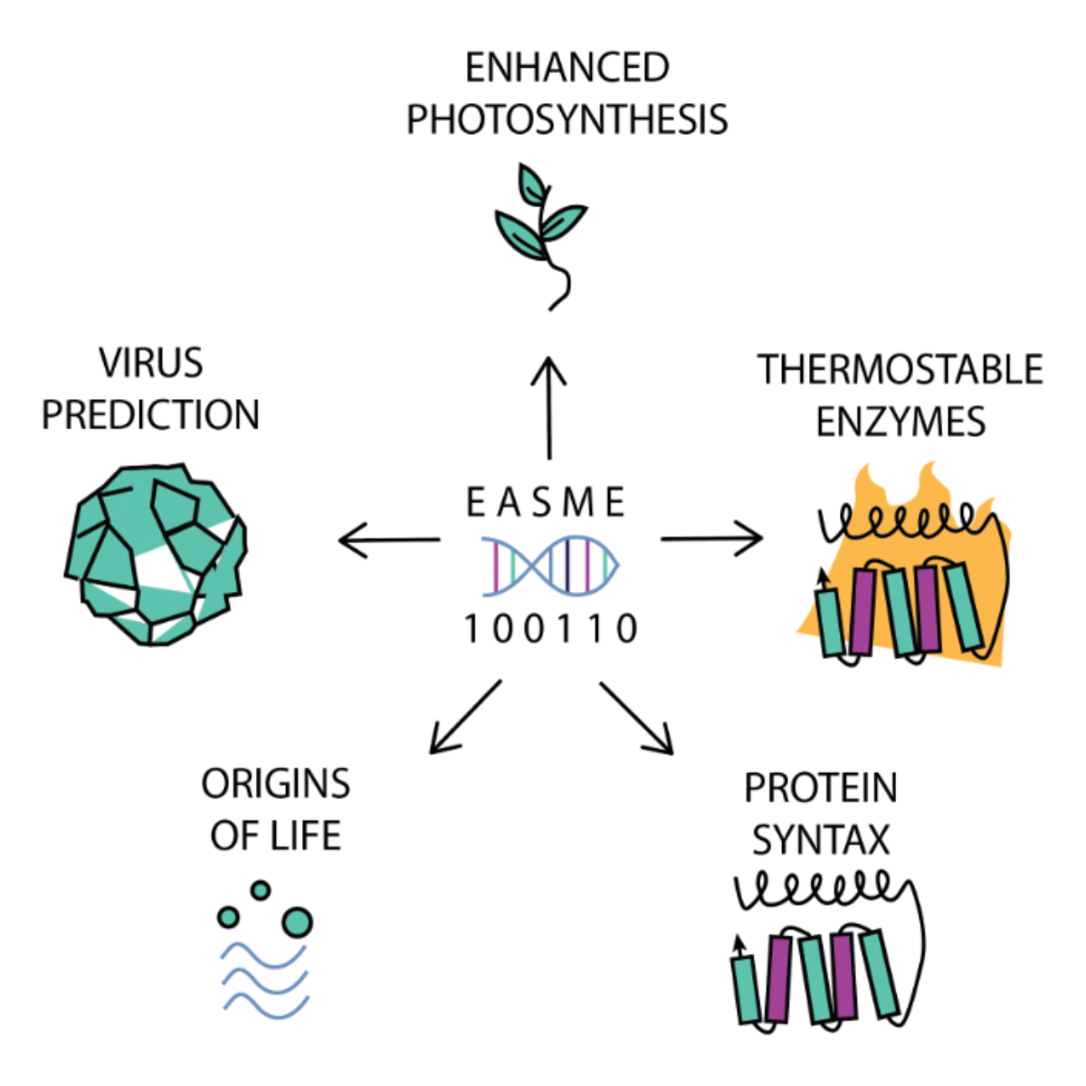
James & Victoria
COMP 5660/6660 11:00-11:50 AM 345 W. Magnolia Ave.
11/12/2025

Slide 24

James & Victoria
COMP 5660/6660 11:00-11:50 AM 345 W. Magnolia Ave.
11/12/2025
easme.auburn.edu

Slide 25
Sources
James & Victoria
COMP 5660/6660 11:00-11:50 AM 345 W. Magnolia Ave.
11/12/2025
Abramson, J., Adler, J., Dunger, J. et al. Accurate structure prediction of biomolecular interactions with AlphaFold 3. Nature 630, 493–500 (2024). https://doi.org/10.1038/s41586-024-07487-w
Browning, J., Tauritz, D., Beckmann, J. “Evolutionary algorithms simulating molecular evolution: a new field proposal.” Briefings in Bioinformatics Vol. 25, Issue 5 (2024).
Hemoglobin render: https://commons.wikimedia.org/wiki/File:1GZX_Haemoglobin.png
“Modeling emergence of Wolbachia toxin-antidote protein functions with an evolutionary algorithm,” Beckmann et al. (2023). Frontiers in Microbiology, Vol. 14.
Ramachandran et al., 1968
Image of Wolbachia: https://commons.wikimedia.org/wiki/File:Wolbachia.png

