Slide 1
This Lecture is testable Material
The material in this lecture will almost certainly show up on Exam 2
Will not ask about low-level details:
  What exactly is Braden doing
  How exactly is Braden doing it
May ask about high-level concepts:
  What are the motivations behind Braden’s research
  What are the general conclusions from Braden’s research
See last year’s Exam 2 for examples

Slide 2
Breaking The Cycle
Exploring The Advantages of Novel Evolutionary Cycles
Braden Tisdale
BONSAI Lab
Auburn University
Auburn, Alabama, USA
bnt0008@auburn.edu
Daniel R. Tauritz
BONSAI Lab
Auburn University
Auburn, Alabama, USA
dtauritz@acm.org
2023 IEEE Symposium Series on Computational Intelligence

Slide 3
Representing Evolution as a Graph
Initialization
Many algorithms are naturally represented as directed graphs
Graphs can represent population flow in an EA, not just algorithmic steps
Primitives: selection & reproduction
Can represent novel evolutionary cycles
Supports splitting & merging populations on different paths
Parent Selection
Reproduction
Survival Selection
Termination

Slide 4
Execution: Nodes
Two types of nodes
  Parent selection & reproduction
    Can be generational or steady-state
  Steady-state survival selection
  All nodes encode both operations – behavior based on edge weights
Nodes execute in linear sequence
  First execution initializes population as needed

Slide 5
Execution: Edges
Directed edges with integer weights
  No restrictions, except bounds on weight
  Weight is population size
Populations can be split
  Multiple edges leaving one node
  Destinations determined by:
    Fitness sort, or random shuffle
    If node reproduced, can partition children from adults

Slide 6
167
2-tournaments &
uniform recomb.
14 worst adults +
83 children
Equivalent to truncation
14
46 adults
Converge
107 best adults
38 best
Truncation
14
13-tournaments & BLX-(1.364) recomb.
Random parents & arithmetic recomb.
38 adults + 94 children
Seed
167 worst
26
Uniform random survival selection
Preserve diversity

Slide 7
Compared to Random Graph Generation
Conducted random search using the Meta-EA’s initialization function
  Randomly-generated graphs (Erdős–Rényi–Gilbert model)
  Uniform random primitives, parameters, edge weights, etc.
30 independent runs of each algorithm
Comparing average performance of the two graph generating algorithms
  Which algorithm produces better graph EAs, on average?
  Is our graph EA representation conducive to evolution?
  Do our variation operators improve the graph EAs effectively?

Slide 8
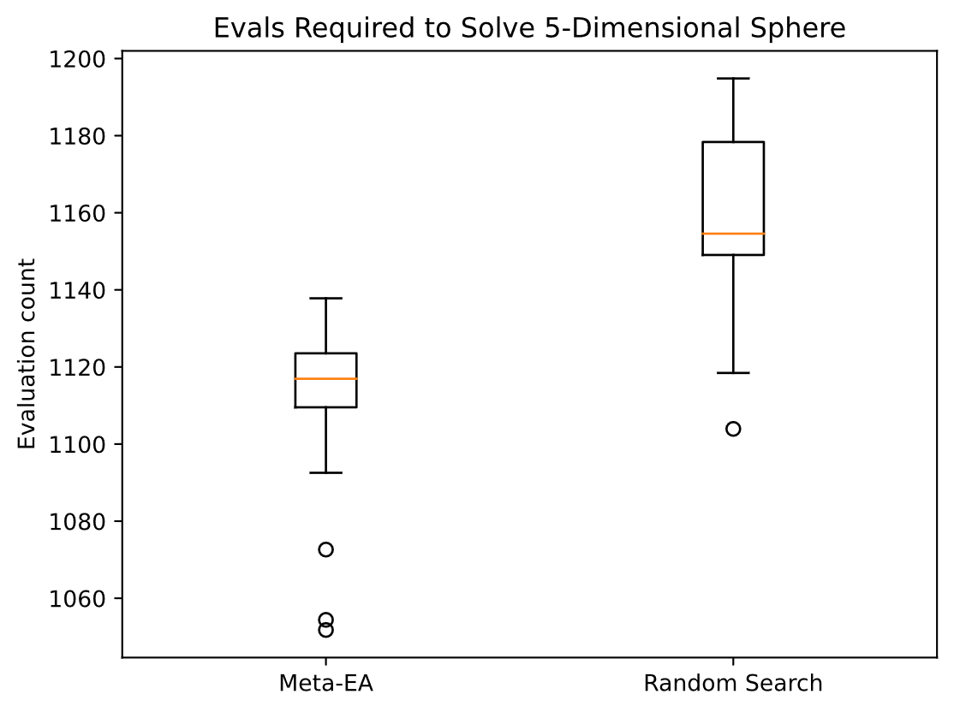
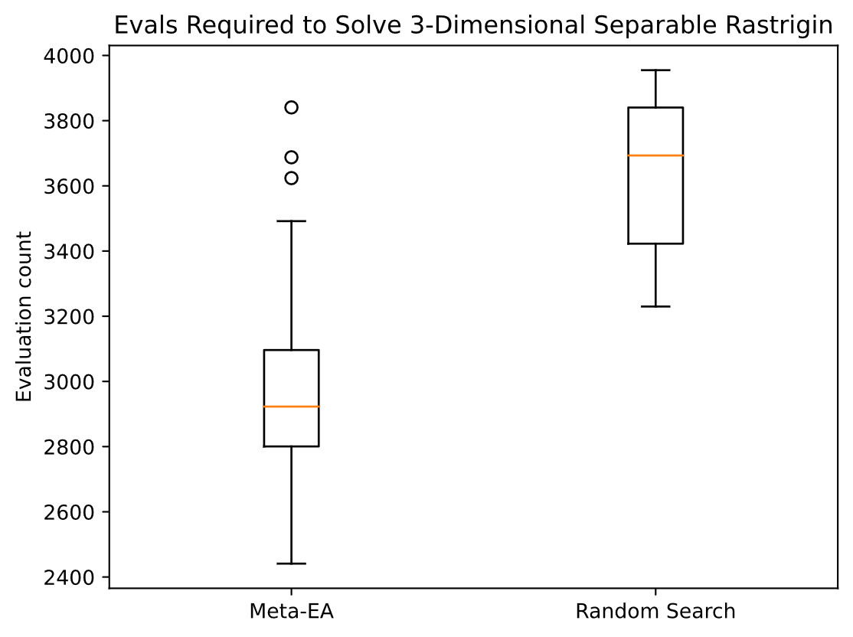
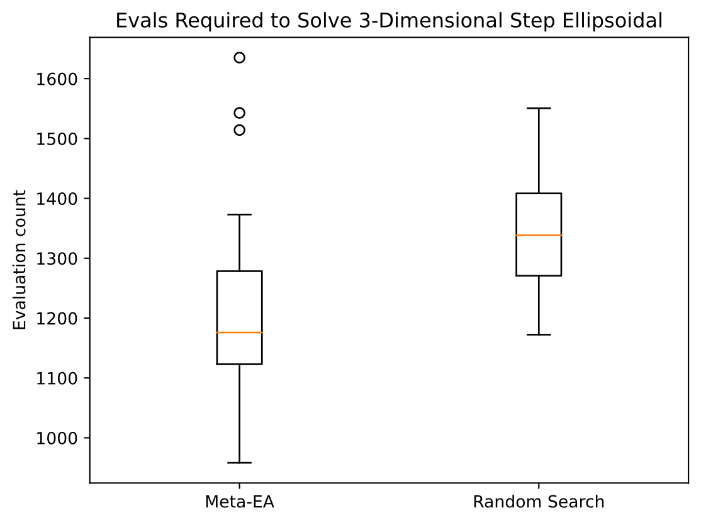
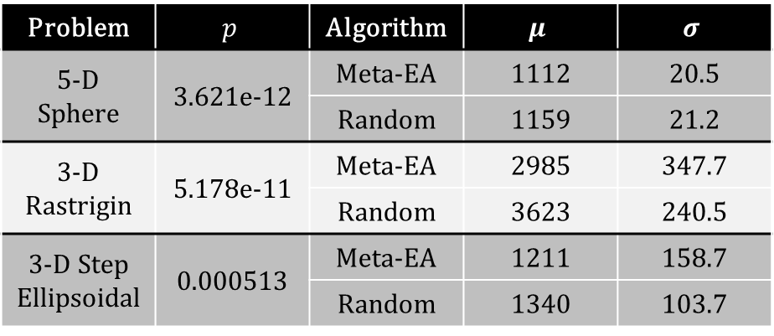
Problem | $$p$$ | Algorithm | $$μ$$ | $$σ$$
5-D Sphere | 3.621e-12 | Meta-EA | 1112 | 20.5
 |  | Random | 1159 | 21.2
3-D Rastrigin | 5.178e-11 | Meta-EA | 2985 | 347.7
 |  | Random | 3623 | 240.5
3-D Step Ellipsoidal | 0.000513 | Meta-EA | 1211 | 158.7
 |  | Random | 1340 | 103.7

Slide 9
Compared to Random Graph Generation:
Conclusions
Meta-EA significantly outperforms random search on every problem
  Our graph EA representation is conducive to evolution
  Our variation operators improve the graph EAs effectively
A minority of runs did not outperform random search
  Fitness landscape is highly multimodal
  Sometimes converges to mediocre optima
  Representation & variation operators could still be improved

Slide 10

Compared to Traditional EAs
Exhaustive search over a discretized EA parameter space
  $μ$, $λ$, recombination, mutation, selection, generational vs steady-state, etc.
  Configurations not tested if they are invalid or redundant
153.7 million configurations tested
  vs 150 million graph EAs (30 runs of 5 million) from each graph algorithm
Comparing performance of best EAs found over entire experiment
  Which algorithm found the best EA?
  Is graph space worth exploring?

Slide 11
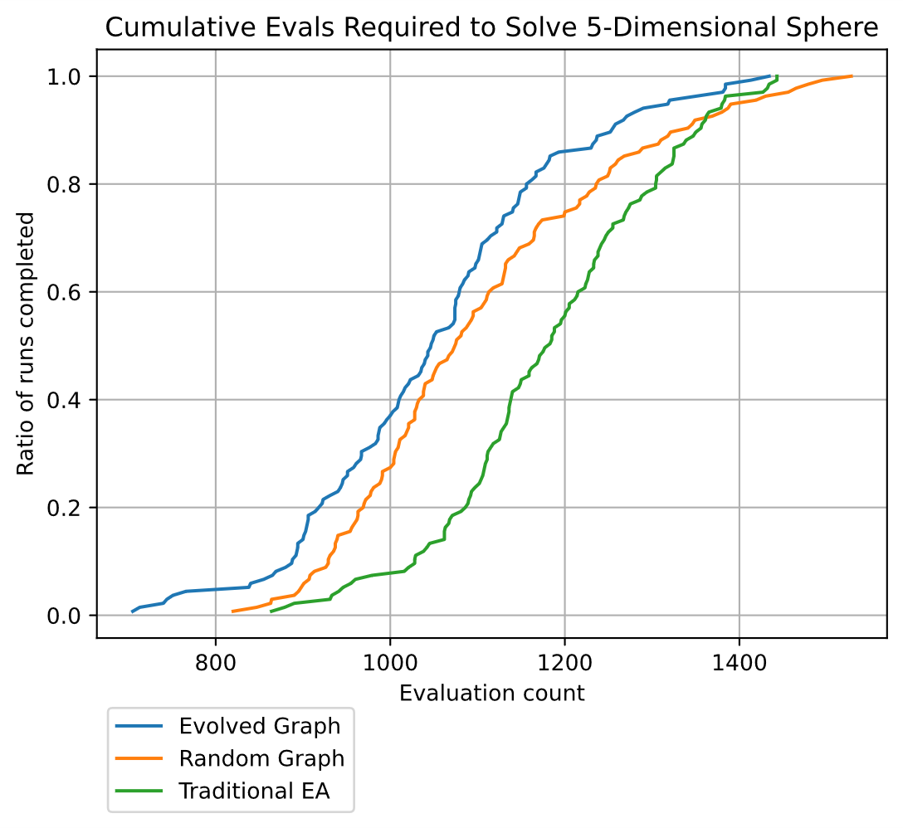
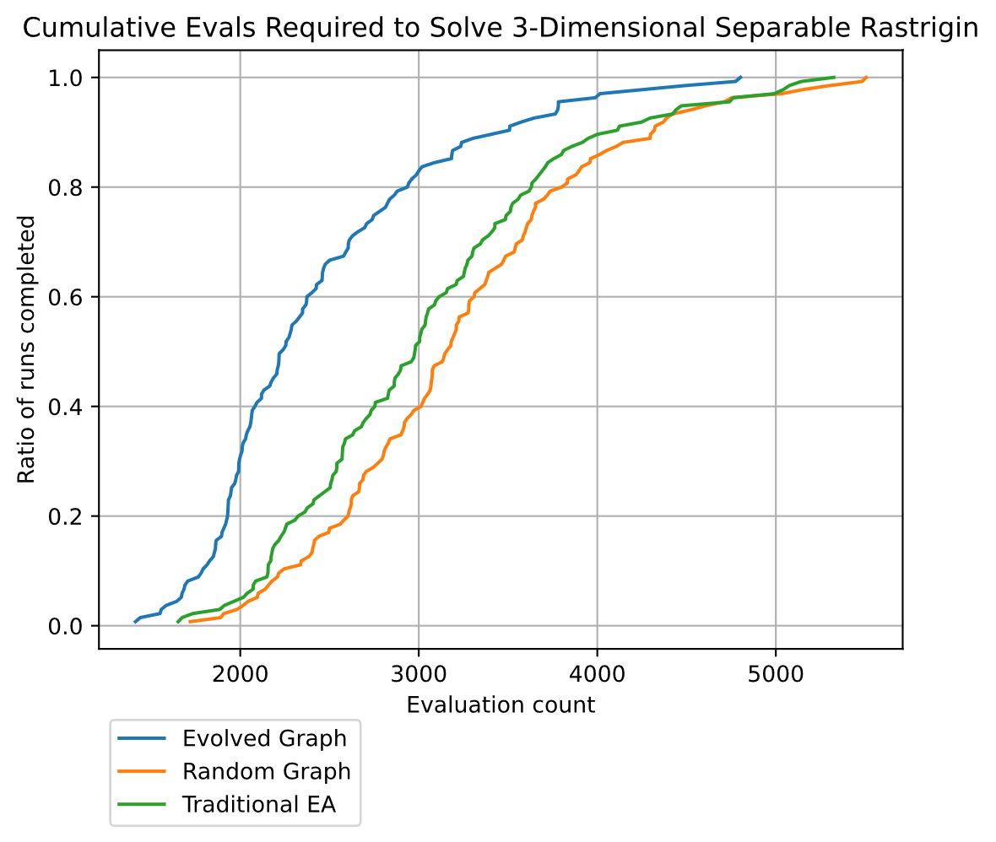
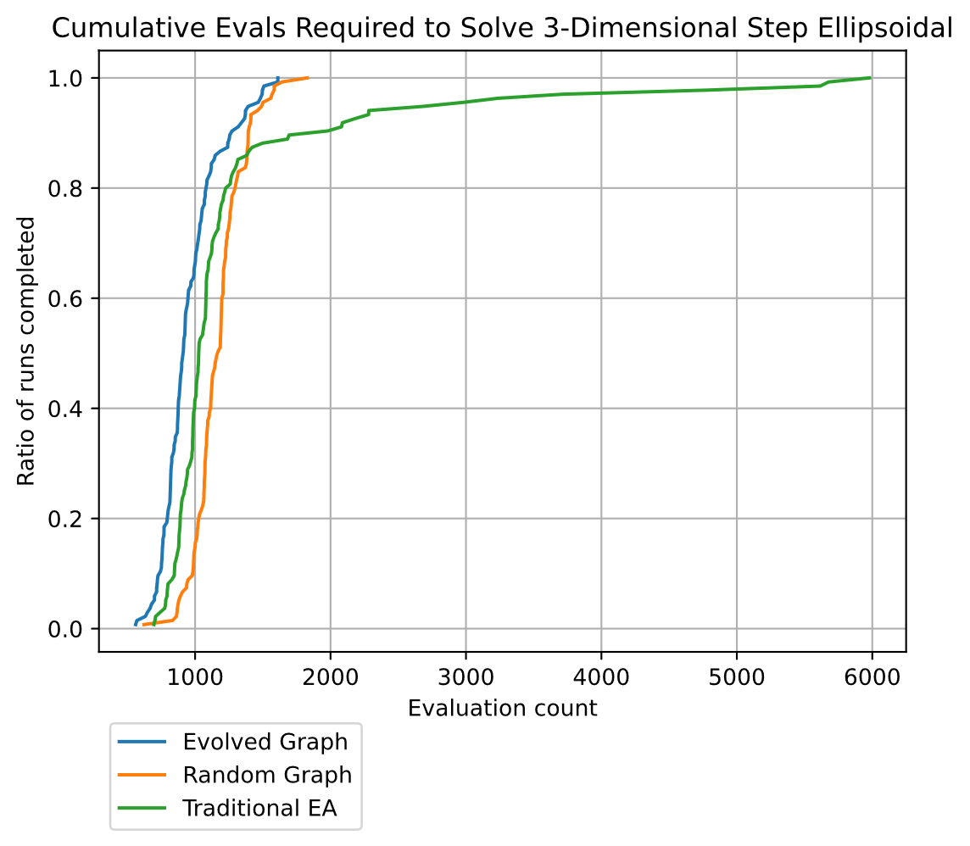
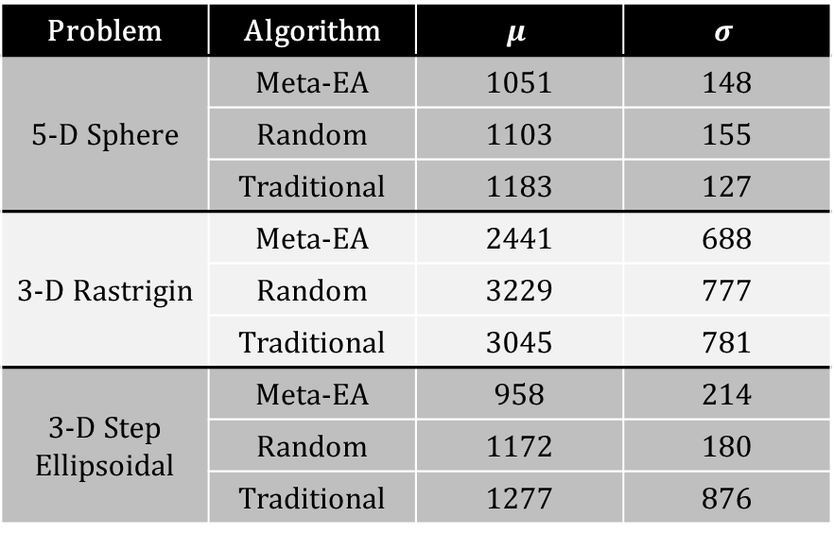
Problem | Algorithm | $$μ$$ | $$σ$$
5-D Sphere | Meta-EA | 1051 | 148
 | Random | 1103 | 155
 | Traditional | 1183 | 127
3-D Rastrigin | Meta-EA | 2441 | 688
 | Random | 3229 | 777
 | Traditional | 3045 | 781
3-D Step Ellipsoidal | Meta-EA | 958 | 214
 | Random | 1172 | 180
 | Traditional | 1277 | 876

Slide 12

Compared to Traditional EAs: Conclusions
On every problem, the best EA was generated by the Meta-EA
  Graph space contains better optima than the tested traditional EA space
  Graph space is worth exploring
Claim: The automatic design of graph EAs can, in the limit, outperform parameter tuning on traditional $\left(μ+λ\right)$- or $\left(μ,λ\right)$-EAs
  Larger search space
    More work
    Better results (in the limit)
    Less generalizable (shown in our previous work)

Slide 13
Exploring Graph Space
Group all graphs by number of nodes & edges
  Place each graph into a (num nodes, num edges) cell
    Similar to MAP-Elites^{[1]}, but no impact on evolution
  Analyze the best graph in each cell
  Analyze number of graphs in each cell
Are the best graph EAs similar to traditional EAs?
How complex are the best graph EAs?
[1] J. Mouret and J. Clune, “Illuminating Search Spaces by Mapping Elites”, 2015.

Slide 14
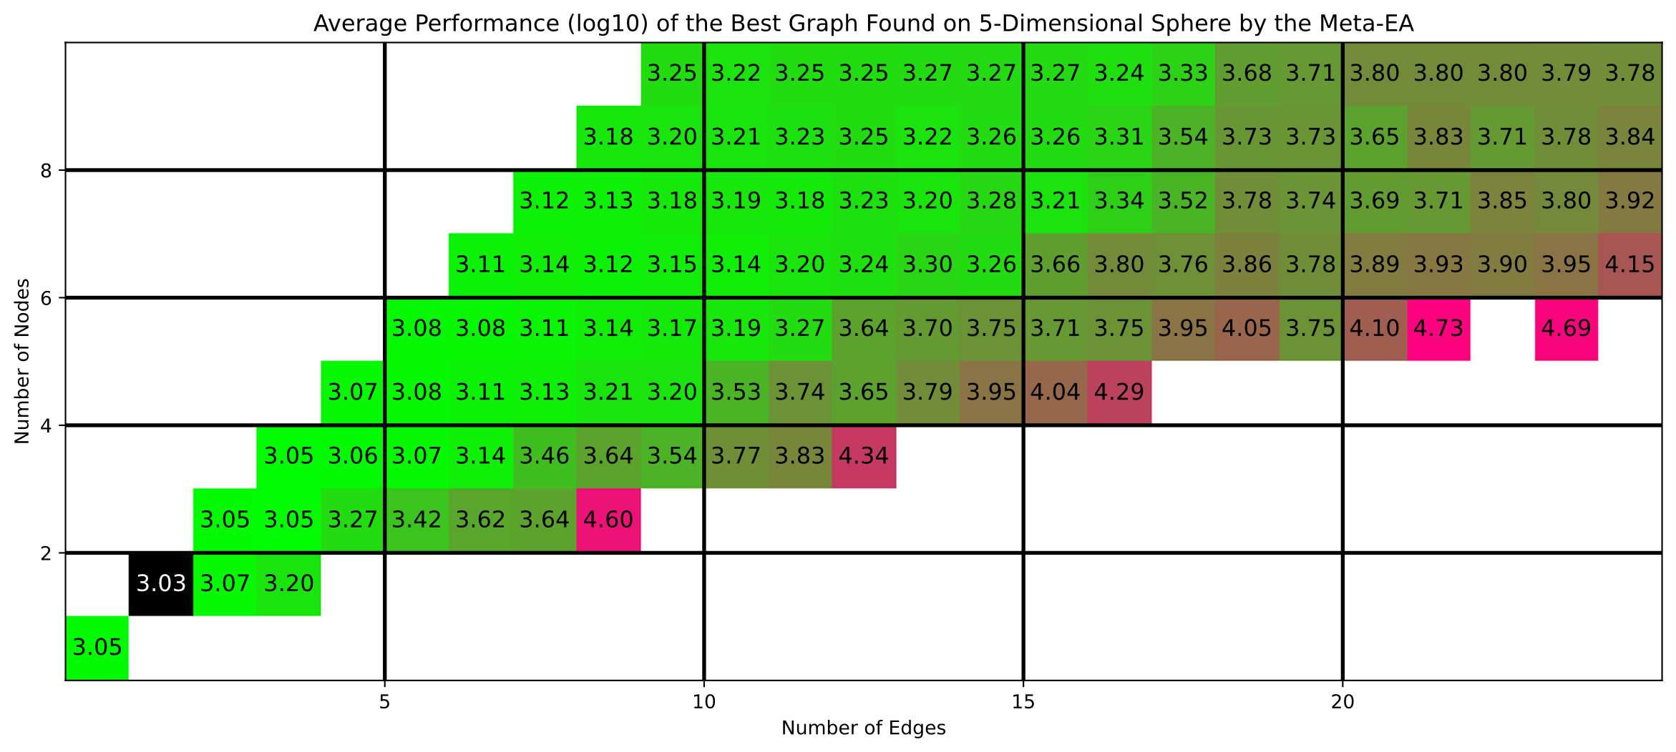
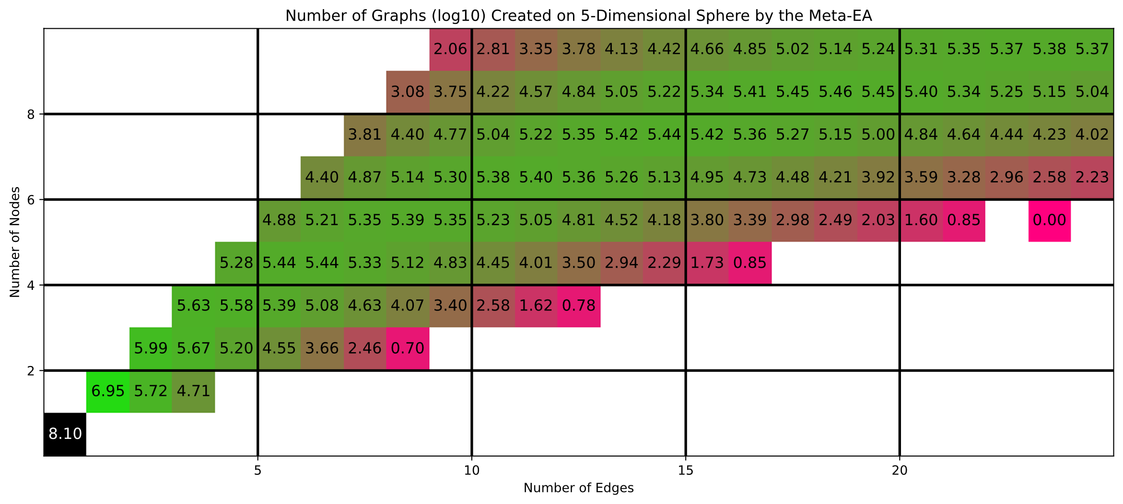

Slide 15
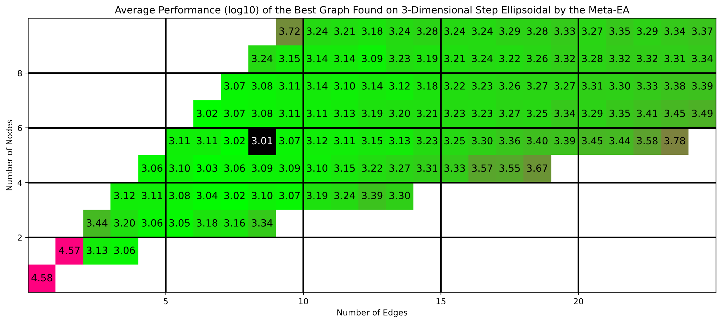
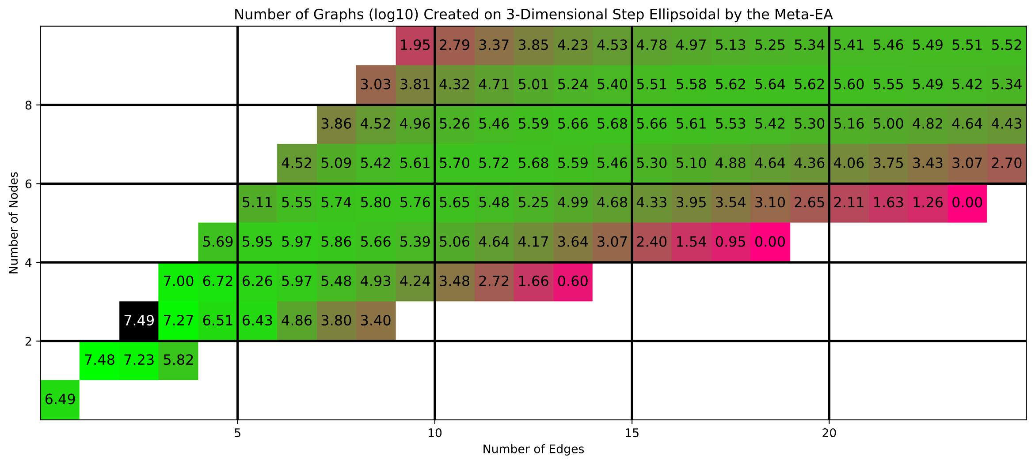

Slide 16
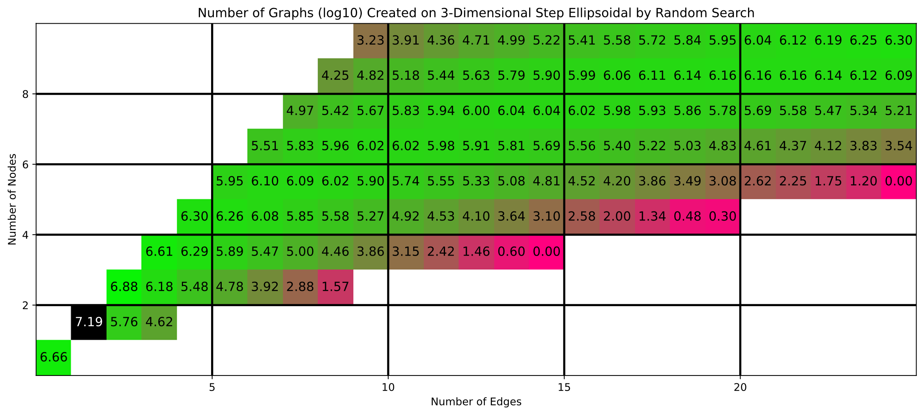
Exploring Graph Space:
Conclusions
On the simplest problem, the best graph EAs were simple
On more complex problems, the best graph EAs were much more complex
Weak correlation between performance and # of graphs created
  Variation operators strongly bias towards simple graphs

Slide 17
New approach
Start with graphs that mimic traditional EAs
Make only one change at a time
  Mutation only
  No repair function or crazy mapping – more similarity between parent & child
  Any complexifications are justified
Observe how the population moves through the landscape
  Does it converge far away from the traditional EAs?
  Do more complex problems encourage more complex algorithms?

Slide 18
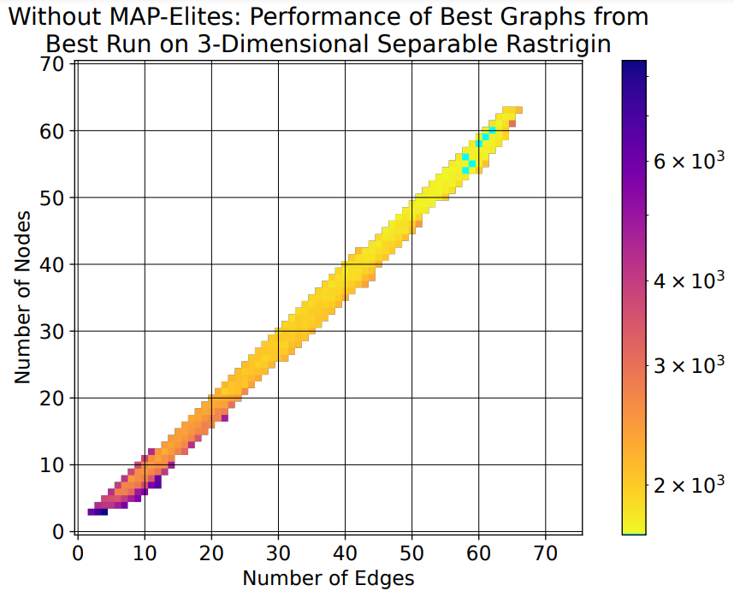
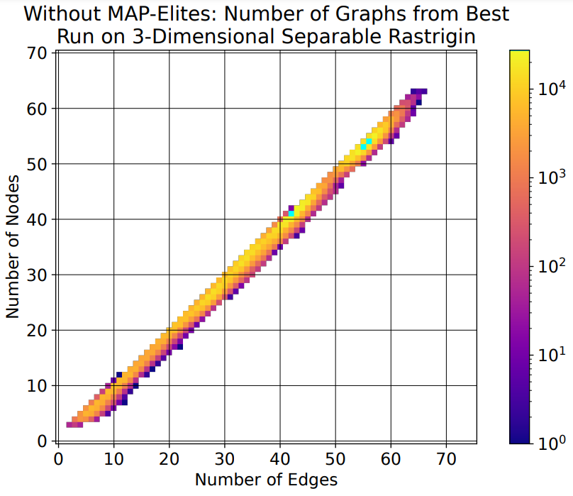

Slide 19
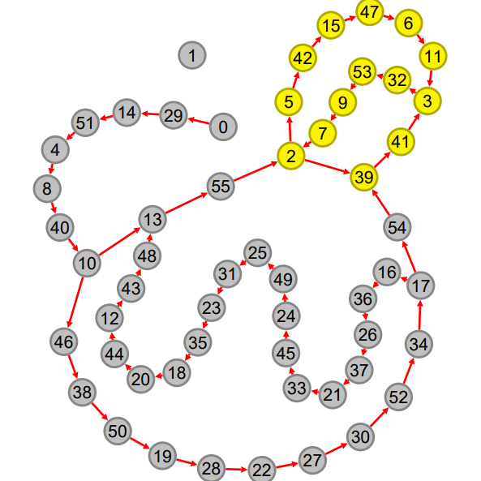

Slide 20
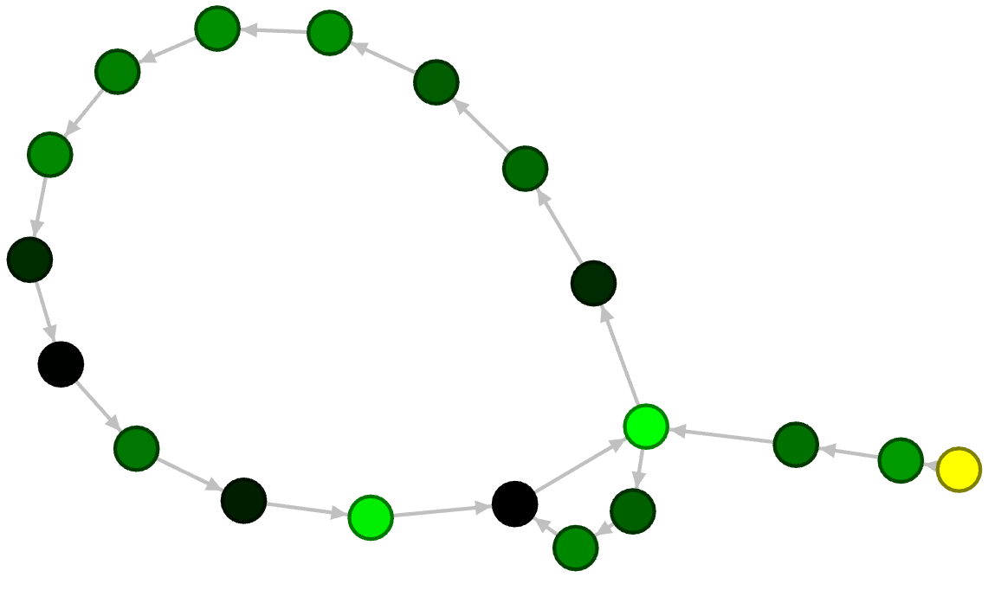

Slide 21
New Approach: Conclusions
Generally improved performance on nontrivial problems
Demonstrates that novel structures may outperform traditional ones
Main hypothesis for future research: Traditional EAs may not even be locally optimal on complex problems in this space
  Supported by only making small, incremental changes
  Important implications for how to efficiently traverse the space
  Currently being tested further

Slide 22
Questions?
Feel free to contact me!
bnt0008@auburn.edu

Slide 23
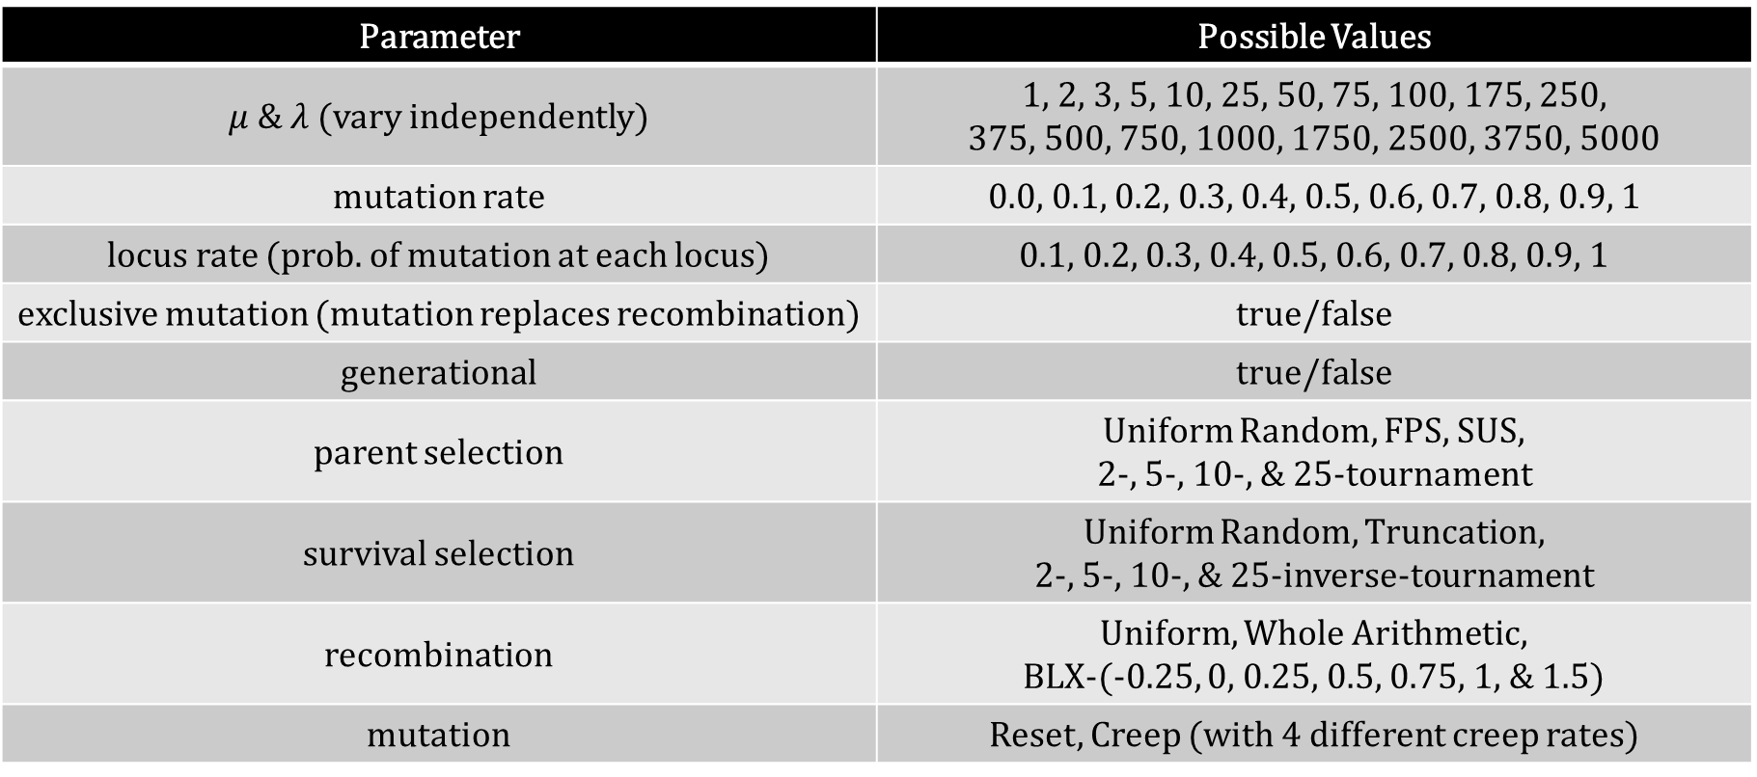
Parameter | Possible Values
$μ \& λ$ (vary independently) | 1, 2, 3, 5, 10, 25, 50, 75, 100, 175, 250, 375, 500, 750, 1000, 1750, 2500, 3750, 5000
mutation rate | 0.0, 0.1, 0.2, 0.3, 0.4, 0.5, 0.6, 0.7, 0.8, 0.9, 1
locus rate (prob. of mutation at each locus) | 0.1, 0.2, 0.3, 0.4, 0.5, 0.6, 0.7, 0.8, 0.9, 1
exclusive mutation (mutation replaces recombination) | true/false
generational | true/false
parent selection | Uniform Random, FPS, SUS, 2-, 5-, 10-, & 25-tournament
survival selection | Uniform Random, Truncation, 2-, 5-, 10-, & 25-inverse-tournament
recombination | Uniform, Whole Arithmetic, BLX-(-0.25, 0, 0.25, 0.5, 0.75, 1, & 1.5)
mutation | Reset, Creep (with 4 different creep rates)

