Slide 1
Empowering Scientists, Protecting Minds:
Secure Compound AI for a Smarter, Safer Future
Dr. Svitlana Volkova, Chief AI Scientist
Office of Science and Technology
Aptima, Inc.

Slide 2
Outline
Generative AI for Scientific Discovery
  LLMs for Chemistry
  Towards Autonomous Science
GenAI Emerging Trends & Treads in the Information Environment
Mitigation Technologies:
  IDEA: Assess information and cognitive domains with AI and causal analytics
  BRIES: Enable counterfactual reasoning with generative agents and causal discovery
Safe and Secure AI for the DoD
From AI Models to Intelligent Agents and Compound AI Systems

Slide 3
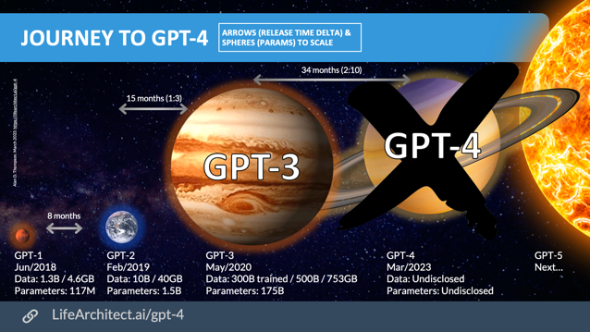
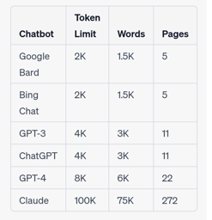
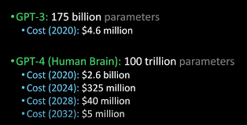
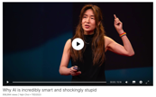

We live in exciting times…
Open-AI GPT (2018 – 2023)
Large amounts of data
Extreme scale compute
Transformers
In-context learning
  Gigantic! Trained on 1 – 2 trillion tokes = human reading 8 hours a day for 22 thousand years
https://lifearchitect.substack.com/p/the-memo-special-edition-gpt-4-release
https://www.ted.com/talks/yejin_choi_why_ai_is_incredibly_smart_and_shockingly_stupid/c?language=en
https://www.youtube.com/watch?v=DeSXnESGxr4
https://medium.com/@exceed73/claude-vs-chatgpt-a2b87f9e089b

Slide 4

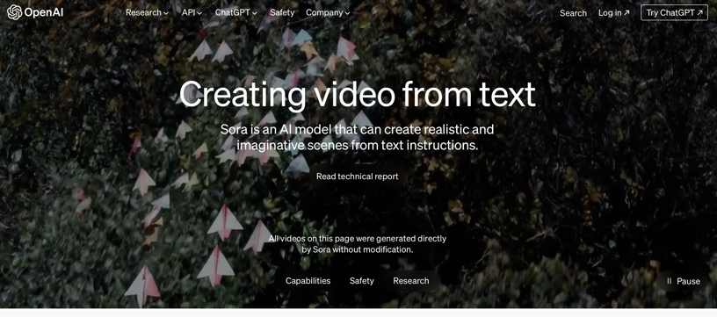
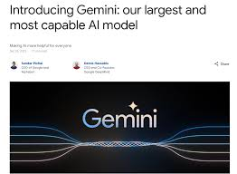
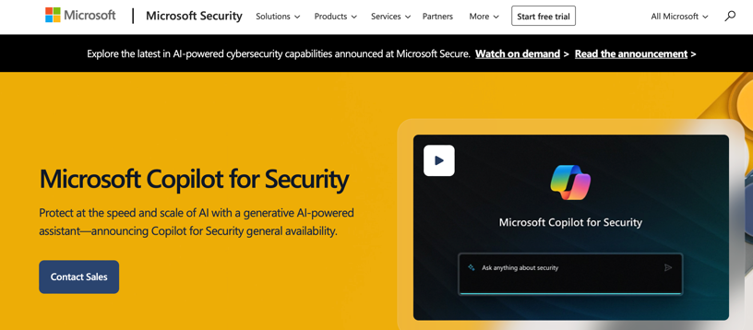

2024…

Slide 5
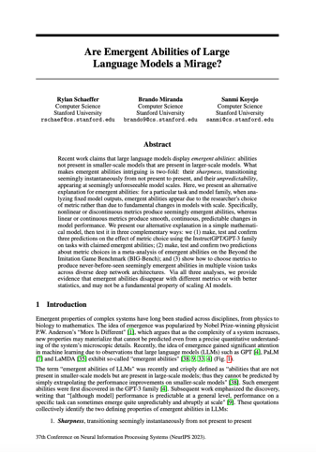
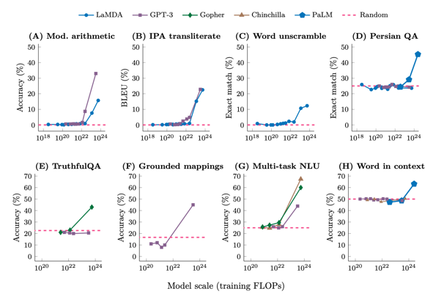
Model Scale and Emerging Capabilities
Emerging abilities are
due to our choice of metrics!
Scale = Compute
Scale Leads to Emerging Capabilities
https://arxiv.org/pdf/2206.07682.pdf

Slide 6
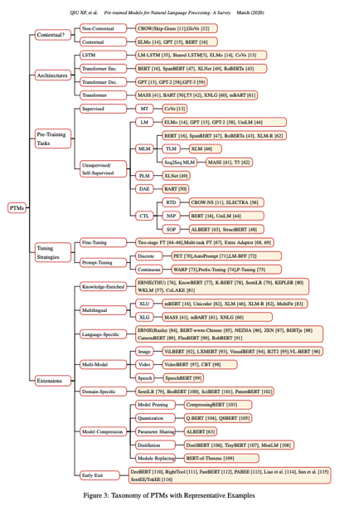
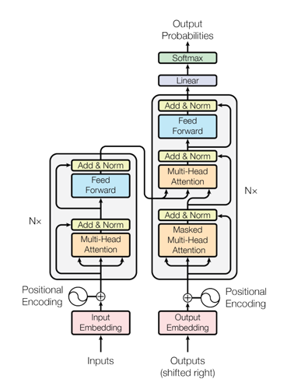
Transformer Evolution
https://arxiv.org/abs/1706.03762

Slide 7
Learning Evolution: In-context Learning
Deep learning (representation learning)
Fully supervised
Pre-trained models
(transfer learning)
Pre-train and fine-tune
Large-scale models
(in-context learning)
Pre-train and prompt
Zero-few shot in context learning
No architecture design
Architecture design
Models are applied to new tasks out of the box
Good performance with no or few examples
Tasks are adapted to models vs. models adapted to tasks
Humans can interact with the models using natural language
Blurring the line between LM users and developers
https://www.microsoft.com/en-us/research/blog/ai-explainer-foundation-models-and-the-next-era-of-ai/

Slide 8
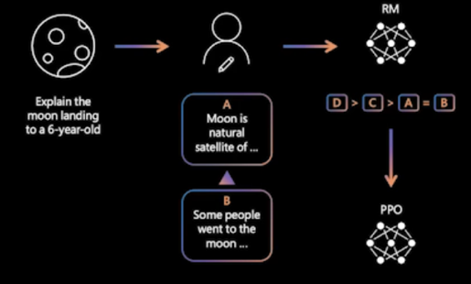
Reinforcement Learning with Human Feedback
Human-generated data
  Humans rank the output (coming from different models or versions on the main model)
  Reward model trained to assign the reward to each input (main model output)
Fine-tuning
  The reward model calculates reward for the output, which is used to update the policy using PPO
https://arxiv.org/pdf/2203.02155.pdf

Slide 9
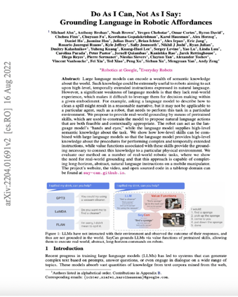
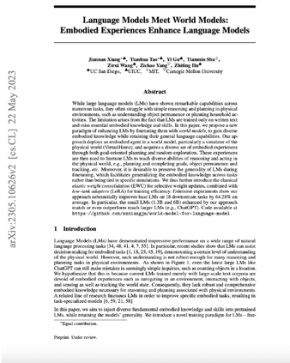
Intelligent Agents
LLMs struggle with reasoning and planning in physical environments
Agents with real-world experiences
… with pre-trained skills
… with real-world grounding
… with embodied knowledge
….
Socially aware intelligent agents
Hybrid human-agent teams
https://arxiv.org/abs/2204.01691
https://arxiv.org/abs/2305.10626

Slide 10
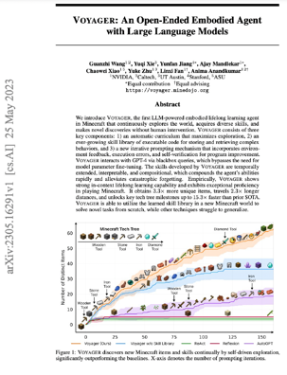
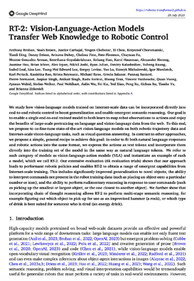
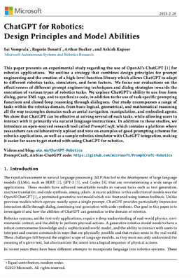
Intelligent Agents with Shared Experiences
Learning from observations
Learning from interactions with each other and with the environment
Learning through shared experiences
https://voyager.minedojo.org/
https://robotics-transformer2.github.io/assets/rt2.pdf
https://arxiv.org/abs/2306.17582

Slide 11
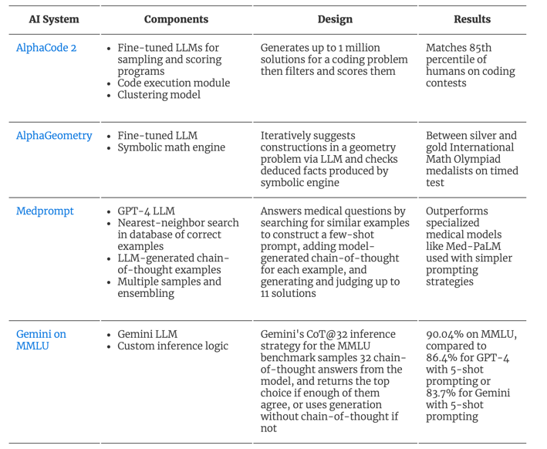
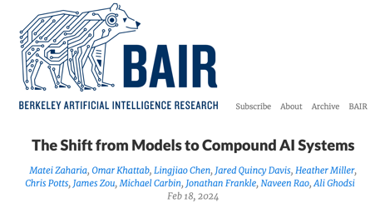
Compound AI Systems

Slide 12

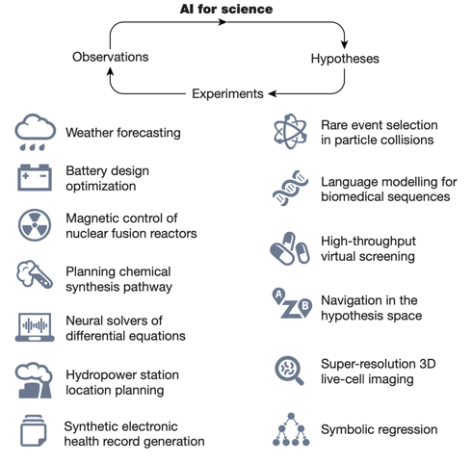
AI for Science
Wang, Hanchen, et al. "Scientific discovery in the age of artificial intelligence." Nature 620.7972 (2023): 47-60.
12

Slide 13
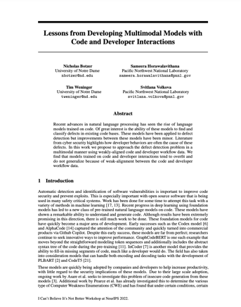
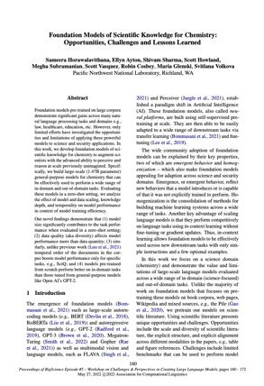
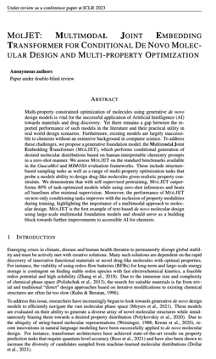
Our Team’s LLMs and PTMs for Science
https://openreview.net/pdf?id=iUUvNqUzJX2
https://aclanthology.org/2022.bigscience-1.12.pdf
https://openreview.net/pdf?id=7UudBVsIrr

Slide 14
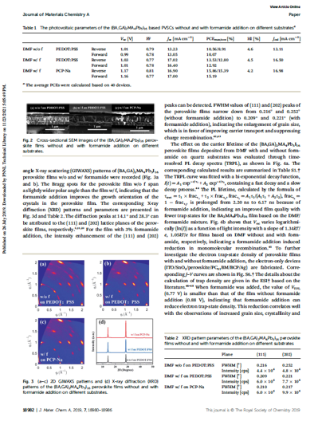

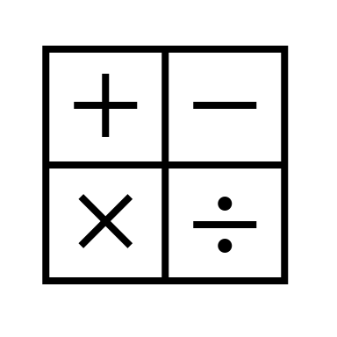
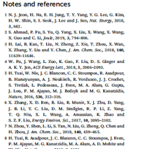



Multimodal Scientific Knowledge
TBD
Tables
TBD
Equations
TBD
Text
TBD
TBD
Citation Graphs
SMILES
NC=O
TBD
Images
TBD
Code

Slide 15
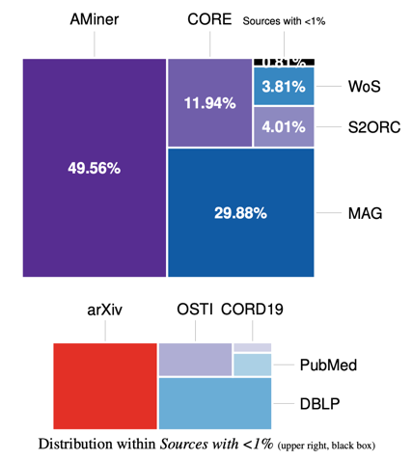
Scaling AI for Scientific Discovery for Chemistry
Science Benchmarks
Best zero-shot performance in chemistry college-level and general science questions outperforming
GPT-2 models
Scaling Effect
Larger models need to be trained with more tokens to achieve better performance by diversifying knowledge
Diversity Effect
XLarge models trained with combined abstract data achieved lowest perplexity in language modeling
Temporal Effect
Question answering and reasoning zero-shot task performance improve over time when learning from temporally-ordered documents
  Foundation Models of Scientific Knowledge for Chemistry: Challenges, Opportunities and Lessons Learned. Big Science Challenges and Perspectives in Creating Large Language Models Workshop. Association for Computational Linguistics 2022.
15

Slide 16


Science Benchmarks
Hendrick's Test Example (College QA)
Prompts are in Blue Model answers are in Black
Question: A buffer is made from equal concentrations of a weak acid and its conjugate base. Doubling the volume of the buffer solution by adding water has what effect on its pH?
Choices:
It has little effect
It significantly increases the pH.
It significantly decreases the pH.
It changes the pH asymptotically to the pKa of the acid.
Answer: A
Question: The T2 of an NMR line is 15 ms. Ignoring other sources of linebroadening, calculate its linewidth.
Choices:
A. 0.0471 Hz B. 21.2 Hz C. 42.4 Hz D. 66.7 Hz
Answer: B
Question: Of the following ions, which has the smallest radius?
Choices:
A. K+ B. Ca2+ C. Sc3+ D. Rb+
Answer: C
Question: Chlorofluorocarbons (CFCs) such as F3CCCl3 are implicated in the decomposition of stratospheric ozone. Which of the following methods would be best suited to measurement of trace amounts (sub-ppb) of CFCs in an air sample?
Choices:
Gas chromatographic separation of the air sample on a capillary column followed by electron capture detection
Gas chromatographic separation of the air sample on a packed column followed by thermal conductivity detection
Gas chromatographic separation of the air sample on a capillary column followed by flame ionization detection
Conversion of the sample of the chlorinated compounds to chloride ions, followed by titration with Ag+
Answer: A
Question: Of the following ionic substances, which has the greatest lattice enthalpy?
Choices:
A. MgO B. MgS C. NaF D. NaCl
Answer: D
Question: Which of the following metal ions cannot be used as a paramagnetic quencher?
Choices:
A. Ti3+ B. Cr3+ C. Fe3+ D. Zn2+
Answer: C
16

Slide 17
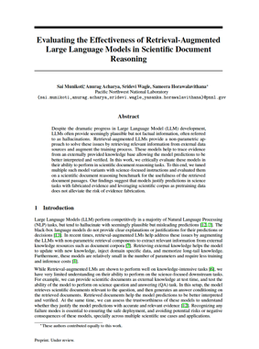
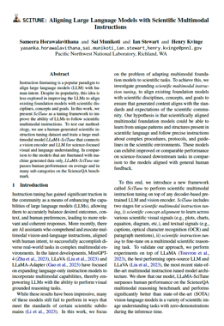
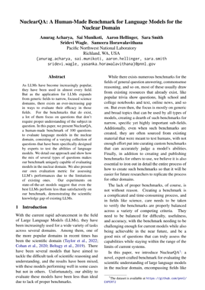
Cross-Disciplinary Multimodal Scientific Reasoning
Retrieving structural knowledge helps to improve the overall performance for intra and inter-disciplinary reasoning: science Q&A and document classification
LLaMA-SciTune (13B) model outperforms human performance; models pretrained across modalities perform better than the model pretrained only with captions.
SOTA LLMs like Llama 2, Galactica, FlanT5, and UnifiedQA still perform poorly on NuclearQA, with the best model (Llama 2) only able to fully answer 16% of questions correctly.
https://arxiv.org/abs/2307.01139
Notes:
Learning to retrieve right knowledge and reason with evidence
Structure-Aware LLMs for Interdisciplinary Science
Multimodal Agents for Scientific Reasoning

Slide 18
Towards Autonomous Scientific Discovery
LLMs to allow robots to read, understand, and generate scientific texts to help them interpret experimental results and procedures.
Improvements in multimodal learning to enable robots to recognize objects, read instrumentation, and visually guide experiments.
Reinforcement learning and simulation-based training that allows robotic control policies to be learned through trial-and-error in a virtual environment to conduct experiments without real-world risks.
Distributed learning to leverage collective experience from teams of robotic scientists working collaboratively on experiments.

Slide 19
AI Threats for the Information Environment
“…developments in artificial intelligence technology would enable the PRC to surgically target foreign audiences…”
Source - Global Engagement Center Special Report: How the People’s Republic of China Seeks to Reshape the Global Information Environment (2023)
Rapid content generation
  Multimodal
  Multilingual
High volume
Low cost
May be difficult to distinguish between auto- and human-generated content
Malicious code generation
  The ability to perform API call
Targeted mis/disinformation

Slide 20
Emerging Generative AI Trends for IE
Actors
  Larger number and more diverse group of propagandists emerge
  Outsourced firms become more important
Behavior
  Automating content production increases scale of campaigns
  Existing behaviors become more efficient
  Novel tactics emerge
Content
  Messages are more credible and persuasive
  Propaganda is less discoverable
Source - Goldstein, J.A., Sastry, G., Musser, M., DiResta, R., Gentzel, M., & Sedova, K. (2023). Generative Language Models and Automated Influence Operations: Emerging Threats and Potential Mitigations. ArXiv, abs/2301.04246.

Slide 21
Generative AI Mitigation Technologies
View generative AI as an opportunity not just a threat
Challenges can be mitigated by supporting planners, operators, and assessors with generative AI technologies
Data-driven decision making
  Multilingual
  Multimodal
Information sharing and collaboration
Tailored to user requirements
Planners
Operators
Assessors

Slide 22
Cognitive Security and Resilience
SEMAFOR
PODIUM
BRIES
IDEA
Detect, attribute, characterize semantic inconsistencies
Multimodal AI-driven approaches for text, speech, image and video processing
Promote civil healthy interactions on social media
Conversational agents to generate multimodal content and test interventions
Information Narrative Detection and Analysis
AI-driven analytics for information and cognitive domain assessment with causal explanations
Building Resilient Information Ecosystem for Science
Generative agents and causal discovery to enable counterfactual reasoning

Slide 23
IDEA: Information Narrative Detection and Analysis
Equip operators and decision makers with automated AI-driven tools to achieve information advantage

Slide 24
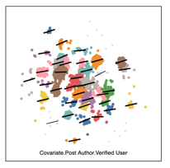
Technical Approach Proto-Narrative Detection
Transform unstructured social media streams into interactive and interpretable narrative representations
Interpretable Structured Narrative Representations
Interactive Narrative Embedding Clusters
We are defending Russian-speaking people in Donbas
defend
Donbas
We
Special military operation to achieve demilitarization and de-nazification of Ukraine
Entity Resolution
Entity Resolution
DNR
Russians
Semantic similarity (word-level embeddings) combined with the NLP enrichments (parsing, entity disambiguation) to represent narratives’ structure (e.g., concepts, relations)
Liberating Ukrainians from Nazi regime
Clustering based on SVO similarity across monolingual and multilingual
embedding spaces
Detecting and Summarizing Narratives in the Information Environment: A Case Study of Misinformation and Disinformation Campaigns. E. Saldanha, …, S. Volkova. Detecting Online Propaganda and Misinformation 2023
24
Notes:
Narrative theory of Labov and Waletzky (Complication and Resolution)
IDEA aims to support top-bottom (with no specified initial query) or bottom-up analytics workflows (e.g., given a set of entities or a narrative “Ukraine started the war, not us… we are defending our motherland”) to:
Convert initial text queries into embedding vectors
Apply spatiotemporal filter e.g., Δt (day, hour) to sample content across platforms
Perform initial sampled content embedding in the text space
Apply several similarity measures find similarity between tweets

Slide 25
Technical Approach Cross-Platform Engagement and Target Audience Analysis
How do narratives spread? How fast, how far, how equally and for how long?
What are the recurrent patterns of narrative evolution?
What are social network characteristics and community properties across narratives?
What audiences engage with narratives? What are their reactions, perspectives, beliefs, attitudes, and behaviors?
Why do some narratives spread, and some do not? Why are some audiences more susceptible than others?
Narrative Engagement
Narrative Recurrence
Narrative Network Analysis
Audience Analysis
Causal Analysis
Machine Intelligence to Detect, Characterize, and Defend against Influence Operations in the Information Environment. S. Volkova et al. Journal of Information Warfare 2021.

Slide 26

Technical Approach Target Audience and Causal Engagement Analysis
Target audience analysis focuses on extending Aptima’s existing AI models to analyze social, cultural, linguistic, psychological and other factors in the IE
Perspectives^{[1,2]}
Reactions^{[3]}
Attitudes^{[4-6]}
Moral framing^{[4-6]}
Emotions^{[7]}
Psycho-demographics^{[8]}
  Gender, age, education, native language
Causal engagement analysis focuses on structural causal models of how relevant features of the world interact with each other, i.e., the mechanisms by which data (observations) are generated.
The causal effect of X on Y is calculated by:
Algorithms used include:
Constraint-based
Score-based
Aptima’s Causal Ensemble Model
(as published in NeurIPS Workshop on
Causal Discovery & Causality-inspired ML)^{[9-11]}
  [1] Multilingual Connotation Frames: A Case Study on Social Media for Targeted Sentiment Analysis and Forecast. H. Rashkin, E. Bell, Y. Choi, and S. Volkova. ACL’17.
  [2] An Enriched Sentiment Analysis Dataset for Social Media in Russian. A. Rogers, A. Romanov, A. Rumshisky, S. Volkova, M. Gronas, and A. Gribov. COLING’18.
  [3] Identifying and Understanding User Reactions to Deceptive and Trusted Social News Sources. M. Glenski, T. Weninger, and S. Volkova. ACL’18.
  [4] Separating Facts from Fiction: Linguistic Models to Classify Suspicious and Trusted News Posts on Twitter. S. Volkova, K. Shaffer, J. Jang, N. Hodas. ACL 2017.
  [5] Truth of Varying Shades: On Political Fact-Checking and Fake News. H. Rashkin, E. Choi, J. Jang, Y. Choi, and S. Volkova. EMNLP 2017.
  [6] Misleading or Falsification? Inferring Deceptive Strategies and Types in Online News and Social Media. S. Volkova and J. Jang. WWW Track on Journalism, Misinformation and Fact Checking 2018.
  [7] Inferring Perceived Demographics from User Emotional Tone and User-Environment Emotional Contrast. S. Volkova and Y. Bachrach. ACL’16.
  [8] Dr. Volkova’s Dissertation: Predicting Demographics and Affect in Social Networks. Johns Hopkins University. 2015
[9] Saldanha, … S. Volkova. 2020. Evaluation of Algorithm Selection and Ensemble Methods for Causal Discovery. In Causal Discovery & Causality-Inspired Machine Learning Workshop at Neural Information Processing Systems, December 2020.
[10] Glenski M.F., S. Volkova. Identifying Causal Influences on Publication Trends and Behavior: A Case Study of the Computational Linguistics Community. In EMNLP Workshop on Causal Inference & NLP. 2020.
[11] Data-Driven Estimation of Heterogeneous Treatment Effects. C Tran, K Burghardt, K Lerman, E Zheleva. 2023.
[12] Leveraging change point detection to discover natural experiments in data. Y.He, KA Burghardt, K Lerman. EPJ Data Science 11 (1), 49
26
Notes:
.

Slide 27
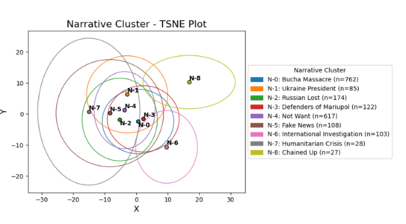
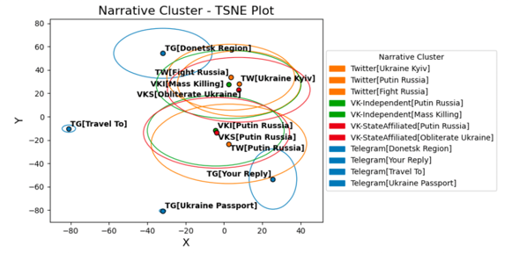
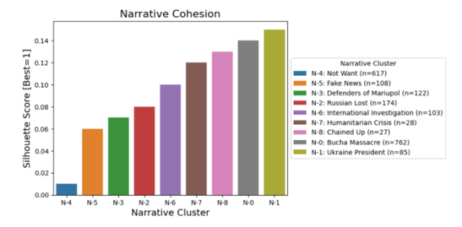
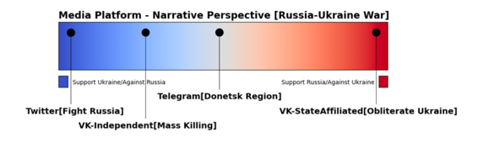
Russia-Ukraine War Cross-Platform Analysis: Narrative Detection
Twitter Narratives
Cross-Platform Narratives

Slide 28
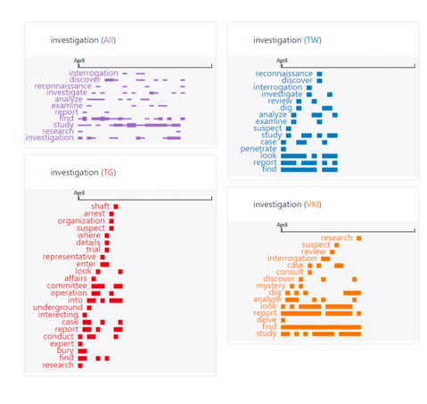
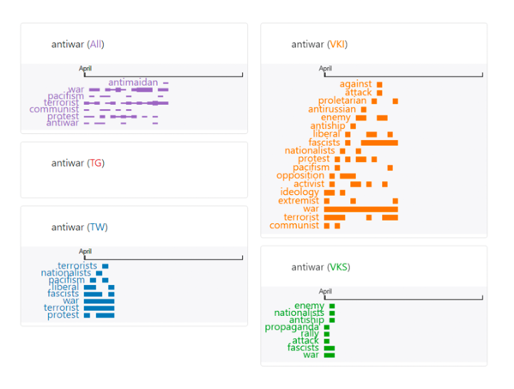
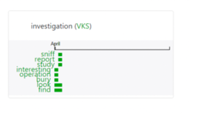
Russia-Ukraine War Cross-Platform Analysis:
Contrastive Narrative Evolution
Investigation
Antiwar

Slide 29
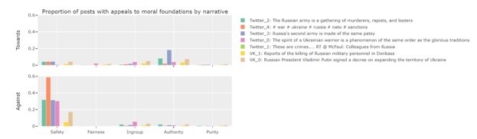
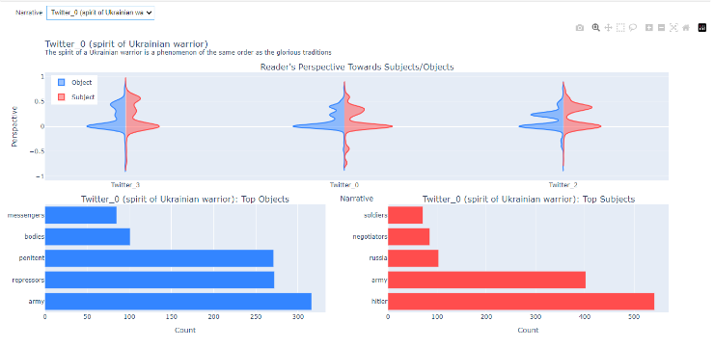
Russia-Ukraine War Twitter and VK Analysis:
Cross-Platform Cognitive Domain Analytics
Target Audience Toxicity & Subjectivity
Target Audience Moral Values
Target Audience Perspectives

Slide 30
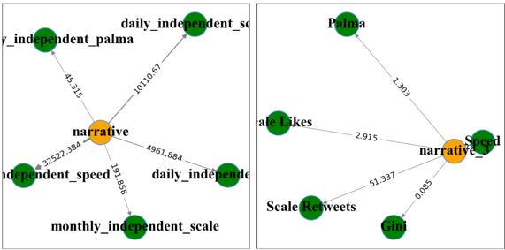
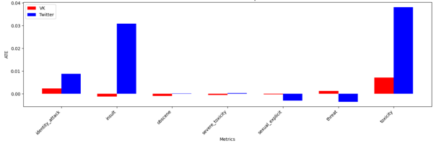
Russia-Ukraine War Cross-Platform Analysis:
Information and Cognitive Domain Analytics
Causal Structure Learning
Cross Platform TAE
Volkova, S., et al. (2023). Explaining and predicting human behavior and social dynamics in simulated virtual worlds: reproducibility, generalizability, and robustness of causal discovery methods. Computational and Mathematical Organization Theory, 29(1).
Saldanha, … S. Volkova. (2020). Evaluation of Algorithm Selection and Ensemble Methods for Causal Discovery. In Causal Discovery & Causality-Inspired Machine Learning Workshop at Neural Information Processing Systems.
Glenski, M., & Volkova, S. (2021). Identifying Causal Influences on Publication Trends and Behavior: A Case Study of the Computational Linguistics Community. In Proceedings of the First Workshop on Causal Inference and NLP (pp. 83-94).
Guo, G., Glenski, M.F., Shaw, Z.H., Saldanha, E.G., Endert, A., Volkova, S., & Arendt, D.L. (2021). VAINE: Visualization and AI for natural experiments. IEEE VIS 2021.
Cottam, J.A., Glenski, M.F., Shaw, Z.H., Rabello, R.S., Golding, A.J., Volkova, S., & Arendt, D.L. (2021). Graph comparison for causal discovery. Visualization in Data Science 2021.

Slide 31
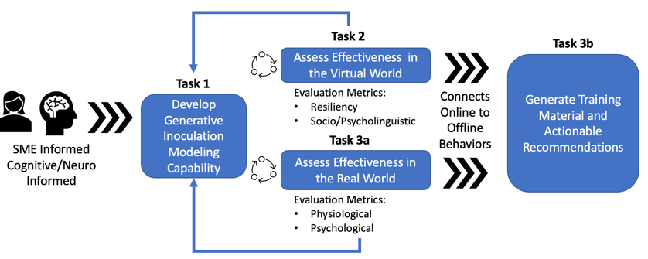
Building Resilient Information Ecosystem
BRIES aims to create a "reputational armor" for scientists and research organizations by leveraging advances in large pre-trained models (LLMs and multimodal foundation models) to:
  identify and validate optimal inoculation strategies;
  provide the evidence of the effectiveness of counter measures; and
  demonstrate that the defense mechanisms reduce targeted attacks on scientists and scientific claims.
Notes:
Generative agents and causal discovery to enable counterfactual reasoning

Slide 32
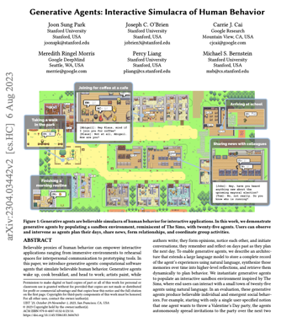
From LLMs to Intelligent Agents
BRIES is a novel proactive capability, built on the utilization of large-scale pretrained models and counterfactual reasoning to
  uncover quantifiable evidence of the effectiveness of defense strategies against targeted attacks in the IE, and
  give a demonstration of how specific defense mechanisms reduce these attacks.
https://arxiv.org/pdf/2304.03442.pdf
BRIES will push the SOTA by developing socially aware and emotionally intelligent generative agents

Slide 33
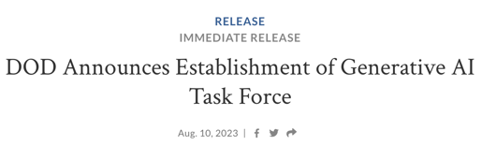
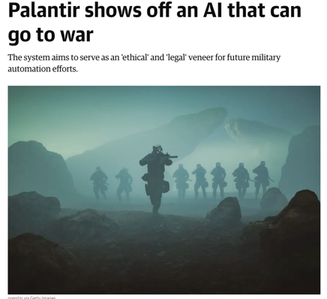
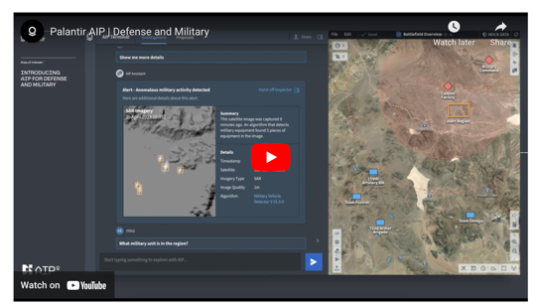
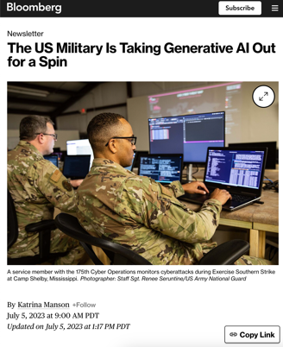
Generative AI and the DoD Mission
https://www.defense.gov/News/Releases/Release/Article/3489803/dod-announces-establishment-of-generative-ai-task-force/
https://www.youtube.com/watch?v=XEM5qz__HOU

Slide 34

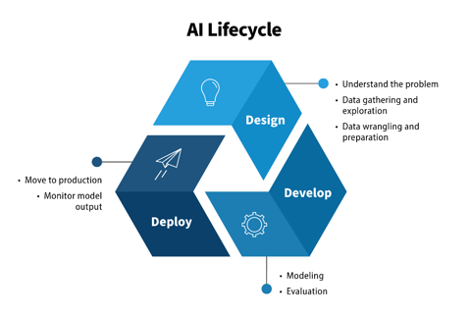
Safe, Secure and Trustworthy AI
Establish guidelines and best practices for developing and deploying safe, secure, and trustworthy AI systems
Develop standards and procedures for developers of AI to conduct AI red-teaming tests
A plan for developing the Department of Energy’s AI model evaluation tools and AI testbeds

Slide 35
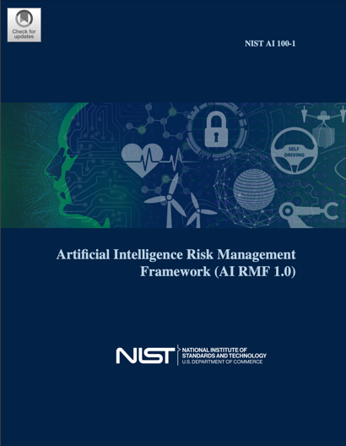

NIST AI Risk Management Framework (AI RMF)
Characteristics of Trustworthy AI Systems
https://nvlpubs.nist.gov/nistpubs/ai/NIST.AI.100-1.pdf

Slide 36

2023 Data, Analytics, and AI Adoption Strategy
Accelerate adoption of data, analytics and AI
Agile, user-focused, product-centric development is essential because humans and machines will work together in the responsible, effective employment of data, analytics, and AI-enabled capabilities.
https://media.defense.gov/2023/Nov/02/2003333301/-1/-1/1/DAAIS_FACTSHEET.PDF
https://media.defense.gov/2023/Nov/02/2003333300/-1/-1/1/DOD_DATA_ANALYTICS_AI_ADOPTION_STRATEGY.PDF
https://www.defense.gov/News/Releases/Release/Article/3577857/deputy-secretary-of-defense-kathleen-hicks-announces-publication-of-data-analyt/

Slide 37


















AI Community Research Capabilities
Focus on metrics and one-off tools
Accountability | Transparency
Fairness | Robustness
37
Notes:
Responsible: datasheets, model and systems cards

Slide 38

Foundation Model Transparency Index
https://crfm.stanford.edu/fmti/

Slide 39


Beyond Classic AI/ML Performance Measures
Accountability: Relative reliability when applied in key circumstances (operational datasets, problem sets, tasks, and scenarios)
Robustness: Quantitative metrics for testing resiliency to variations in data input
Transparency of model behavior and identify points of failure through data inputs and model predictions trust in AI/ML in operational setting
CrossCheck^{[1]} Understanding representative data and reason for model misclassifications
[1] CrossCheck: Rapid, Reproducible, and Interpretable Model Evaluation. Arendt, D., Shaw, Z., Shrestha, P., Ayton, E., Glenski, M., and Volkova, S. ACL Workshop on Data Science with HITL. 2021.
[2] ESTEEM: A Novel Framework for Qualitatively Evaluating and Visualizing Spatiotemporal Embeddings in Social Media. D. Arendt, and S. Volkova. ACL’17
[3] W. Wu, D. Arendt, S. Volkova. (2021) Evaluating Neural Machine Comprehension Model Robustness to Noisy Inputs and Adversarial Attacks. EACL’21.
ESTEEM^{[2]} Visualizing spatiotemporal embeddings
Notes:
Responsible: datasheets, model and systems cards

Slide 40




AI Limitations
AI/ML systems:
  Are specialized and brittle
  Neither reason nor plan (except those that play games and control robots)
  Make stupid mistakes
  Do not use common sense
Humans:
  Can lean new tasks very quickly
  Understand how the world works
  Can reason and plan
    Perform chains of reasoning with an unlimited number of steps
    Can plan complex tasks by decomposing them into subtasks
  Have common sense
  Can predict consequences of their actions
https://www.noemamag.com/ai-and-the-limits-of-language/

Slide 41




Machine Learning vs. Human Learning
Learning to reason
…cause and effect
…to plan
Babies learn by observation and initially with little communication
Accumulate a lot of background knowledge
Does common sense emerge from observation and communication?
… skills
…through experiences

Slide 42

Dr. Svitlana Volkova
svolkova@aptima.com

Slide 43
Generative AI for Science
Horawalavithana, S., Ayton, E., Sharma, S., Howland, S., Subramanian, M., Vasquez, S., ... & Volkova, S. (2022). Foundation models of scientific knowledge for chemistry: Opportunities, challenges and lessons learned. In Proceedings of BigScience Episode# 5--Workshop on Challenges & Perspectives in Creating Large Language Models
Dollar, O. W., Horawalavithana, S., Vasquez, S., Pfaendtner, W. J., & Volkova, S. (2022). MolJET: Multimodal Joint Embedding Transformer for Conditional de novo Molecular Design and Multi-Property Optimization.
Botzer, N., Horawalavithana, S., Weninger, T., & Volkova, S. (2022). Lessons from Developing Multimodal Models with Code and Developer Interactions. In I Can't Believe It's Not Better Workshop: Understanding Deep Learning Through Empirical Falsification.
Munikoti, S., Acharya, A., Wagle, S., Horawalavithana, S. (2023) Evaluating the Effectiveness of Retrieval-Augmented Large Language Models in Scientific Document Reasoning. (preprint)
Munikoti, S., Acharya, A., Wagle, S., Horawalavithana, S. (2023) ATLANTIC: Structure-Aware Retrieval-Augmented Language Model for Interdisciplinary Science.
Horawalavithana, S., Munikoti, S., Stewart, I., & Kvinge, H. (2023). SCITUNE: Aligning Large Language Models with Scientific Multimodal Instructions.
Acharya, A., Munikoti, S., Hellinger, A., Smith, S., Wagle, S., Horawalavithana, S. (2023) NuclearQA: A Human-Made Benchmark for Language Models for the Nuclear Domain.

Slide 44
AI-powered Cognitive Security and Resilience
Volkova, S., Glenski, M., Ayton, E., Saldanha, E., Mendoza, J., Arendt, D., ... & Greaves, M. (2021). Machine Intelligence to Detect, Characterise, and Defend against Influence Operations in the Information Environment. Journal of Information Warfare, 20(2), 42-66.
Rashkin, H., Bell, E., Choi, Y., & Volkova, S. (2017). Multilingual connotation frames: A case study on social media for targeted sentiment analysis and forecast. In Proceedings of the 55th Annual Meeting of the Association for Computational Linguistics (pp. 1489-1498).
Rogers, A., Romanov, A., Rumshisky, A., Volkova, S., Gronas, M., & Gribov, A. (2018). An enriched sentiment analysis dataset for social media in Russian. In Proceedings of the 27th International Conference on Computational Linguistics (pp. 714-725). Santa Fe, New Mexico, USA: Association for Computational Linguistics.
Glenski, M., Weninger, T., & Volkova, S. (2018). Identifying and understanding user reactions to deceptive and trusted social news sources. In Proceedings of the 56th Annual Meeting of the Association for Computational Linguistics (Volume 1: Long Papers) (pp. 1890-1901).
Volkova, S., Shaffer, K., Jang, J., & Hodas, N. (2017). Separating facts from fiction: Linguistic models to classify suspicious and trusted news posts on Twitter. In Proceedings of the 55th Annual Meeting of the Association for Computational Linguistics (pp. 647–653).
Rashkin, H., Choi, E., Jang, J. Y., Choi, Y., & Volkova, S. (2017). Truth of varying shades: Analyzing language in fake news and political fact-checking. In Proceedings of the 2017 Conference on Empirical Methods in Natural Language Processing (pp. 2931–2937).
Volkova, S., & Jang, J. Y. (2018). Misleading or falsification? Inferring deceptive strategies and types in online news and social media. In Companion Proceedings of the The Web Conference 2018 (pp. 575-583).
Saldanha, T., Ghassemi, M., Klementiev, A., Volkova, S., & Cohen, W. W. (2020). Evaluation of algorithm selection and ensemble methods for causal discovery. In Causal Discovery & Causality-Inspired Machine Learning Workshop at Neural Information Processing Systems.
Glenski, M. F., & Volkova, S. (2020). Identifying causal influences on publication trends and behavior: A case study of the computational linguistics community. In Proceedings of the Second Workshop on Causal Inference and NLP (pp. 1-11).

Slide 45
Safe, Secure and Trustworthy AI
Robustness
W. Wu, D. Arendt, S. Volkova. (2021) Evaluating Neural Machine Comprehension Model Robustness to Noisy Inputs and Adversarial Attacks. EACL’21.
M. Glenski, E. Ayton, R. Cosbey, D. Arendt, and S. Volkova. (2020). Towards Trustworthy Deception Detection: Benchmarking Model Robustness across Domains, Modalities, and Languages. International Workshop on Rumors and Deception in Social Media at COLING.
M. Glenski, E. Ayton, R. Cosbey, D. Arendt, and S. Volkova. (2021). Evaluating Deception Detection Model Robustness To Linguistic Variation." In International Workshop on Natural Language Processing for Social Media (SocialNLP).
Transparency
Volkova, S., Ayton, E., Arendt, D., Huang, Z., & Hutchinson, B. (2019). Explaining Multimodal Deceptive News Prediction Models. Proceedings of the International AAAI Conference on Web and Social Media.
Arendt, D., & Volkova, S. (2017). ESTEEM: A novel framework for qualitatively evaluating and visualizing spatiotemporal embeddings in social media. Proceedings of ACL 2017, System Demonstrations.
Reliability
Arendt, D., Huang, Z., Shrestha, P., Ayton, E., Glenski, M., & Volkova, S. (2021). CrossCheck: Rapid, Reproducible, and Interpretable Model Evaluation. Workshop on Data Science with Human-in-the-loop: Language Advances (DaSH-LA) colocated with NAACL 2021.
Arendt, D., E. Grace, and S. Volkova. (2018). Interactive machine learning at scale with CHISSL. In Thirty-Second AAAI Conference on Artificial Intelligence.
S., Emily, L. M. Blaha, A. V. Sathanur, N. Hodas, S. Volkova, and M. Greaves. (2019). Evaluation and Validation Approaches for Simulation of Social Behavior: Challenges and Opportunities." In Social-Behavioral Modeling for Complex Systems.
Human-AI Integration and Trust
ReCarmody, K., Ficke, C., Nguyen, D., Addis, A., Rebensky, S., & Carroll, M. (2022). A Qualitative Analysis of Trust Dynamics in Human-Agent Teams (HATs). In Proceedings of the Human Factors and Ergonomics Society Annual Meeting (Vol. 66, No. 1, pp. 152-156). Sage CA: Los Angeles, CA: SAGE Publications.
bensky, S., Carmody, K., Ficke, C., Carroll, M., & Bennett, W. (2022). Teammates instead of tools: The impacts of level of autonomy on mission performance and human-agent teaming dynamics in multi-agent distributed teams. Frontiers in Robotics and AI, 102.
Rebensky, S., et al. (2021) Whoops! Something went wrong: Errors, trust, and trust repair strategies in human agent teaming. Artificial Intelligence in HCI: Second International Conference, AI-HCI 2021, Held as Part of the 23rd HCI International Conference, HCII 2021, Virtual Event, July 24–29, 2021, Proceedings. Cham: Springer International Publishing.
Ezer, N., Bruni, S., Cai, Y., Hepenstal, S. J., Miller, C. A., & Schmorrow, D. D. (2019). Trust engineering for human-AI teams. In Proceedings of the Human Factors and Ergonomics Society Annual Meeting (Vol. 63, No. 1, pp. 322-326). Sage CA: Los Angeles, CA: SAGE Publications.

