Slide 1
What is AI?
Systems that…
act like humans (Turing Test)
think like humans
think rationally
act rationally
Play Ultimatum Game

Slide 2
What is an agent?
Perceives environment
Operates autonomously
Persists over prolonged periods

Slide 3
What is a rational agent?
Environment
Sensors (percepts)
Actuators (actions)

Slide 4
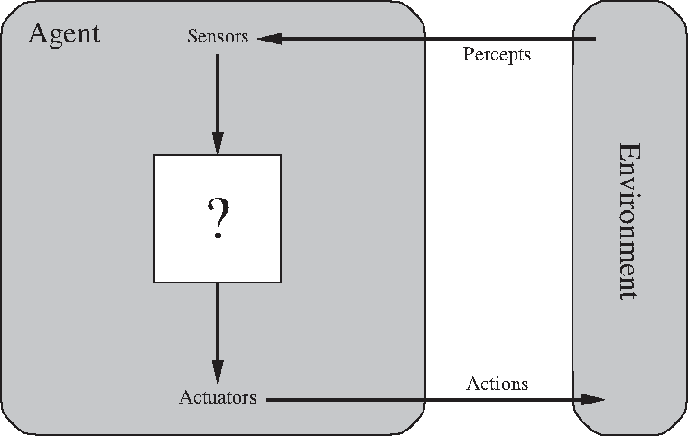
Agent-Environment Interactions
Environment
Sensors (percepts)
Actuators (actions)

Slide 5
What is a rational computer agent?
Environment
Sensors (percepts)
Actuators (actions)
Agent Function
Agent Program

Slide 6
Vacuum Agent World

Slide 7
Rational agent behavior
depends on:
Agent’s performance measure
Agent’s prior knowledge
Possible percepts and actions
Agent’s percept sequence

Slide 8
Rational Agent Definition
“For each possible percept sequence, a rational agent selects an action that is expected to maximize its performance measure, given the evidence provided by the percept sequence and any prior knowledge the agent has.”

Slide 9
PEAS description & properties:
Fully/Partially Observable
Deterministic, Stochastic, Strategic
Episodic, Sequential
Static, Dynamic, Semi-dynamic
Discrete, Continuous
Single agent, Multiagent
Competitive, Cooperative
Known, Unknown

