Slide 1
About Me
Deacon Seals
Ph.D. student researching competitive coevolution
TA, grader, and assignment creator for this course
Missouri University of Science & Technology (2018)
Triple B.S. in electrical engineering, computer engineering, and computer science
Became a TA for Dr. T in 2018
Auburn University (2019-current)
M.S. Computer Science and Software Engineering – 2023
Technical Project Lead – CEADS-LIN
Collaboration with Los Alamos National Lab
Teaching Assistant – Evolutionary Computing – 2019-2023
Created new assignments for entire course

Slide 2
Artificial Intelligence for Uninitiated Colleagues
Slides by Deacon Seals

Slide 3
Disclaimer
There are a multitude of philosophical debates surrounding AI that this presentation doesn’t attempt to address:
What constitutes intelligence/thought?
How should intelligence be measured/quantified/defined?
AI Singularity (self-awareness)
The topics within scope of this presentation:
Problems AI techniques are suitable for
Taxonomy of AI techniques and their characteristics
Demystifying and de-snake-oiling AI
Time willing, a (brief) historical overview of the field of AI

Slide 4
Table of Contents
What is AI?
AI problem classes
Representations in AI
Optimization techniques

Slide 5
What is Artificial Intelligence?

Slide 6
What is Artificial Intelligence?
Historically, difficult to answer
Most fields experience chaos in their infancy and AI is no different
Currently, the field of AI is a superset of many other fields; each with their own techniques and practices
Lots of confusing terms with loose and/or overlapping definitions
Machine learning
Computational intelligence
Better question: What passes as artificial intelligence?
Changes periodically as motivations and capabilities evolve
Useful in explaining historical progression of AI

Slide 7
What Passes As Artificial Intelligence?
Faster than a human
Solve puzzles, mazes, etc. quickly
Search algorithms: breadth-first, depth-first, iterative deepening depth-first, A* (pronounced “A star”) search
Outsmarting a human
Beat grandmasters at Chess, Go, Starcraft II, etc.
Identify images better than humans (e.g., detecting cancer)
Designing more efficient circuits, airfoils, delivery routes, etc.
Approaching human behavior
Writing text coherently
Driving a car

Slide 8
What is an AI algorithm?
Almost always an optimization and/or search algorithm
Solves problems by manipulating a solution representation of some kind
Typically employs a performance metric to guide creation of new/better solutions
Solution representation and optimization technique vary between subfields of AI
More on these topics later

Slide 9
Common AI Tasks

Slide 10
A Coarse AI Task Taxonomy
Discrete Decision – Which option(s) should I select?
Continuous Decision – What value should I output for a particular input?
Generation – What thing would solve my problem well?

Slide 11
Discrete Decision
Which option(s) should I select?
Assuming a discrete number of options
Classification
Binary classification – Correctly output true or false to a given input
E.g., Does an image contain a dog?
N-ary classification – Correctly select one of N options for a given input
E.g., Correctly label a picture of a horse, dog, cat, boat, etc.
Multi-label classification – Correctly select a set of N options for a given input
E.g., What are the correct keywords for a publication?
Metric: accuracy
Which discrete action would be best to make in, for example, a game?
Metric: game score

Slide 12
Discrete Selection/Classification
Goal: select the best option
Each output corresponds to specific option
Generate a score for each option
Choose the option with the best (e.g., highest) score
Option 1
Option 2
AI Model
Option 3
Information
Option4
…
Option N

Slide 13
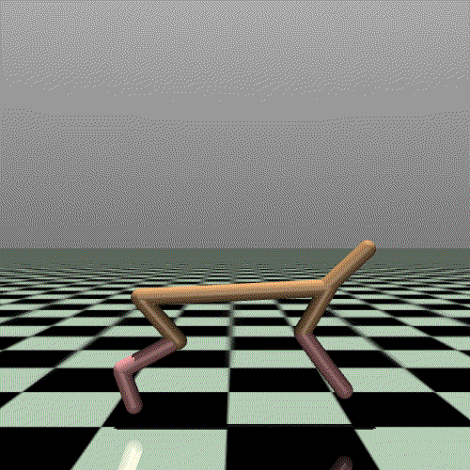
Continuous Decision(s)
What continuous value should I output for a particular input?
Regression
Find a function that produces the same output as a collection of data
Metric: error from expected output
Control tasks
How much power should be applied to a motor to control a robot?
Metric: robot performance (e.g., distance moved)

Slide 14
Continuous Heuristic
AI Model
Option 1 Information
Option 1 Score
Goal: select the best option
Number of options is inconsistent
Generate a score for each option
Choose the option with the best (e.g., highest) score
AI Model
Option 2 Information
Option 2 Score
AI Model
Option 3 Information
Option 3 Score
…
AI Model
Option N Information
Option N Score

Slide 15
Generation
What thing would solve my problem well?
Generates artifacts rather than strictly numeric outputs
Artifacts often a collection of numeric values though
Automatic generation of
Art – Metric: human feedback or opinion of critic AI
Music – Metric: human feedback or opinion of critic AI
Game levels – Metric: human feedback, difficulty to player/AI, etc.
Circuits – Metric: circuit characteristics in simulation
Programs – Metric: program characteristics in execution (e.g., accuracy/speed of sorting)
Etc.

Slide 16
Other Common Tasks
Prediction
Clustering
Anomaly detection
Dimensional reduction

Slide 17
Representations in AI
What does your solution look like?

Slide 18
Direct Representations
Typically, a collection of decisions, discrete or continuous, that represent the solution to a problem
Exact form of solution is inherently problem specific
Often a one-off solution to a particular instance of a problem
Useful if solutions are sufficiently easy to find or need to solve problem is infrequent

Slide 19
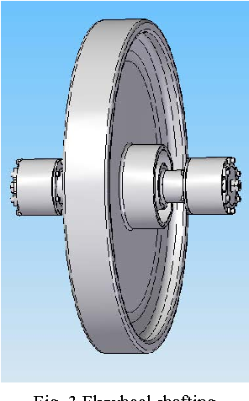
Flywheel Example
Spinning disks that store mechanical energy
Used for control moment gyroscopes and high-efficiency energy storage
Performance impacted directly by geometry of disk

Slide 20
Flywheel Direct Solution Representation
Flywheel geometry described by an array of thicknesses
Each thickness corresponds to some location in the flywheel cross section
Flywheel 01 = [5, 5, 2, 2, 2, 2, 2]
Assessed via simulation performance of each flywheel geometry
Optimize to improve energy storage

Slide 21
Indirect Solution Representations
Typically, a solution capable of solving multiple instances of a problem
Classification of arbitrary images
Agents capable of handling environments with stochasticity, arbitrary opponents, etc.
Search/optimization sometimes more difficult than direct solutions
A solution needs to perform well on multiple problem instances than just one
Depends greatly on required generality of solution and thoroughness of evaluation
Choice of indirect representation can also greatly impact performance/difficulty
Increased computational expense may be justified by inherent reusability of solution

Slide 22
Indirect Representations: Neural Networks
A linear algebra equation containing many numeric constants
These numeric constants are called parameters
The matrix operations in this equation can often be accelerated on GPU
This description is a slight oversimplification
Optimization of the parameters affects the behavior of the equation
If the equation is differentiable and we know the desired output of our equation for a particular input, then we can compute a gradient w.r.t. the equation parameters
This is the underlying technique behind deep learning optimization
Gradient computation can also be accelerated on GPU
Gradient-free optimization techniques, such as neuroevolution, also exist

Slide 23
Indirect Representations: Neural Networks
The input and output dimensions of a neural network are fixed
There are various methods to accommodate variable-length data
These methods mitigate the performance/usability impacts of this limitation, but not the limitation itself
A network consists of layers
Contain different linear algebra operations
Can affect the dimensionality of intermediate values of equation execution
The architecture of a network describes:
The collection of layers in a network
The sizes of each layer
The way in which intermediate values are passed between network layers

Slide 24
There’s a lot more to say about neural networks outside the scope of this lecture

Slide 25
Indirect Representations: Genetic Programming
A program or function comprised of primitive operations/values
Often organized as a tree, graph, or stack(s)
Typically optimized using a generate-and-test technique
Combine portions of programs
Modify programs
Significantly impacted by chosen primitive set
Example Parse Tree
+
*
x
x
/
y
z
Represents the function $$f\left(x,y,z\right)=x^{2}+\frac{y}{z}$$

Slide 26
Other Indirect Representations
Finite state machines
Decision trees
Probabilistic models

Slide 27
Optimization Techniques
How do we find our solution?

Slide 28
A Coarse Taxonomy of AI (According to Deacon)
AI can be split into lots of sub-fields
Far more than I care to enumerate
Many are somewhat isolated from one another
Deep Learning currently the largest and most popular (by far)
Most modern AI you hear about via social media or news is probably deep learning
ChatGPT, DALL-e, and DeepFakes
Deep Learning
Modern Computer Vision
Natural Language Processing
Evolutionary Computing
Neuroevolution
Model-based Search Algorithms
A* (pronounced “a-star”)
Mini-max (e.g., Stockfish Chess AI)
Deep Reinforcement Learning
Genetic Programming
Classic search algorithms
Evolutionary Algorithms

Slide 29
Deep Learning
A subset of machine learning, specifically concerned with neural networks
Recall that neural networks are highly-parameterized linear algebra equations
Exploits the following:
Differentiability of a neural network
Known desired output for a given input
The computation of a gradient w.r.t. network parameters
Both network evaluation and gradient computation are accelerated by a GPU

Slide 30
Deep Learning
Considering each network parameter as a dimension in a multivariate continuous space
This is the search space we’re traversing with optimization
Compute a partial derivative of a loss function w.r.t. the network parameters for a particular input
Loss function is commonly the difference between the generated output and a desired output
The gradient received from the partial derivative is basically the heading/direction that cause an increase in our loss function
This direction does not detail a magnitude, however
The gradient is multiplied by a scalar step size to provide this magnitude
The scaled gradient is subtracted to the parameters for gradient descent
Add for gradient ascent

Slide 31
Deep Learning Problems
The calculated gradients may point to local optima that are not global optima
They may point to a hill rather than a mountain, a pit rather than a canyon
Loss itself may be misleading and/or misrepresentative of a desired performance
Loss is only representative of those examples encountered during training and may not generalize to other examples
This can result in neural networks which rely on “fragile features” they mistakenly treat as important

Slide 32
Evolutionary Computing
A family of population-based stochastic search algorithms
Typically use gradient-free optimization
Solutions are encoded with modular representations
Analogous to genetic information
Solutions are assigned a fitness value that represents quality
New solutions are created by combining existing solutions and/or mutation
Reproduction and survival are typically guided by fitness

Slide 33
Evolutionary Computing
Instantiate a population of solutions
Evaluate fitness of population
Generational cycle
Select parents to reproduce
Generate children from selected parents
Evaluate fitness of children
Select individuals to survive to the next generation
Determine whether evolution should continue

Slide 34
Recombination & Mutation
Recombination
Combining the genetic information or multiple parents to produce a new child
Exploits existing genetic information
Genetic information from each parent is often stochastically selected
Hopefully you get the good parts of each parent
Mutation
Genetic information is modified in some way to add new genetic information
Explores new areas of the search space
Mutation is typically stochastic and controlled by a mutation rate
Promotes genetic diversity
Too much mutation can derail evolution

Slide 35
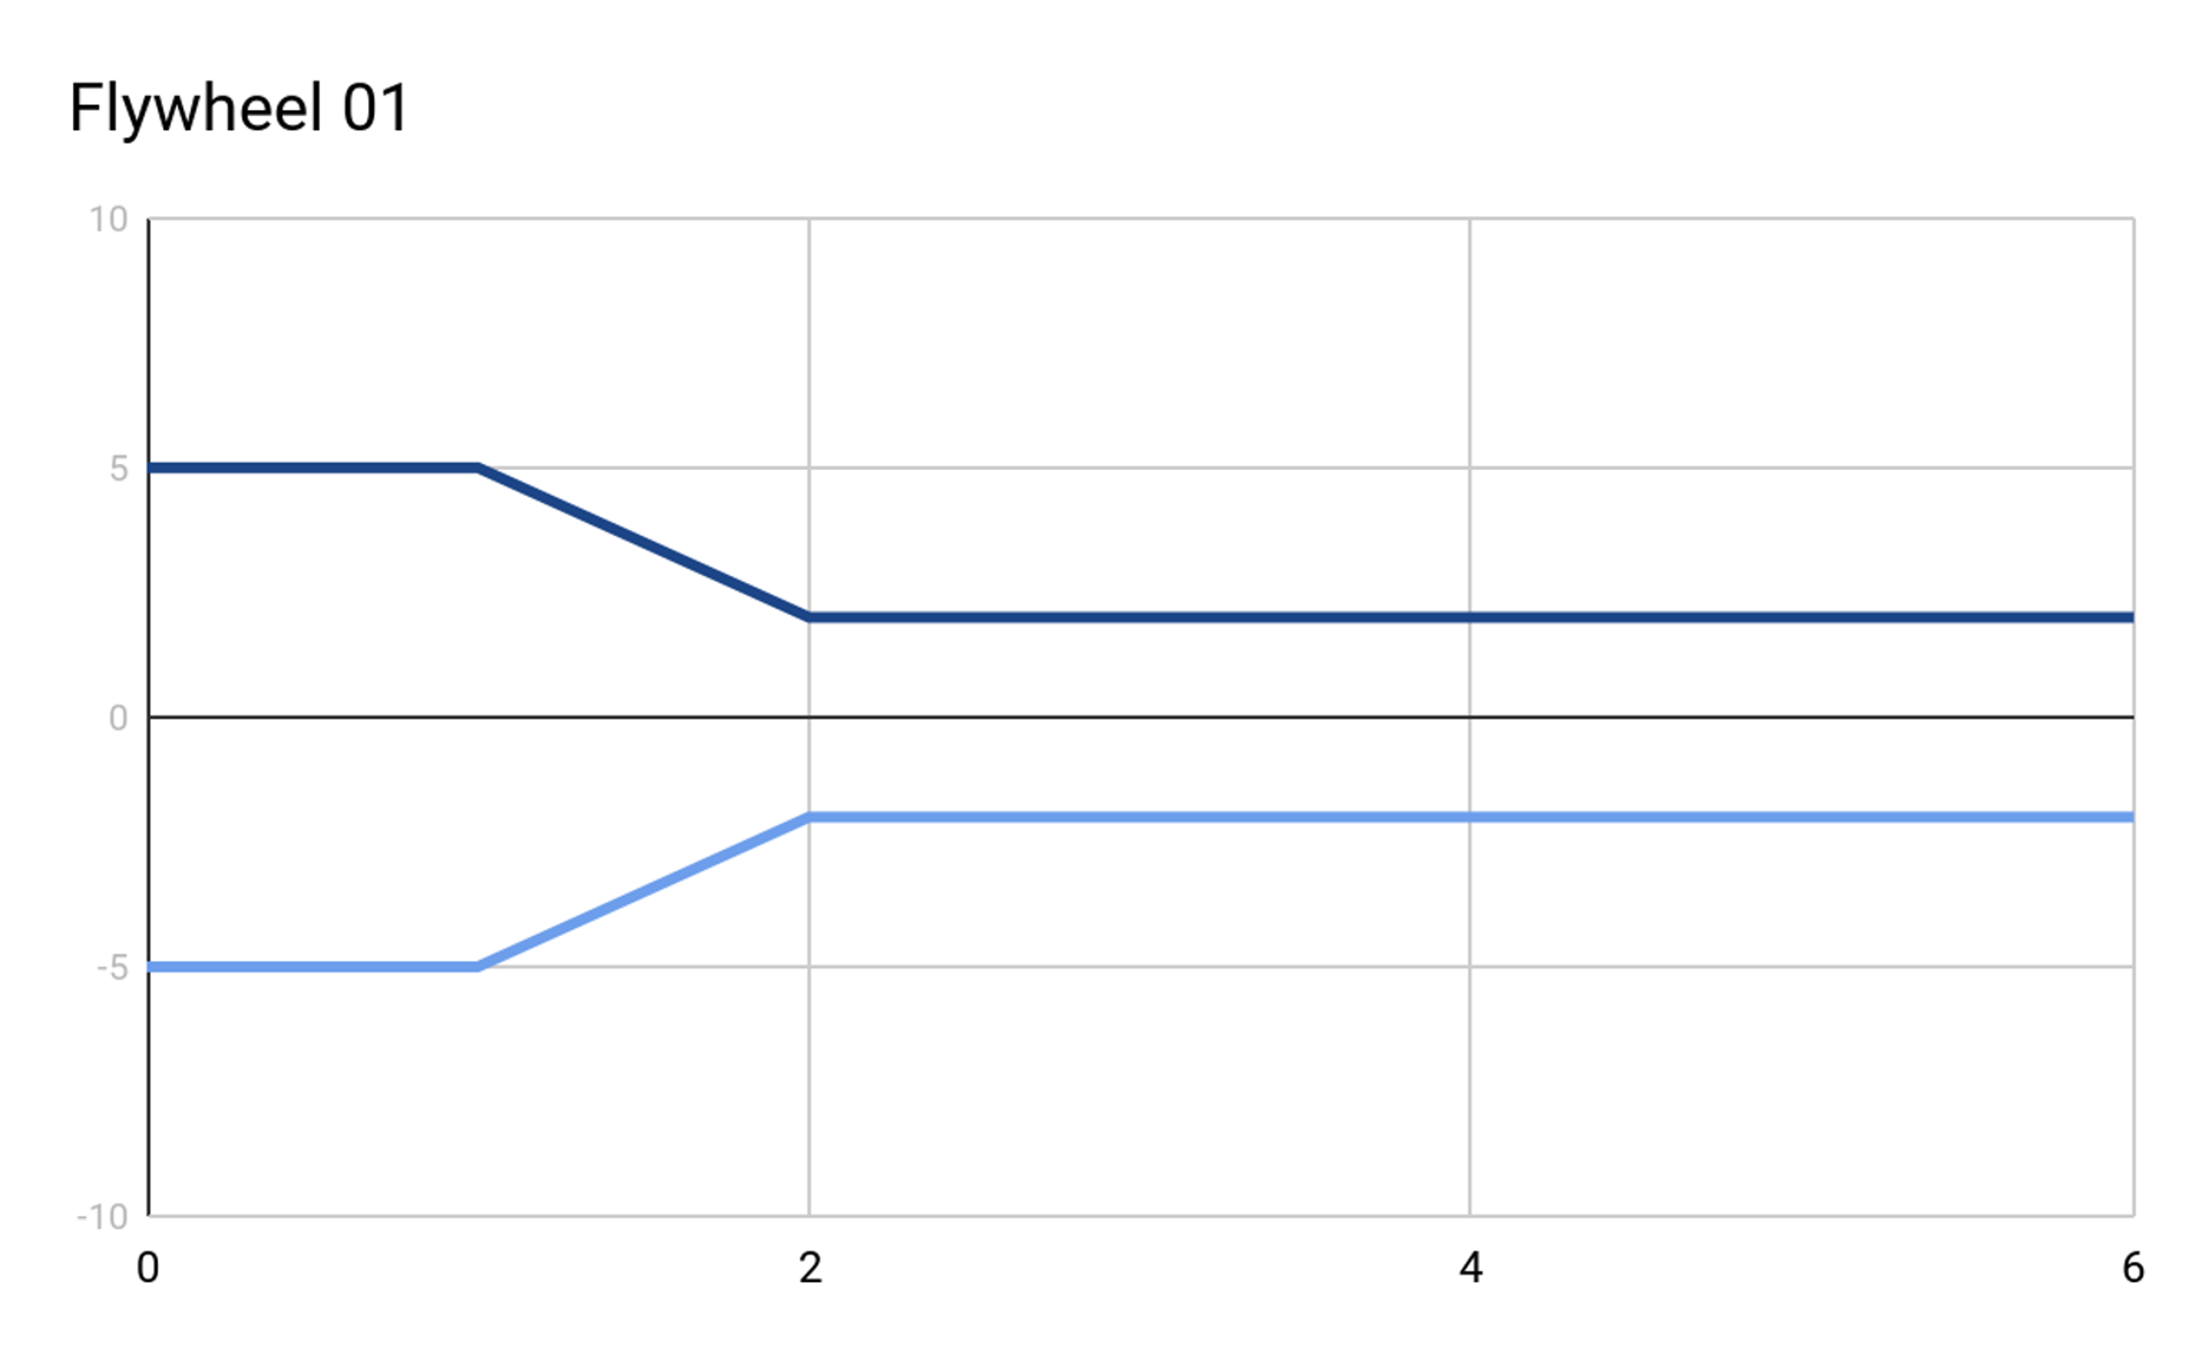
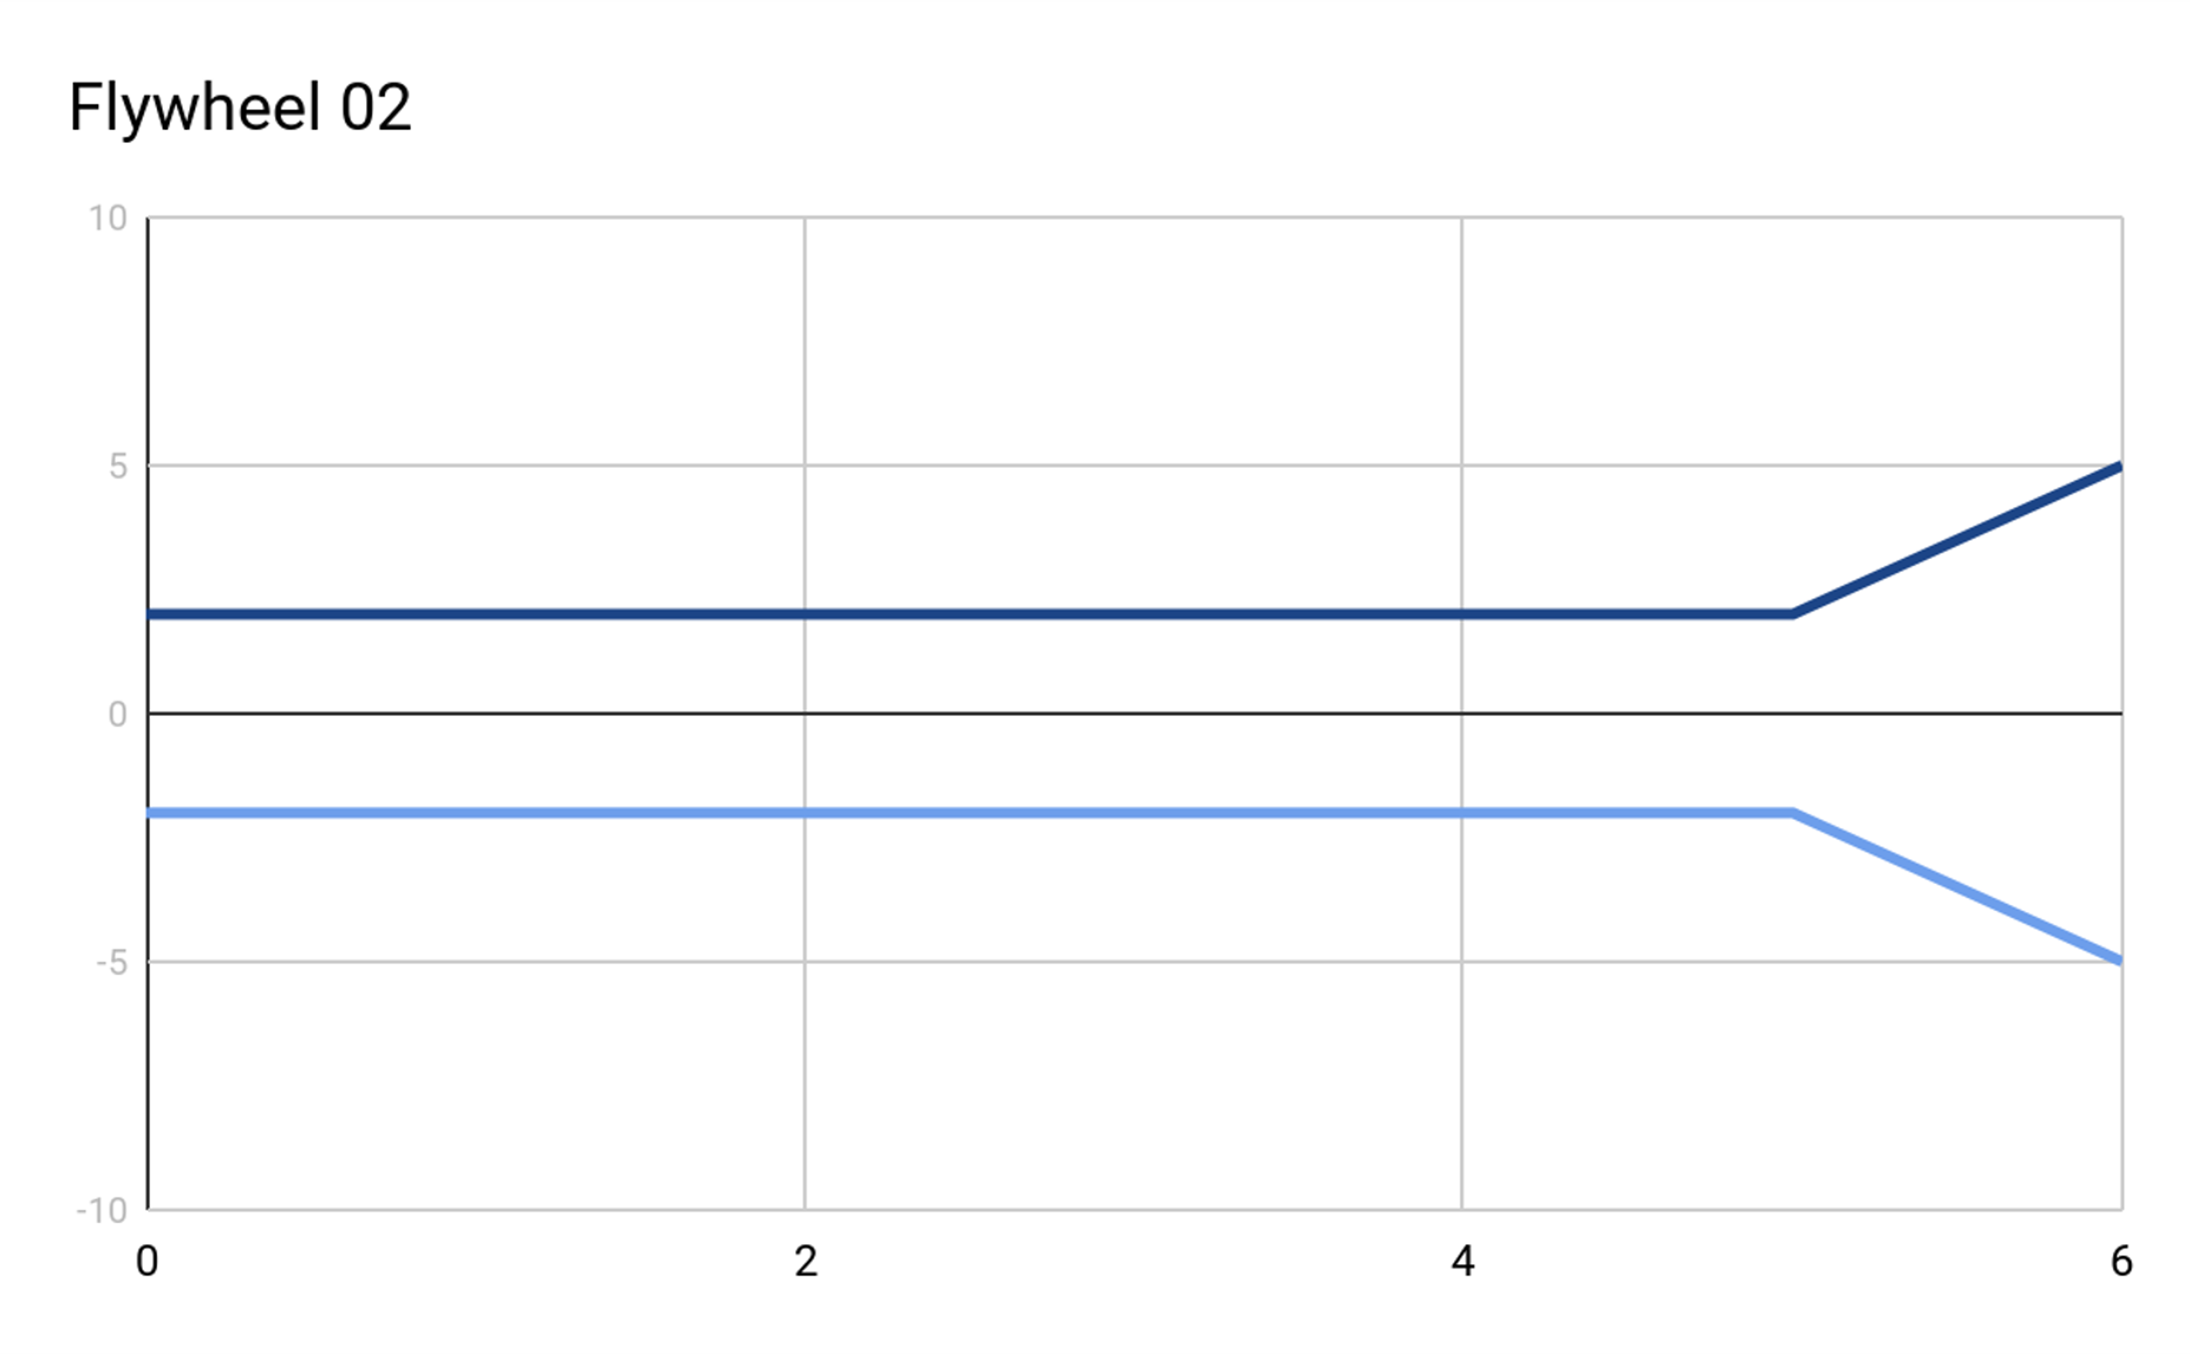
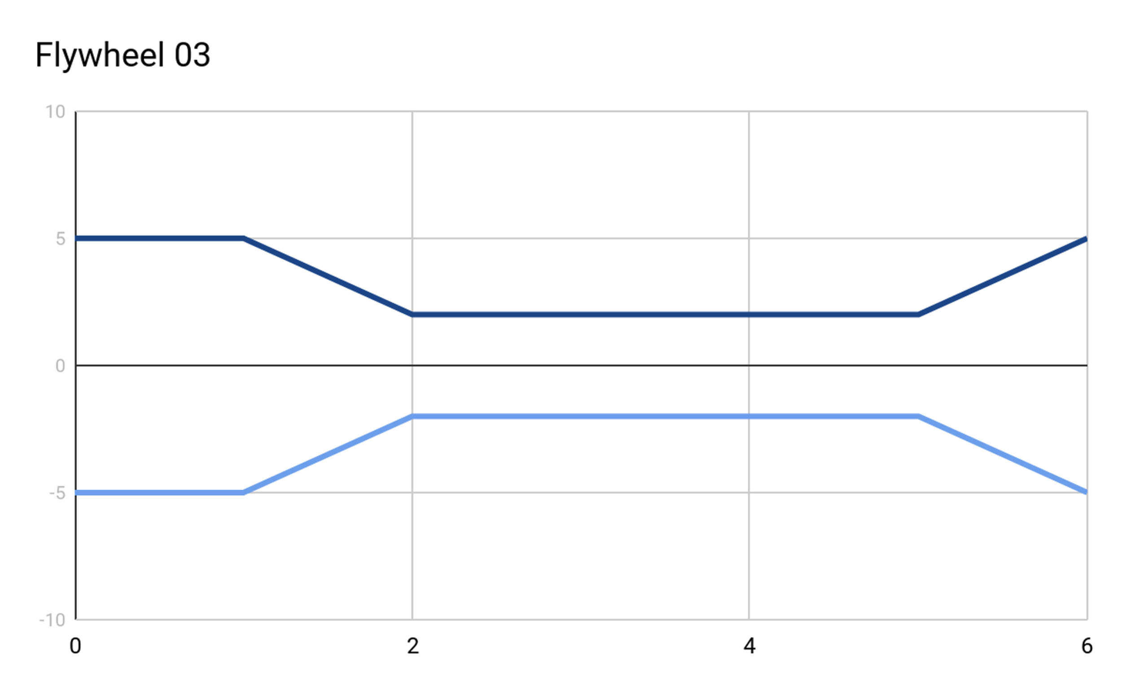
Flywheel Recombination
Parents
Flywheel 01 = [5, 5, 2, 2, 2, 2, 2]
Flywheel 02 = [2, 2, 2, 2, 2, 2, 5]
Child
Flywheel 03 = [5, 5, 2, 2, 2, 2, 5]

Slide 36
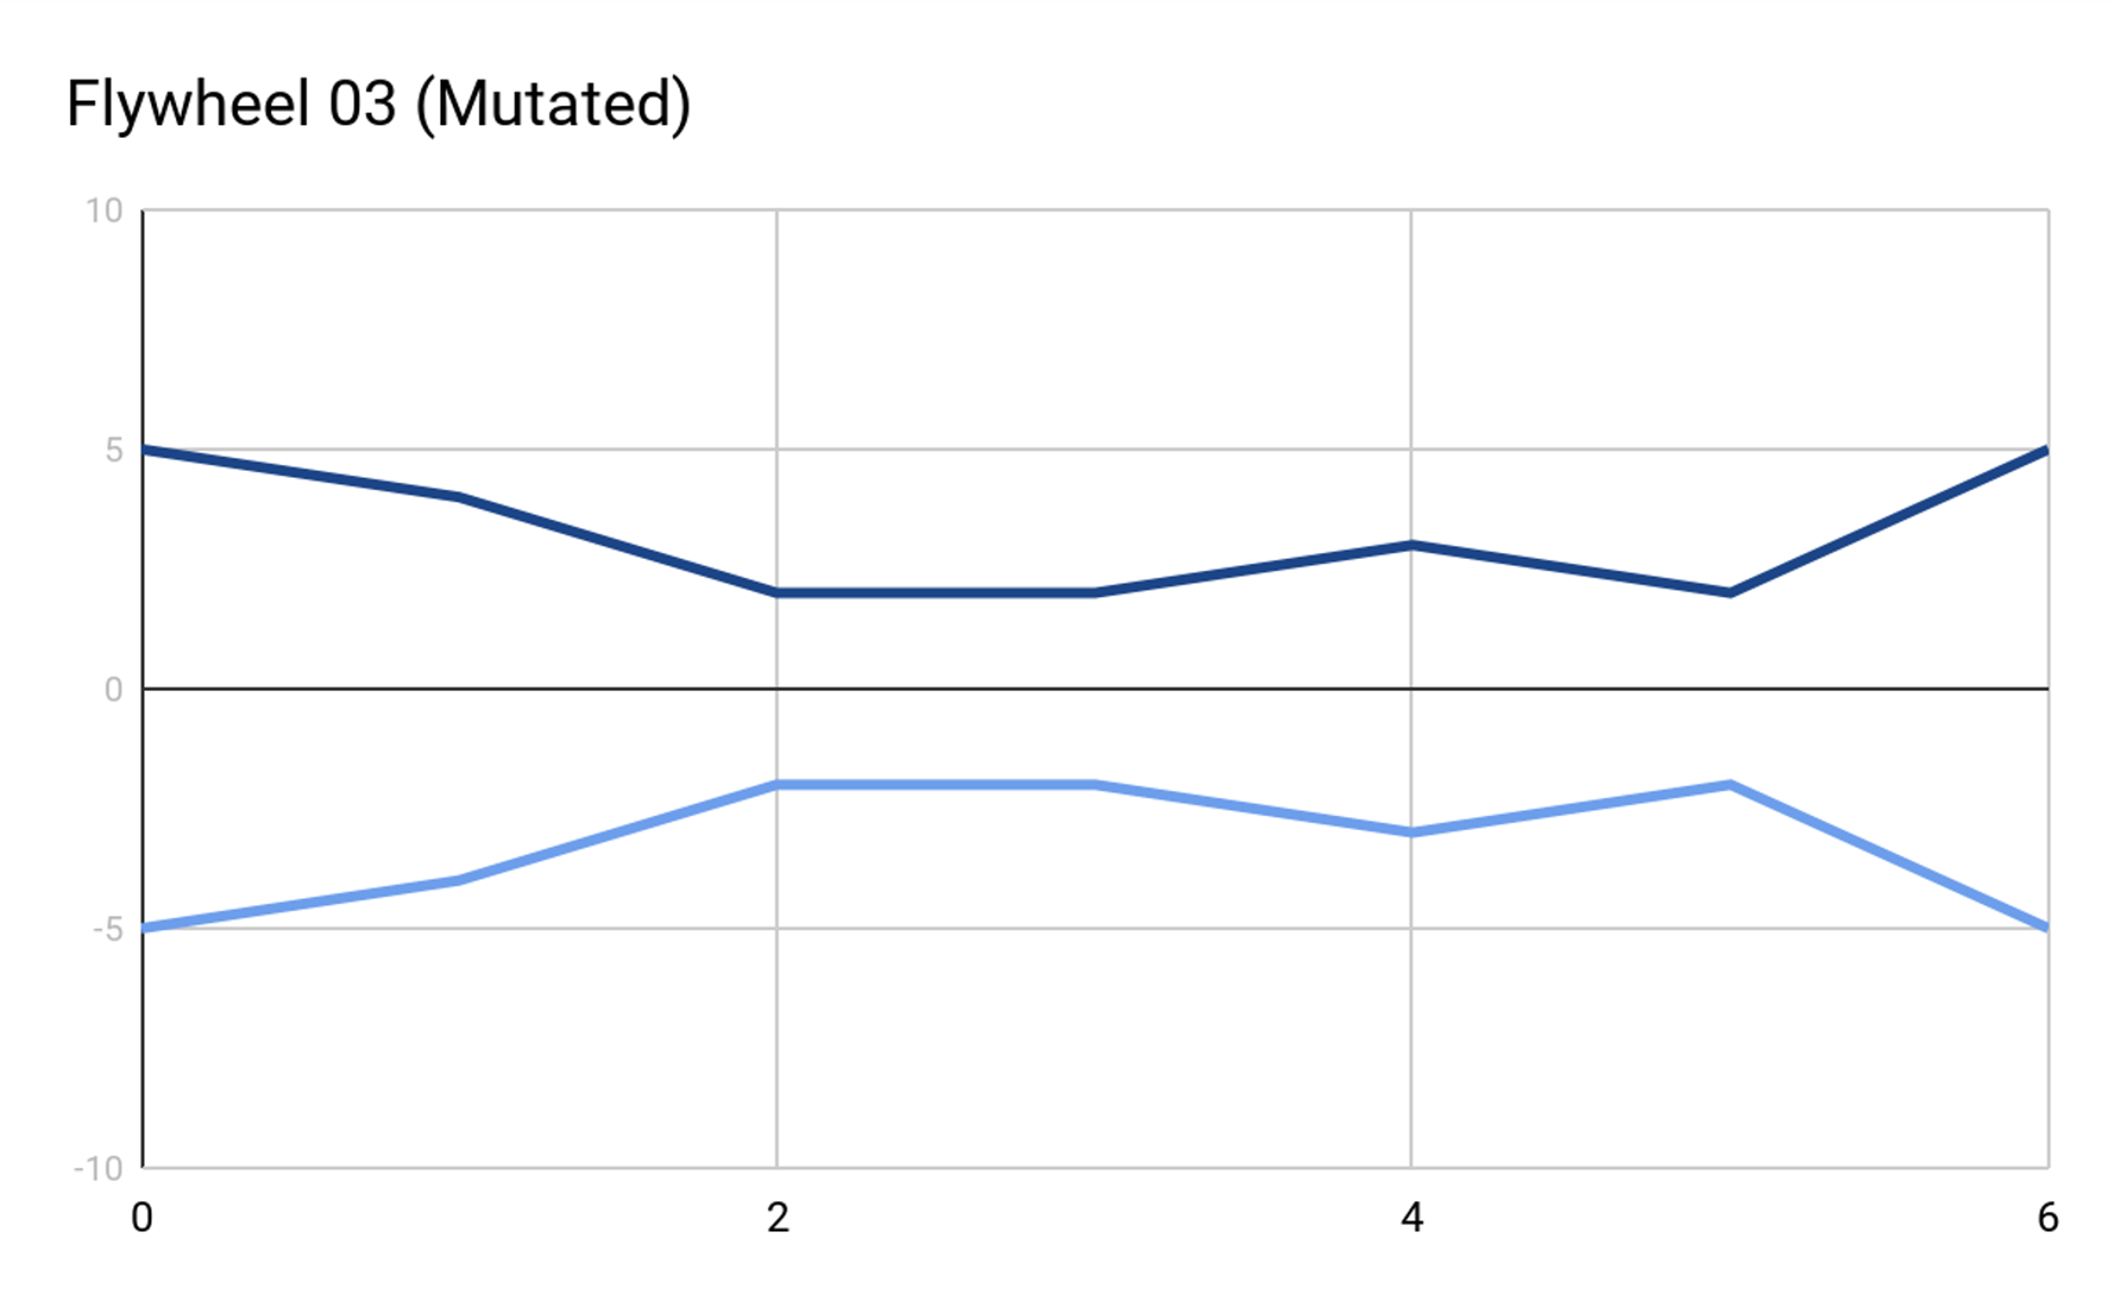
Flywheel Mutation
Child
Flywheel 03 = [5, 5, 2, 2, 2, 2, 5]
Mutated Child
Flywheel 03 = [5, 4, 2, 2, 3, 2, 5]

Slide 37
Neuroevolution
Subset of evolutionary algorithms applied to the optimization of neural networks
Uses an Ask-Eval-Tell cycle distinct from other evolutionary algorithms
Ask: generate numerous sets of parameters for your neural network architecture
Eval: evaluate each set of neural network parameters on the problem
Tell: use the performance of each parameter set to inform the mechanism used to generate parameters
In some algorithms this updates the means and covariance matrix of a multivariate normal distribution that is sampled to generate parameters in the ask stage
We’ll explore this more in the first assignment using the evosax library

Slide 38
Evolutionary Computing Problems
Decisions regarding solution representation often dominate optimization performance
This necessitates a fair amount of manual design for each problem
Optimization can be very computationally expensive
GPU acceleration isn’t an inherent characteristic of evolutionary algorithms, frequently resulting in CPU bottlenecks
Requires full evaluations while other techniques (like deep learning) may perform optimization during an evaluation
Solution quality is often improved by using larger populations and evolving for more generations

Slide 39
Common AI problems
Overfitting
Optimizing for solutions that perform well on task instances encountered during training, but poorly on other instances
A solution is performant on particular task instances, but poor in general
Vanishing gradient
An area of the search landscape is entered in which there are no clear direction for optimization
E.g., all nearby solutions appear similar or identical
Catastrophic forgetting/cycling
When optimizing using multiple task instances, performance on one or more instance rise and fall in an oscillating manner

Slide 40
Common AI Triumphs
Hybridizing multiple optimization techniques to account for differing strengths and weaknesses
Utilizing increased exploration and population diversity to avoid getting stuck in suboptimal areas of the search landscape
Phrasing a problem in a way that enables the use of a seemingly unrelated optimization technique
Regression for image classification
Prediction of next character/word to generate text (basically how ChatGPT works)
Seemingly a superpower of the deep learning community

Slide 41
Final Points
AI isn’t magic
There are always underlying mechanisms which can be understood and reasoned about (it’s often math )
There are also a plethora of exceedingly clever applications of these techniques to seemingly unrelated problems
All AI techniques have their strengths and weaknesses
This field is huge, and you are not expected to be an expert after this talk

Slide 42
Questions?

Slide 43
Oversimplified AI History (Deep Learning)
Early neural network predecessor appeared somewhere around 1943
Intended to be implemented as physical circuits
First learned artificial neuron (Perceptron) appears in 1958
Published in 1969 that Perceptrons can’t handle non-linear problems (XOR)
Begins first AI Winter that lasts until 1980
Causes consideration of using multiple layers of perceptrons (multi-layer perceptrons A.K.A. MLP)
Backpropogation, the foundational techniques in deep learning, is introduced in 1986
Second AI Winter goes from 1987~1992
Computational cost of training networks too high
Performance problems with training

Slide 44
Oversimplified AI History (Deep Learning)
In 2012, AlexNet demonstrated the ability to accelerate deep learning with a graphics card (GPU)
Achieved unprecedented performance on a highly-competitive computer vision problem
Extreme acceleration of deep learning via GPU since referred to as “winning the hardware lottery”
Set off a huge boom in deep learning research still going today
Transformer neural networks are introduced in 2017 and begin a new era of deep learning
Improved performance on natural language processing (NLP) tasks
Also found to meaningfully improve performance on most tasks that had previously exclusively used neural networks with memory

Slide 45
Oversimplified AI History (Evolutionary Computing)
Turing proposes “genetical or evolutionary search” in 1948
First computer experiments performed by Bremermann in 1962
Formally introduced under various names in the 1960s
Evolutionary programming by Fogel, Owens, and Walsh
Genetic algorithms by John Holland
Evolution strategies by Rechenberg and Schwefel
Joined as the singular field of Evolutionary Computing in the early 1990s
Algorithms now referred to as evolutionary algorithms
Genetic Programming introduced in early 1990s
Championed by John Koza, who demonstrated applications on a wide variety of automated design problems (e.g., programs, circuits, chemical reactions)

